Slide 1
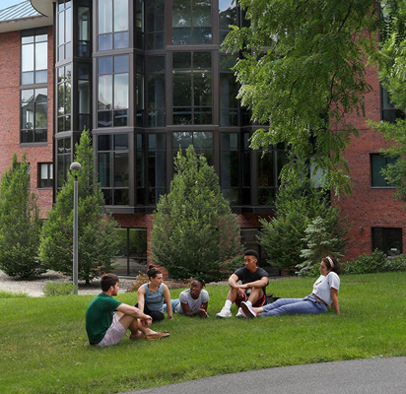
Return to Campus Policy
SKIDMORE COLLEGE

Slide 2
Guiding Principles
Skidmore College’s mission is best achieved when students, faculty and staff can learn, teach and work together as a community.
A path to returning remote staff and faculty to campus has emerged as New York eases restrictions and vaccination rates increase.
The College’s priority is the health and safety of its faculty, staff and students. As such, this policy and all return to campus plans are subject to evolving federal and state guidelines, vaccination rates and the pandemic’s trajectory over the summer.

Slide 3
Policy Key Elements
Academics: A return to pre-COVID academic offerings in the fall with remote courses only offered in very limited circumstances, when approved as a reasonable accommodation.
Offices: A phased return of staff to provide normal on-campus services in offices beginning no later than August 2 and gradually increasing to full capacity by September 2, 2021.

Slide 4
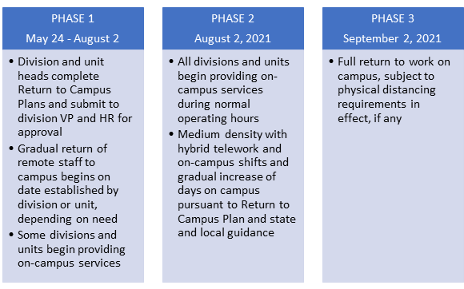
Return to Campus Phases

Slide 5
Reasonable Accommodations
The following employees may request an accommodation to the Return to Campus plan:
  Employees who have a medical condition or disability that impacts their ability to return to on-campus work
  Employees who reside with an individual with a higher risk of complications from COVID-19 who cannot be vaccinated because of a medical condition or vaccine eligibility
Reasonable accommodations requests will be handled through HR under the College’s Reasonable Accommodations for Employees and Applicants policy

