Slide 1

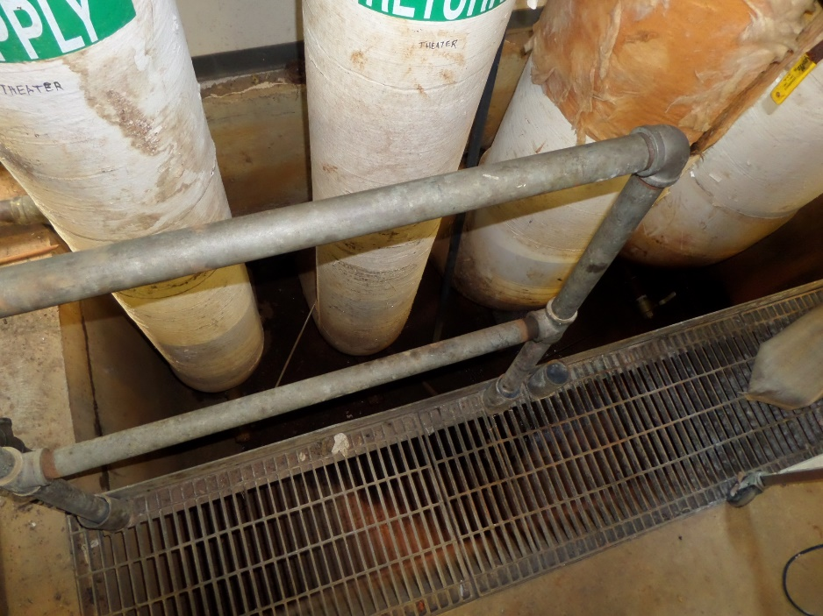
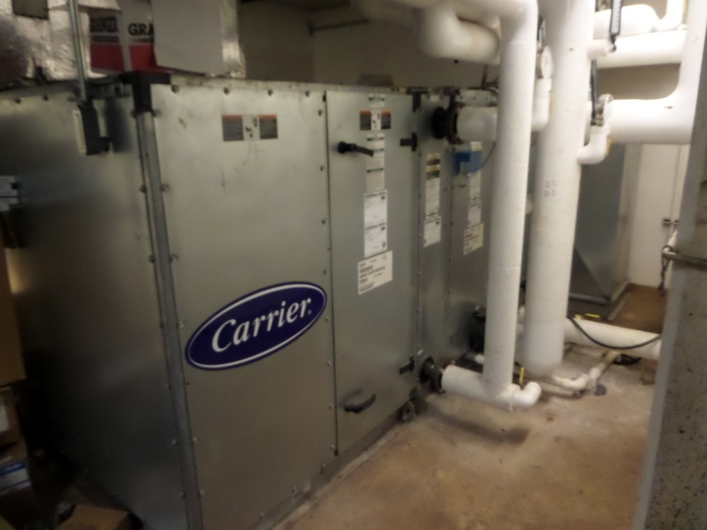
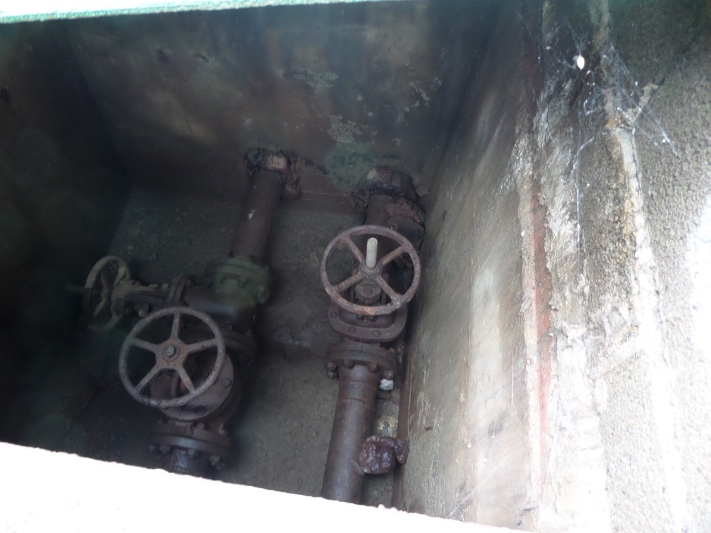
Confined Spaces Training
Avoiding Unnecessary Hazards and Hazardous Entry

Slide 2
Agenda
Objectives
Confined Spaces - Can be dangerous workplaces
What is a “Confined Space” according to OSHA?
Confined Space Hazards 101
Skidmore Examples
Confined Spaces at Skidmore
Skidmore Confined Space Program
Practical Application
Quiz

Slide 3

Objectives
Recognize various types of confined spaces at Skidmore.
Understand OSHA definition for “confined space”:
  Permit-required confined space
  Non-permit confined space
  Alternate procedure
Recognize life-threatening hazards related to confined space work.
Recognize proper work requirements for “permit-required” and “alternate procedure” confined spaces.
Understand OSHA requirements for employers, employees, and Contractors.

Slide 4
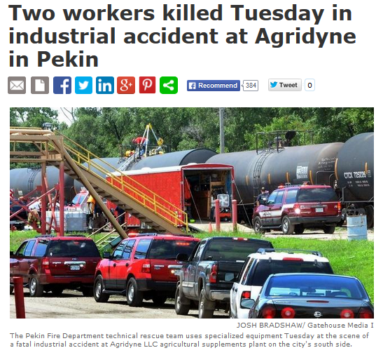
Confined Spaces – Dangerous workplaces
January 7, 2015
OSHA cites Agridyne after 2 workers succumb to dangerous fumes in June 2014.
A 37-year-old worker entered a rail car to clean out corn steep residue and was overcome by hydrogen sulfide gas H2S. A 29-year-old tank inspector, entered to attempt rescue, and succumbed to the gas exposure. Neither worker made it out of the car alive.
http://www.pjstar.com/article/20140624/NEWS/140629581

Slide 5
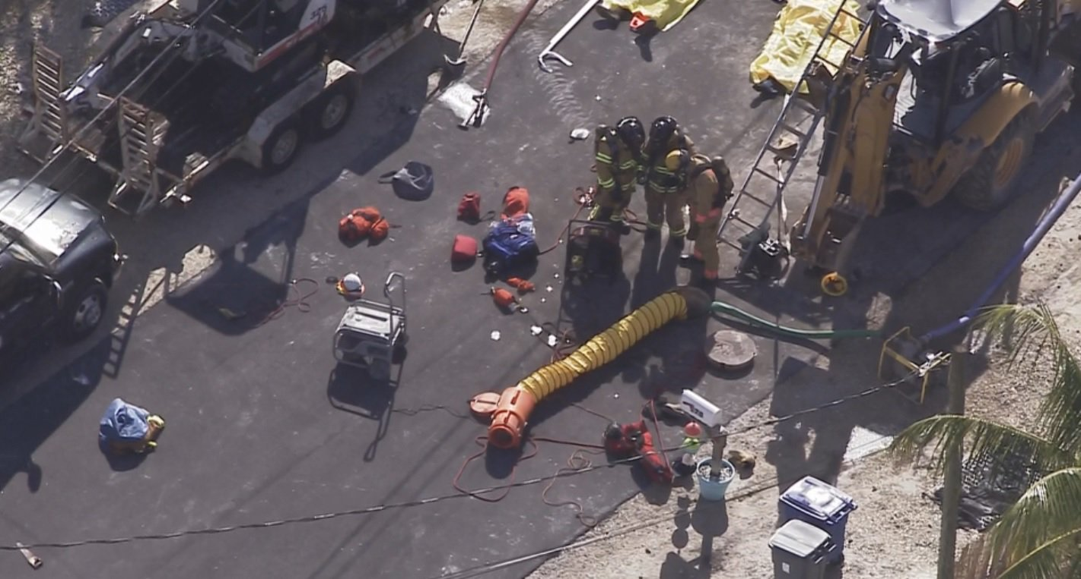
Confined Spaces – Dangerous workplaces
1/16/2017 Key Largo, Fla:
One by one, 3 utility workers descended into a manhole. One by one, they died.

Slide 6
Confined Spaces – Dangerous workplaces
Continued Key Largo
When a utility worker in Key Largo, Fla., noticed that a section of a paved street was not settling properly, he decided to remove a manhole cover and descend into the earth.
Moments later the hole went silent. Sensing the man was trapped, a fellow utility worker climbed into the drainage hole to rescue him. When he, too, stopped responding, a third worker entered the same hole.
All three men died, overcome by Hydrogen Sulfide (H2S)

Slide 7
Confined Spaces can be dangerous workplaces
What were possible causes for these tragedies?
Lack of awareness
Lack of effective education and training
Lack of preparation
Unknown or changing conditions
These tragedies were not anticipated!

Slide 8
By the numbers:
OSHA estimates that about 224,000 establishments have permit spaces;
7.2 million production workers are employed at these establishments;
and about 2.1 million workers enter permit spaces annually.
OSHA anticipates that compliance with these regulations will avoid 53 worker deaths and injuries, 4,900 lost workday cases and 5,700 non-lost time accident annually.

Slide 9
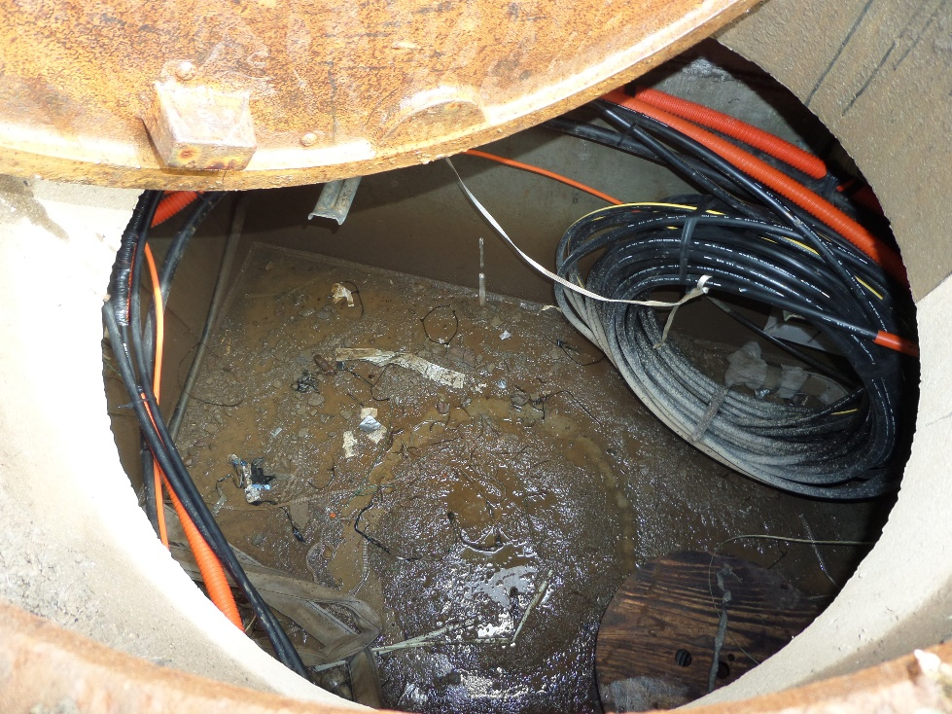
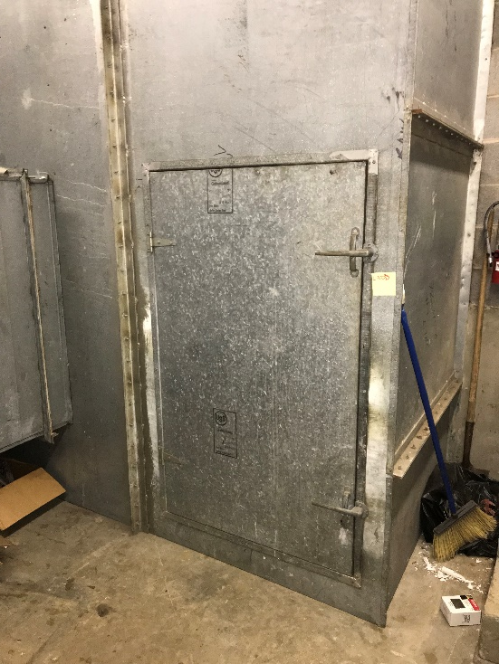
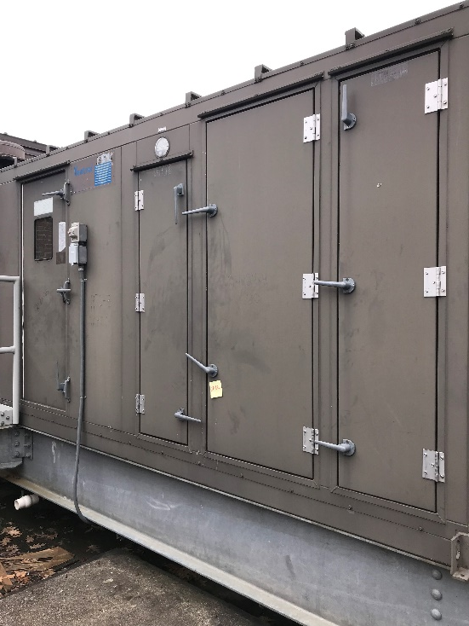
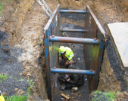
What is a Confined Space?
OSHA defines a confined space 29 CFR Part 1910.146; Part 1926.1202 as:
1. Any space large enough and configured to permit bodily entry to perform work, AND
2. Limited or restricted means for entry and exit,
AND
3. Not designed for continuous occupancy

Slide 10
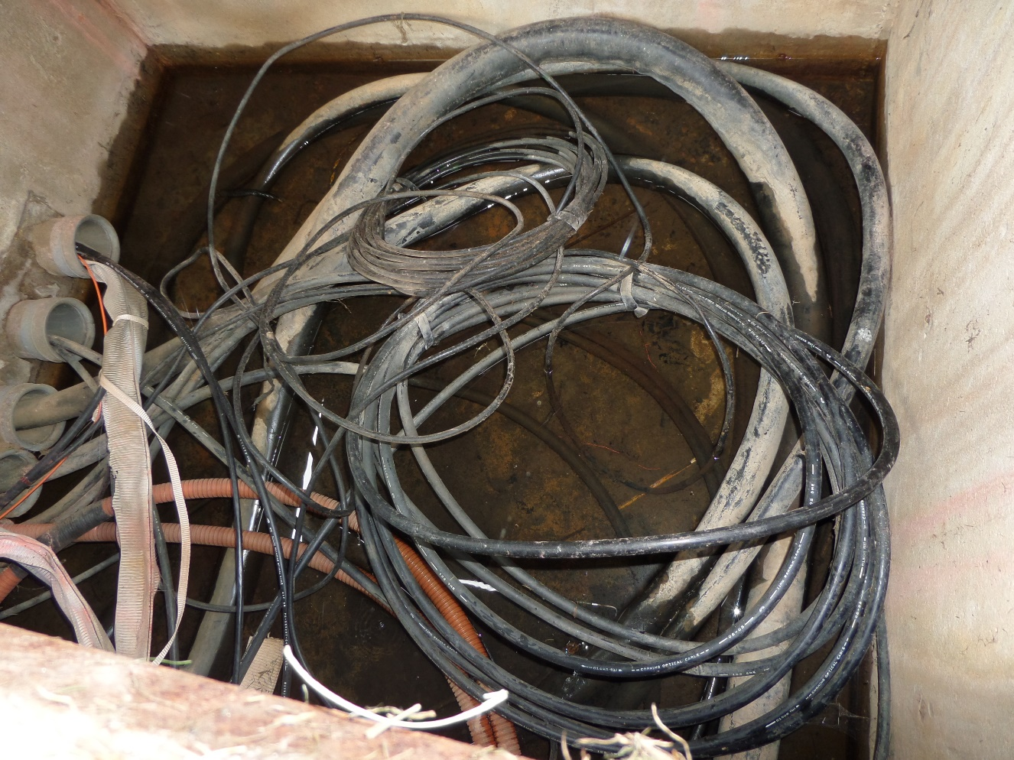
What is a Confined Space?
No. 1: Any space large enough and configured to permit bodily entry to perform work:
A manhole
Crawlspace
Air Handler
Diesel Tank
Etc.

Slide 11
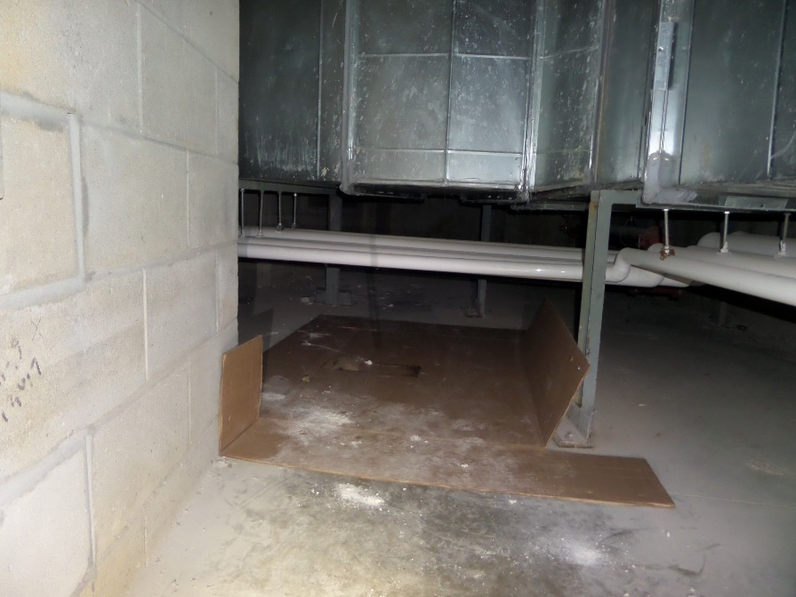
What is a Confined Space?
No. 2: Limited or restricted means for entry and exit:
Example conditions:
May have one way in or out, whether opening is large or small (16-18” diameter),
May pose difficulty in getting an unconscious worker out,
May be difficult to introduce safety or work equipment,
May necessitate climbing over pipes, equipment or obstacles in the work space.

Slide 12
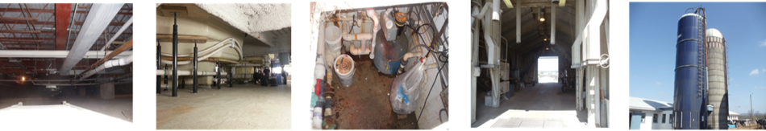
What is a Confined Space?
No. 3: Not designed for continuous occupancy:
  Crawl space under a building
  Process enclosure or vault for a tank, vessel, electrical conduit
  Maintenance hatchway for equipment repair, replacement, clean-up, service

Slide 13
“Permit-Required” Confined Space
Permit-required confined space has one or more of the following characteristics:
Contains / potential to contain a hazardous atmosphere,
Contains material with potential to engulf an entrant,
Internal configuration can cause an entrant to be trapped or asphyxiated by inwardly converging walls or floor that slopes downward and tapers to a smaller cross section,
Contains any other recognized serious safety or health hazards.
PRCS entries require RESCUE preparation, equipment and planning
OSHA 29 CFR 1910.146 OSHA 29 CFR 1926.1202

Slide 14
To permit …or not to permit (OSHA)
Space large enough to enter, AND
Limited or restricted entry or exit, AND
Not designed continuous worker occupancy.
Not a Confined Space
NO
YES
Confined Space
Permit-
Required
Confined
Space
(OSHA)
Hazardous Atmosphere?
Non-
Permit-
Confined
Space
(OSHA)
Or
Engulfment Hazard?
YES
NO
Or
Configuration Hazard?
Or
Any other recognized
serious hazard?

Slide 15
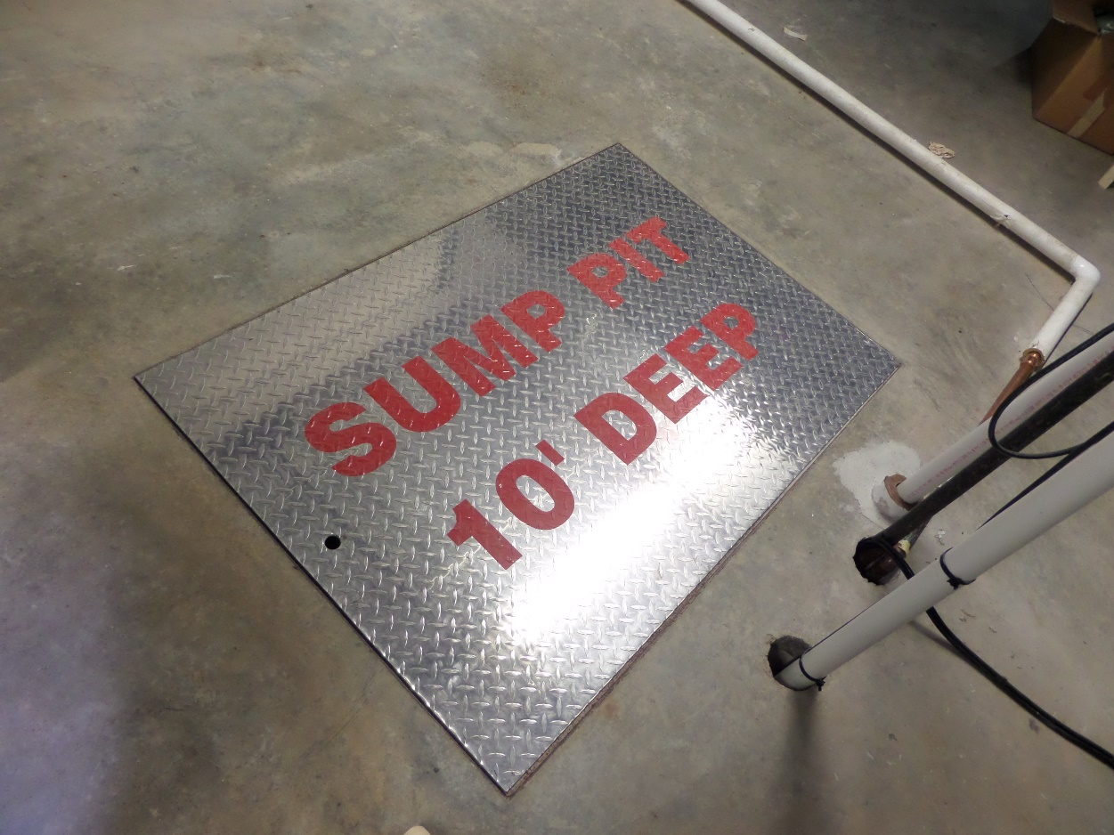
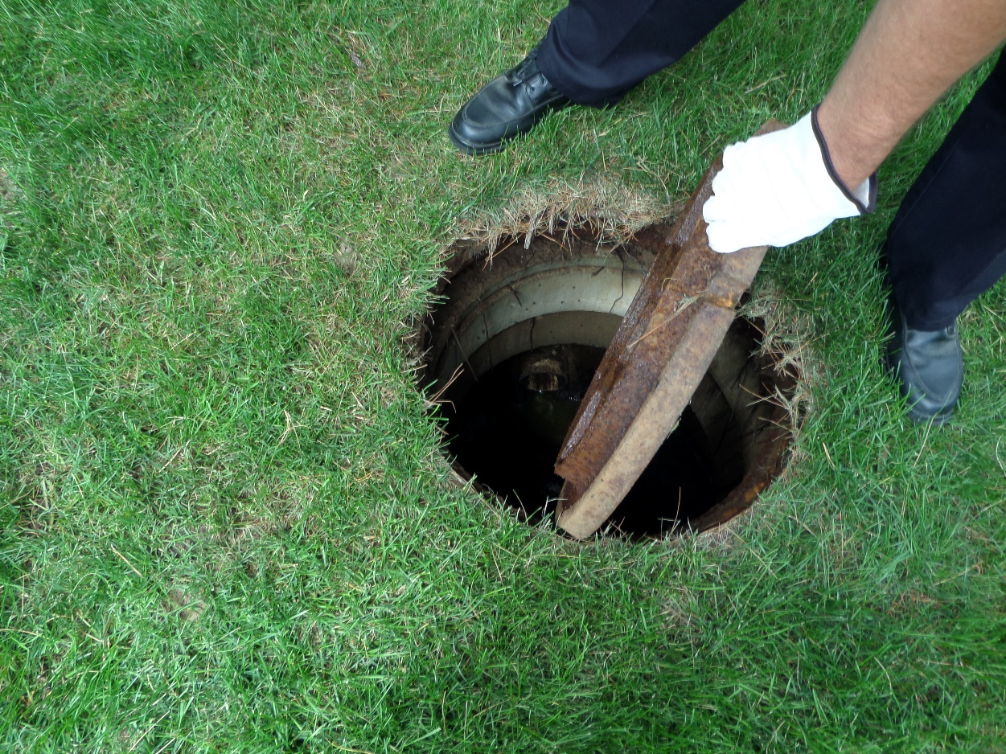
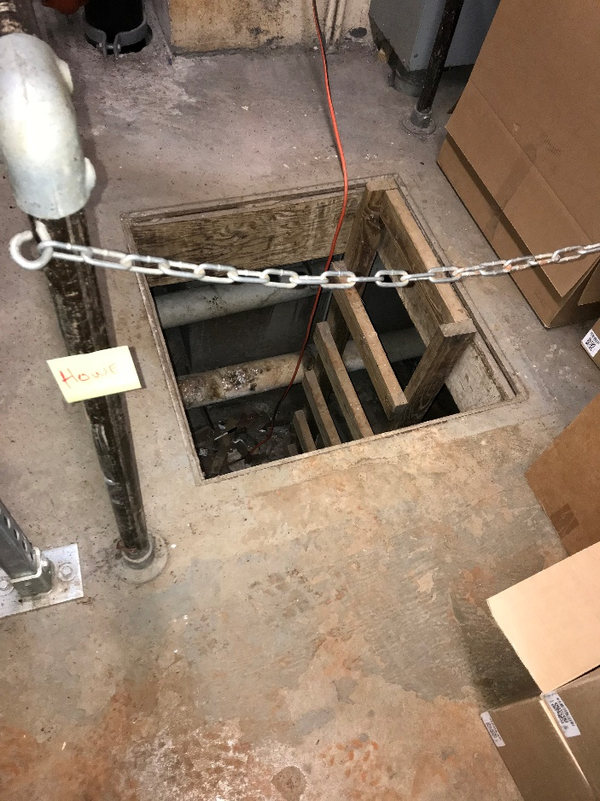
Skidmore Examples of Confined Spaces
Crawlspaces, air handlers, manholes, tanks, boilers, meter pits, water tower, transformer and electric vaults, trenches, HVAC equipment….

Slide 16
Confined Space Hazards 101
Atmospheric – toxic gases, oxygen displacing gases, other hazardous atmospheres (i.e. explosive or life-threatening)
Engulfment – by water, grain, powders, earth/soil, other substances…
Entrapment – tight or convoluted spaces, …can also make a worker vulnerable to other hazards!
OTHER Serious Safety or Health Hazards – electrical, mechanical, steam, fire/explosion

Slide 17
Confined Space Hazards 101
Atmospheric Hazards
  Flammable gas, vapor, mist exceeding 10% lower explosive limit (LEL)
  Atmospheric oxygen content less than 19.5% (oxygen-deficient), or greater than 23.5% (oxygen-enriched)
  Hydrogen Sulfide gas (H2S) content at or above 10ppm
  Carbon Monoxide (CO) content at or above 35ppm
  Any other atmospheric condition that is “Immediately Dangerous to Life or Health” (IDLH) – toxic or other hazardous atmosphere
  Airborne combustible dust

Slide 18
Confined Space Hazards 101
Atmospheric Hazards
  Created by:
  Lack of air movement into and through the space – gases or vapors can build up.
  Toxic or deadly gases can have a different density than air – forming a toxic layer, or displacing air in the space.
  Organic materials can decompose to create toxic gases – using up oxygen from the air in the space.
  Gases, vapors, or fine dusts can become explosive in the right concentration – become easily ignited.
  Nearby vehicles or emergency generators produce carbon monoxide – can infiltrate a nearby space.

Slide 19
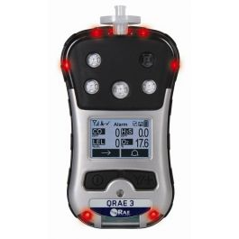
Confined Space Hazards 101
  Atmospheric Hazards
  How can we check the atmosphere?
  Confined Space Monitoring
  Check air quality throughout the space by instrument test. Tests based on the expected hazardous conditions:
    1. Flammability - LEL (not more than 10% of lower explosive level)
    2. Oxygen content - O2 (between 19.5 – 23.5%)
    3. Carbon monoxide - CO (OSHA PEL – 50 ppm – alarm set at 35 ppm)
    4. Hydrogen sulfide - H2S (OSHA PEL - 10 ppm, 20 ppm - Ceiling; IDLH – 100ppm)

Slide 20
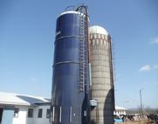

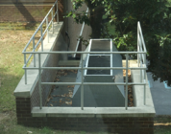
Confined Space Hazards 101
Engulfment Hazards
Examples?
Loose, granular materials stored in bins and hoppers
Unstable soil in trenches/excavations
Water, sewage, or liquids under pressure, from valves or sources of openings in confined spaces that may be worked on.

Slide 21
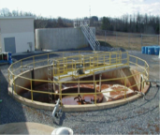

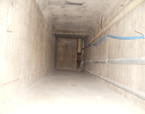
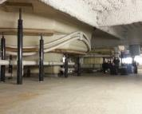
Confined Space Hazards 101
Entrapment Hazards
Examples
Pits or sub-basements with convoluted piping or equipment
Narrow, or shallow passageways or tunnels, that can make it difficult or more hazardous to perform work (may or may not contain obstacles)

Slide 22
Confined Space Hazards 101
Other Serious Safety or Health Hazards
Examples
Air temperature extremes (hot, cold)
Steam under pressure
Hot or cold process equipment, pipes
High electrical voltage or amperage/ arc-flash- explosion
Heavy or falling objects inside the confined space
Very high noise levels that can damage hearing
Can any of these hazards be controlled?

Slide 23
Confined Spaces at Skidmore
What should we do to keep ourselves safe?
  Be aware of potential hazards
  Training
  Preparation for the job
  Use the correct equipment
  Monitor potential dangerous atmospheres
  Do not enter confined spaces without proper training, preparation, equipment, authorization and supervision.

Slide 24

Skidmore’s Confined Space Entry Program
Table of Contents
Personnel Responsibilities
Confined Space Inventory and Hazard Assessment
Training Plan
Entry Procedures
Non-Permit Entry
Alternate Procedure Entry
Permit Required Confined Space Entry
Confined Space Rescue Team
Emergencies
Confined Space Entry Equipment
Duties: Authorized Entrants
Duties: Attendants
Duties: Entry Supervisors
Skidmore colleges confined space inventory

Slide 25
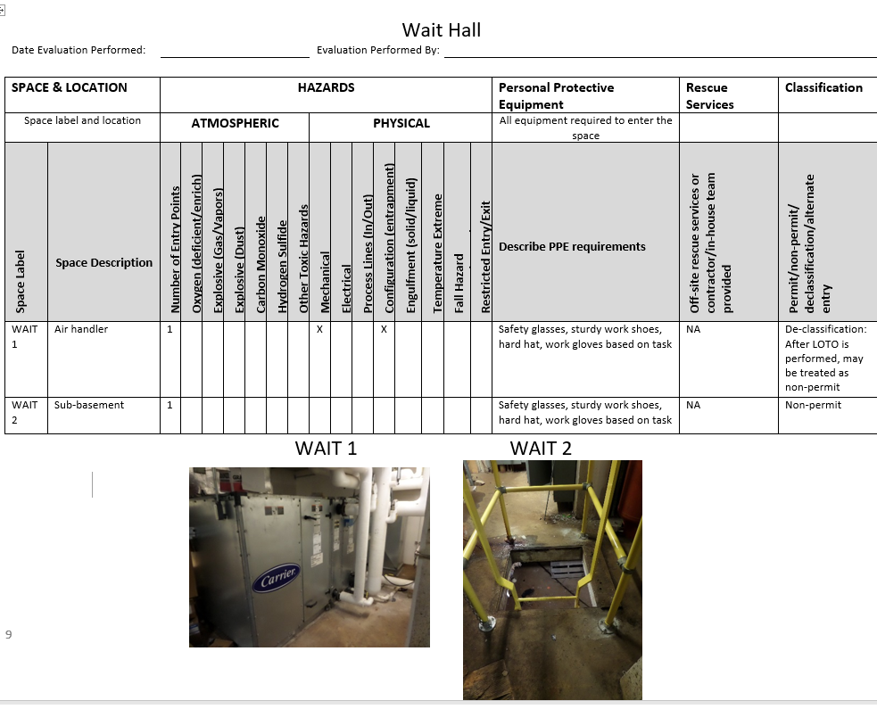
Skidmore Confined Space Program
  Inventory of confined spaces (by location)

Slide 26
Skidmore’s Confined Space Entry Program
There are three kinds of confined space entries at Skidmore College
    Non-permit entry
    Permit Required entry
    Alternate Procedure entry

Slide 27

Skidmore’s Confined Space Entry Program
Training:
“Skidmore employees or contractors may not enter a Skidmore confined space, unless they have received confined space entry safety training.“
Those who have not received the training must not:
perform confined space related work
act as a confined space entrant, attendant or entry supervisor.

Slide 28
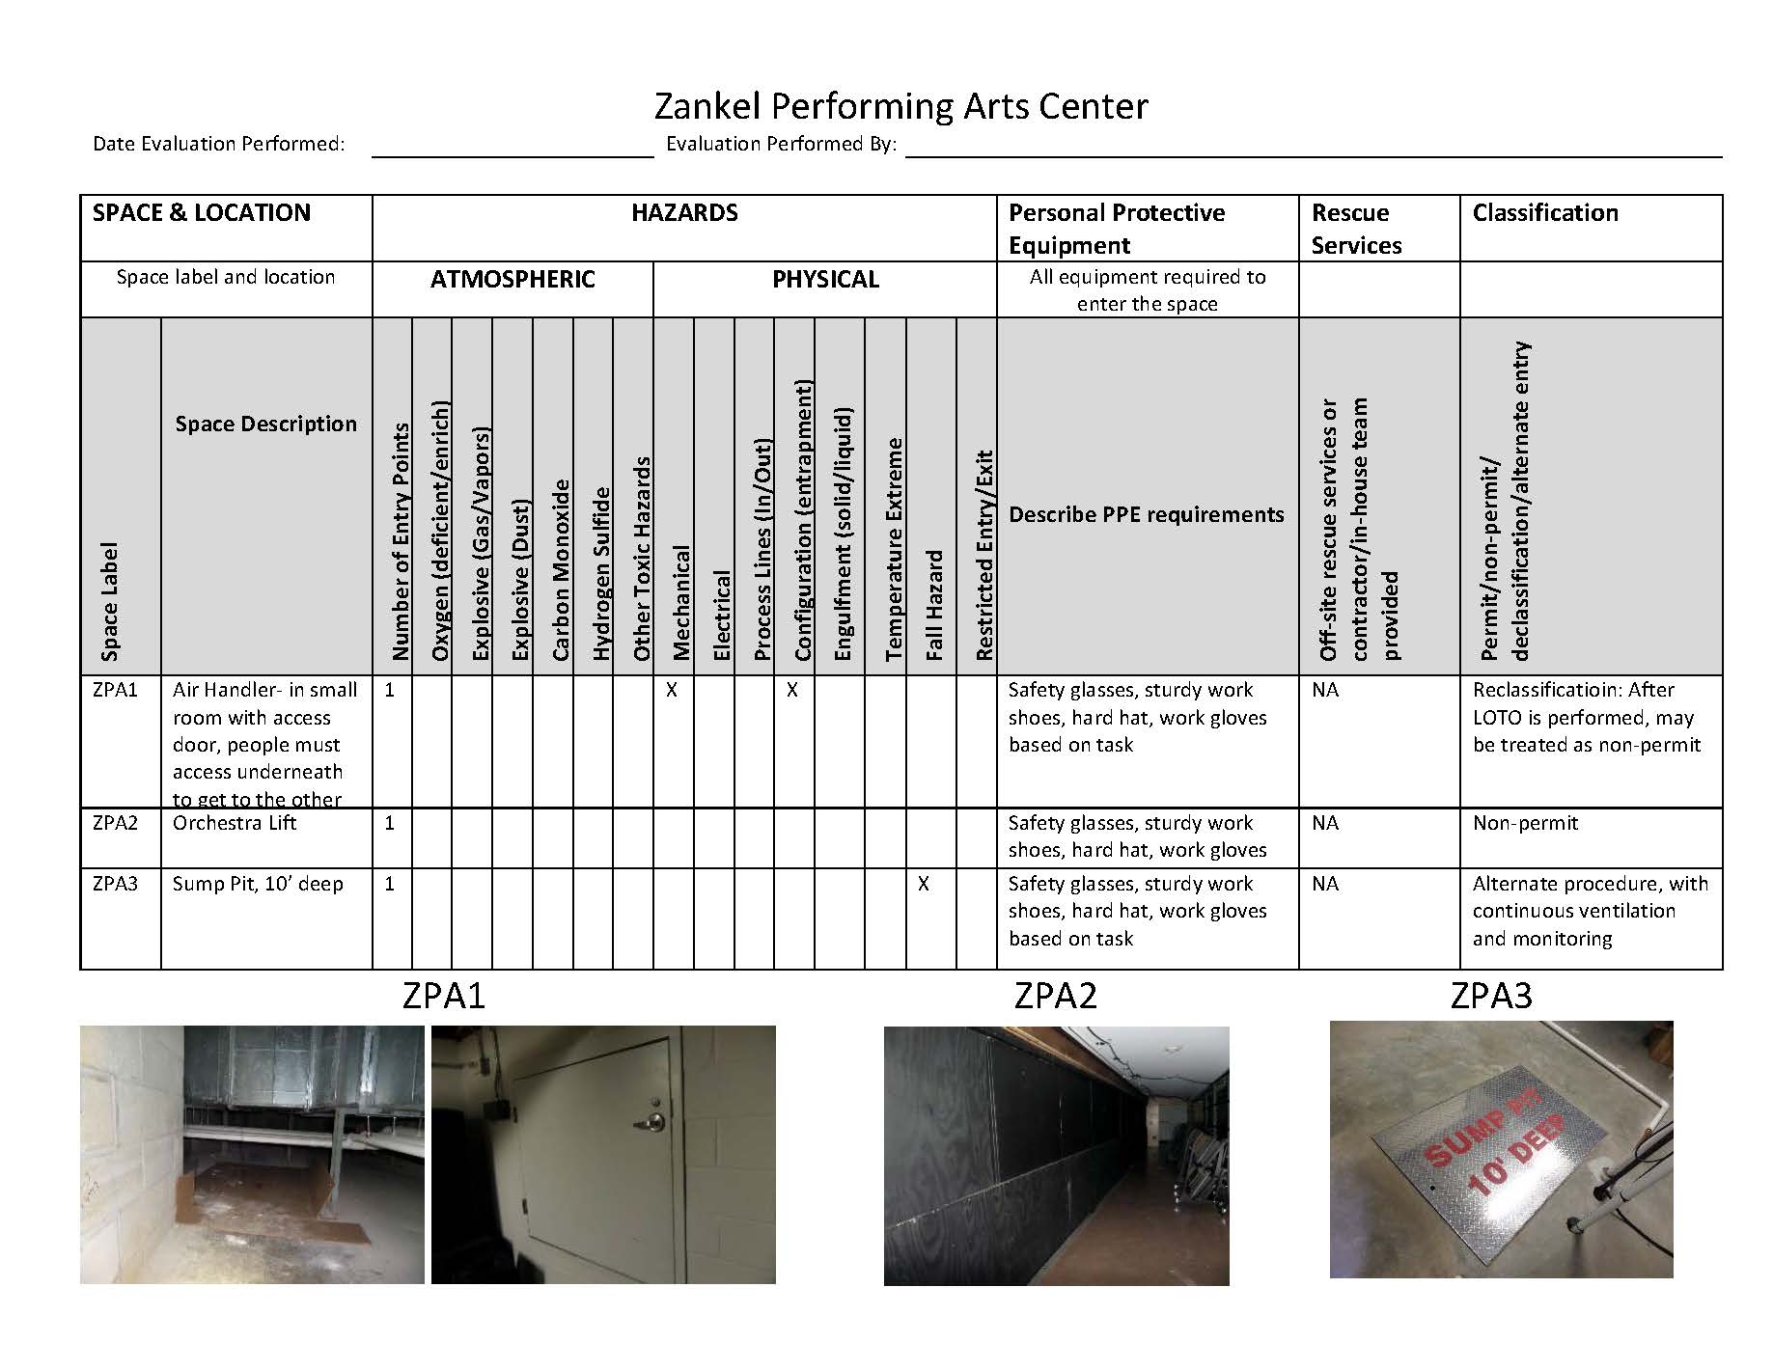
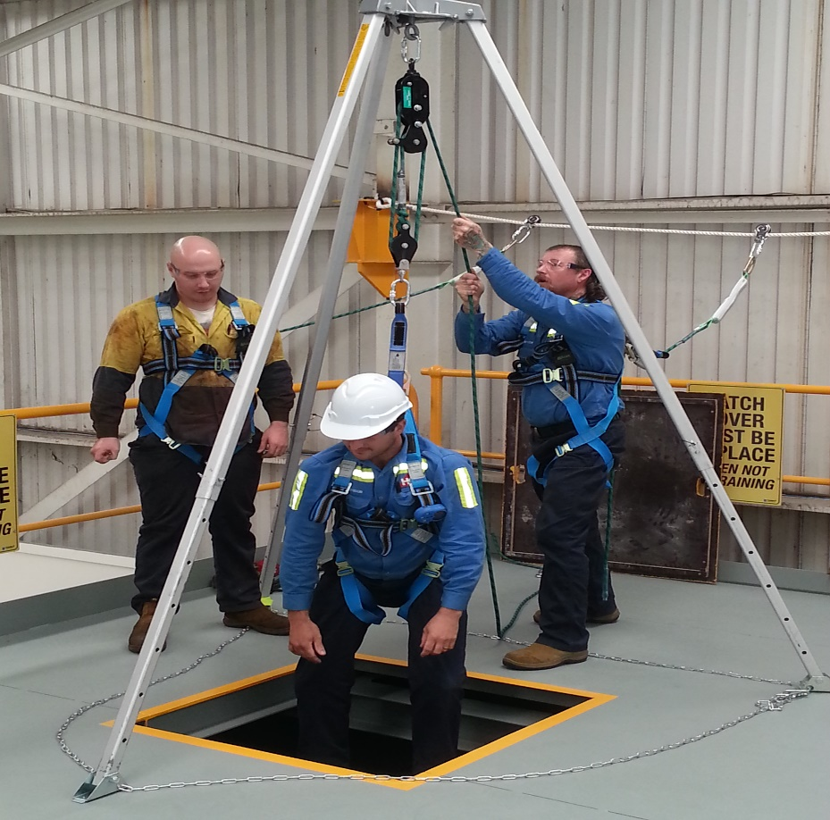
Skidmore’s Confined Space Entry Program
Entry procedures:
Determine confined space classifications by referencing the Confined Space Inventory
If space is Permit or Alternate Procedure, notify your supervisor.

Slide 29
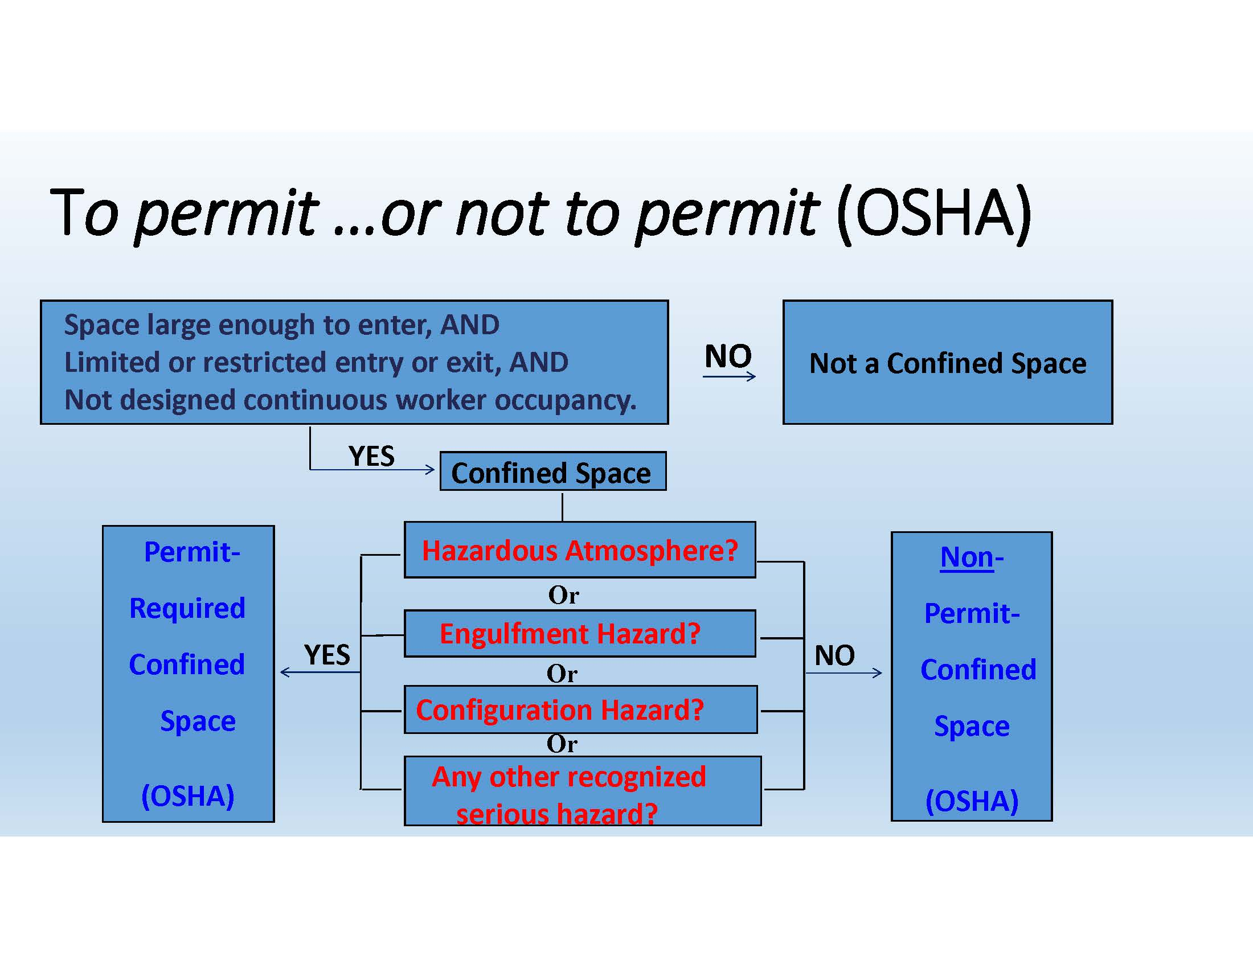
Skidmore’s Confined Space Entry Program
Non-permit entry
The majority of confined spaces on campus.
Where there are no hazards present.

Slide 30
Skidmore’s Confined Space Entry Program
Question: If we have a confined space with a recognized hazard, must we always consider it a Permit Required Confined Space?
Answer: No, we can perform a “reclassification” of the space

Slide 31
Skidmore’s Confined Space Entry Program
Reclassification of a Permit to a Non-Permit Space
In 29 CFR 1910.146(c)(7), “A space classified by the employer as a permit-required confined space may be reclassified as a non-permit confined space under the following procedures:
If the permit space poses no actual or potential atmospheric hazards, and
If all hazards within the space are eliminated without entry into the space
An example of Reclassification is to remove all hazards by performing lockout/tagout on air handlers
Question: Must you have an attendant when entering a reclassified space?
Answer: No, by performing LOTO, you have eliminated the hazard in the confined space. It is now considered a non-permit space.

Slide 32
Skidmore’s Confined Space Entry Program
If a space can be reclassified as Non-permit, you must perform two steps prior to entry:
Identify confined space in the inventory and confirm the hazards can be eliminated
Perform lockout/tagout procedure to eliminate hazards

Slide 33
Skidmore’s Confined Space Entry Program
NON-Permit Entry PROCEDURES
Identify the equipment on the confined space inventory/ hazard assessment
Perform lockout/tagout procedure to eliminate any such hazard(s)
Use personal protective equipment as required
It is now safe to enter the space.

Slide 34
Skidmore’s Confined Space Entry Program
Permit Required Confined Space Entry
Permit required confined spaces are spaces that the primary hazards in the space cannot be controlled or eliminated.
In other words, if a space cannot be successfully eliminated of all hazards (e.g. high voltage system in a manway that is not locked and tagged out), the space is classified as Permit Required.

Slide 35
Skidmore’s Confined Space Entry Program
Permit Required Confined Space Entry PROCEDURES
Identify the space on the confined space inventory and assessment and complete a Job Hazard Analysis form (JHA)
Supervisor or project manager will coordinate on-site rescue team at least 72 hours prior to proposed entry
All applicable sections of the permit will be filled out and checked off as permit required entry
Utilize the 4-gas monitor to ensure atmospheric conditions are acceptable and record readings on permit (continuous monitoring)
Set up Tri-pod system with winch over the hole. Don harness and attach life-line to harness
Set up ventilation system and continuously ventilate
Entrant may now enter the permit only hole to perform work

Slide 36
Skidmore’s Confined Space Entry Program
PRCS PROCEDURES Cont’d
Employees will sign on the permit as entrant and attendant. Supervisors will sign off as entry supervisor.
After employees finish work, permits will be returned to their supervisor who will file the permit with EHS.
Entering of Permit Required Confined Spaces by any Skidmore employee is prohibited without the expressed written permission by the Director or Assistant Director of Facilities Services.
A rescue team must be present for all Permit Required Confined Space entries.

Slide 37
Skidmore’s Confined Space Entry Program
Question: If we are entering a confined space with the potential of a hazardous atmosphere, must we always enter as a Permit Space?
Answer: No, we can enter via Alternate procedures

Slide 38
Skidmore’s Confined Space Entry Program
Alternate procedures defined
In 29 CFR 1910.146(c)(5) Alternate procedures may be used if, “The employer can demonstrate that the only hazard posed by the permit space is an actual or potential hazardous atmosphere;
The employer can demonstrate that continuous forced air ventilation alone is sufficient to maintain that permit space safe for entry;
The employer develops monitoring and inspection data that supports the demonstrations required.”
Examples of Alternate Procedure Entries
  Telecommunications vaults
  Zankel sump pit

Slide 39
Skidmore’s Confined Space Entry Program
Alternate Procedures entry process is as follows:
Identify the space on the confined space inventory and assessment and complete a Job Hazard Analysis (JHA)
Notify your supervisor that you are entering a Permit confined space
Fill out permit with date and location of space, checking off the Alternate Entry Approach box
Utilize the 4-gas monitor to ensure atmospheric conditions are acceptable
Attendant to record readings on permit and provide continuous monitoring
Set up Confined Space Entry Equipment (tripod, harness, life-line, etc.)
Set up ventilation system and continuously ventilate
Entrant may now enter the hole to perform work
Evacuate the space immediately and notify supervisor if atmospheric or other unsafe conditions arise

Slide 40
Skidmore’s Confined Space Entry Program
Question: If you can confirm the only potential hazard in a confined space is atmospheric, are you required to fill out a permit and have an attendant?
Answer:
Yes,
Alternate procedures states you must have an attendant monitor the atmosphere with the meter AND use the blower for continuous forced air ventilation.

Slide 41
Skidmore’s Confined Space Entry Program
Duties: Authorized Entrants:
Review the JHA and understand the hazards that may be faced during entry
Maintain direct communication with the attendant
Alert the attendant whenever:
  The entrant recognizes any warning sign or symptom of exposure to a dangerous situation, or
  The entrant detects a prohibited condition;
Exit from the permit space as quickly as possible whenever:
  An order to evacuate is given by the attendant or the entry supervisor,
  The entrant recognizes any warning sign or symptom of exposure to a dangerous situation,
  The entrant detects a prohibited condition, or
  An evacuation alarm is activated.
  When in doubt, get out!

Slide 42
Skidmore’s Confined Space Entry Program
Duties: Attendants:
Know the hazards that may be faced during entry, including information on the, signs or symptoms, behavioral effects and consequences of an atmospheric exposure
Maintain visual contact of authorized entrant(s) in the permit space
Remain outside the permit space during an entire entry operation unless relieved by another qualified attendant
Communicate with authorized entrants as necessary to monitor entrant status and to alert entrants of the need to evacuate the space
Monitor activities inside and outside the space to ensure constant safety

Slide 43
Skidmore’s Confined Space Entry Program
Duties: Attendants: cont’d
Attendant may order immediate evacuation of the entrant(s) when following conditions arise:
  If the attendant detects a prohibited condition
  If the attendant detects the behavioral effects of hazard exposure in an authorized entrant
  If the attendant detects a situation outside the space that could endanger the authorized entrants
  If the attendant cannot effectively and safely perform all the duties required
  Conditions in the space change that may impact safe operations
  Continuous monitoring and or continuous ventilation required cannot be performed
Summon rescue and other emergency services if authorized entrants need assistance to escape from a confined space.
And for permit required spaces, assist rescue team with entry or non-entry rescue

Slide 44
Skidmore’s Confined Space Entry Program
Duties: Entry Supervisors:
Is familiar with and understands the hazards that may be faced during entry, including information on the mode, signs or symptoms, and consequences of the exposure;
Verifies that all tests specified by the permit have been conducted and that all procedures and equipment specified by the permit are in place before endorsing the permit and allowing entry to begin.
For permit spaces: verify that rescue services are available and that the means for summoning them are operable.
Cancels or suspends entry if a condition that is not allowed appears.

Slide 45
Skidmore’s Confined Space Entry Program
Duties: Entry Supervisors: CONT’D
Removes unauthorized individuals who enter or who attempt to enter the permit space during entry operations
Determines whenever responsibility for a permit space entry operation is transferred, and at intervals dictated by the hazards and operations performed within the space, that entry operations remain consistent with terms of the entry permit and that acceptable entry conditions are maintained.
Ensures the Confined Space Assessment and Inventory is referenced
The permit is properly utilized and completed
Proper equipment is used, procedures are followed and the permit is filed with EHS.

Slide 46
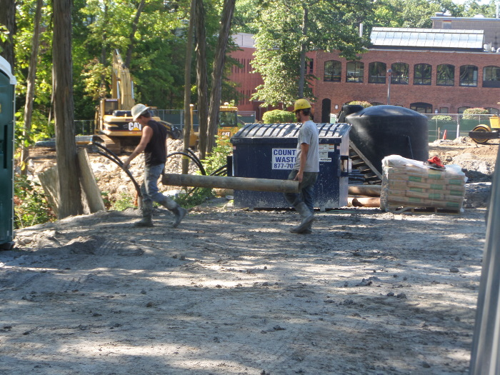
What about OSHA requirements for Construction / Contractors?
Unless a contractors written Confined Space Entry Program meets or exceeds standards written in Skidmore’s Program:
  contractors will be required to follow Skidmore College’s Confined Space Entry Program.
  be required to submit proof of training
Project Managers and Department Supervisors will be required to coordinate contractor activities to ensure adherence to this policy.

Slide 47
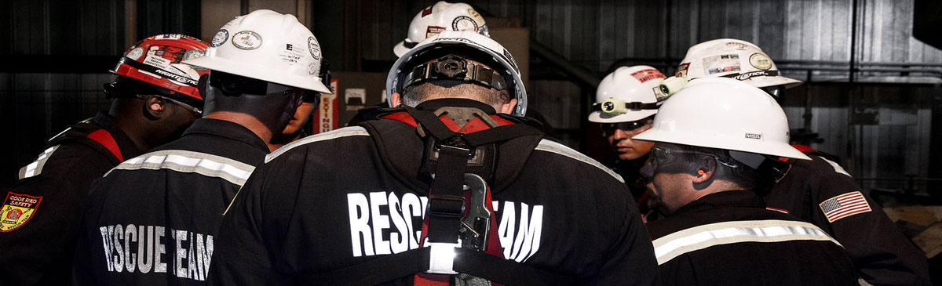
Skidmore’s Confined Space Entry Program
Confined Space Rescue Team:
Permit required entries will require an off-site confined space rescue team to be available onsite during entry. Unless the entry is an emergency, the rescue team must be notified and scheduled for services at least 72 hours in advance.
Skidmore College’s available rescue teams:
1. Capital Technical Rescue, 22 Mill Street, Unit 2, Albany NY 12204, 518-930-4500
2. NRC, 4240 Albany Street, Albany, NY 12205 Phone: (518) 355-0197

Slide 48

Skidmore’s Confined Space Entry Program
Emergencies:
In the event of a non-life threatening emergency, notify Campus Safety immediately at 518-580-5566.
If emergency is life-threatening, first call 911 and then contact Campus Safety.

Slide 49
Skidmore’s Confined Space Entry Program
Confined Space Entry Equipment:
QRAE 3 Wireless 4-gas Monitor. Detects oxygen (O2), hydrogen sulfide (H2S), carbon monoxide (CO) and methane (LEL). The monitor has a built in pump for remote sampling.
Ventilation—Confined space blower at 1200 cfm.
Retrieval system (Miller tripod and lifeline/winch).
Harness.
Lighting as needed.
Communication equipment if necessary.
Ladders for safe access and egress from space.
Permit and Alternate Procedure entries: Barricades to be placed around confined space entry area.
Other Personal Protective Equipment, as needed.

Slide 50
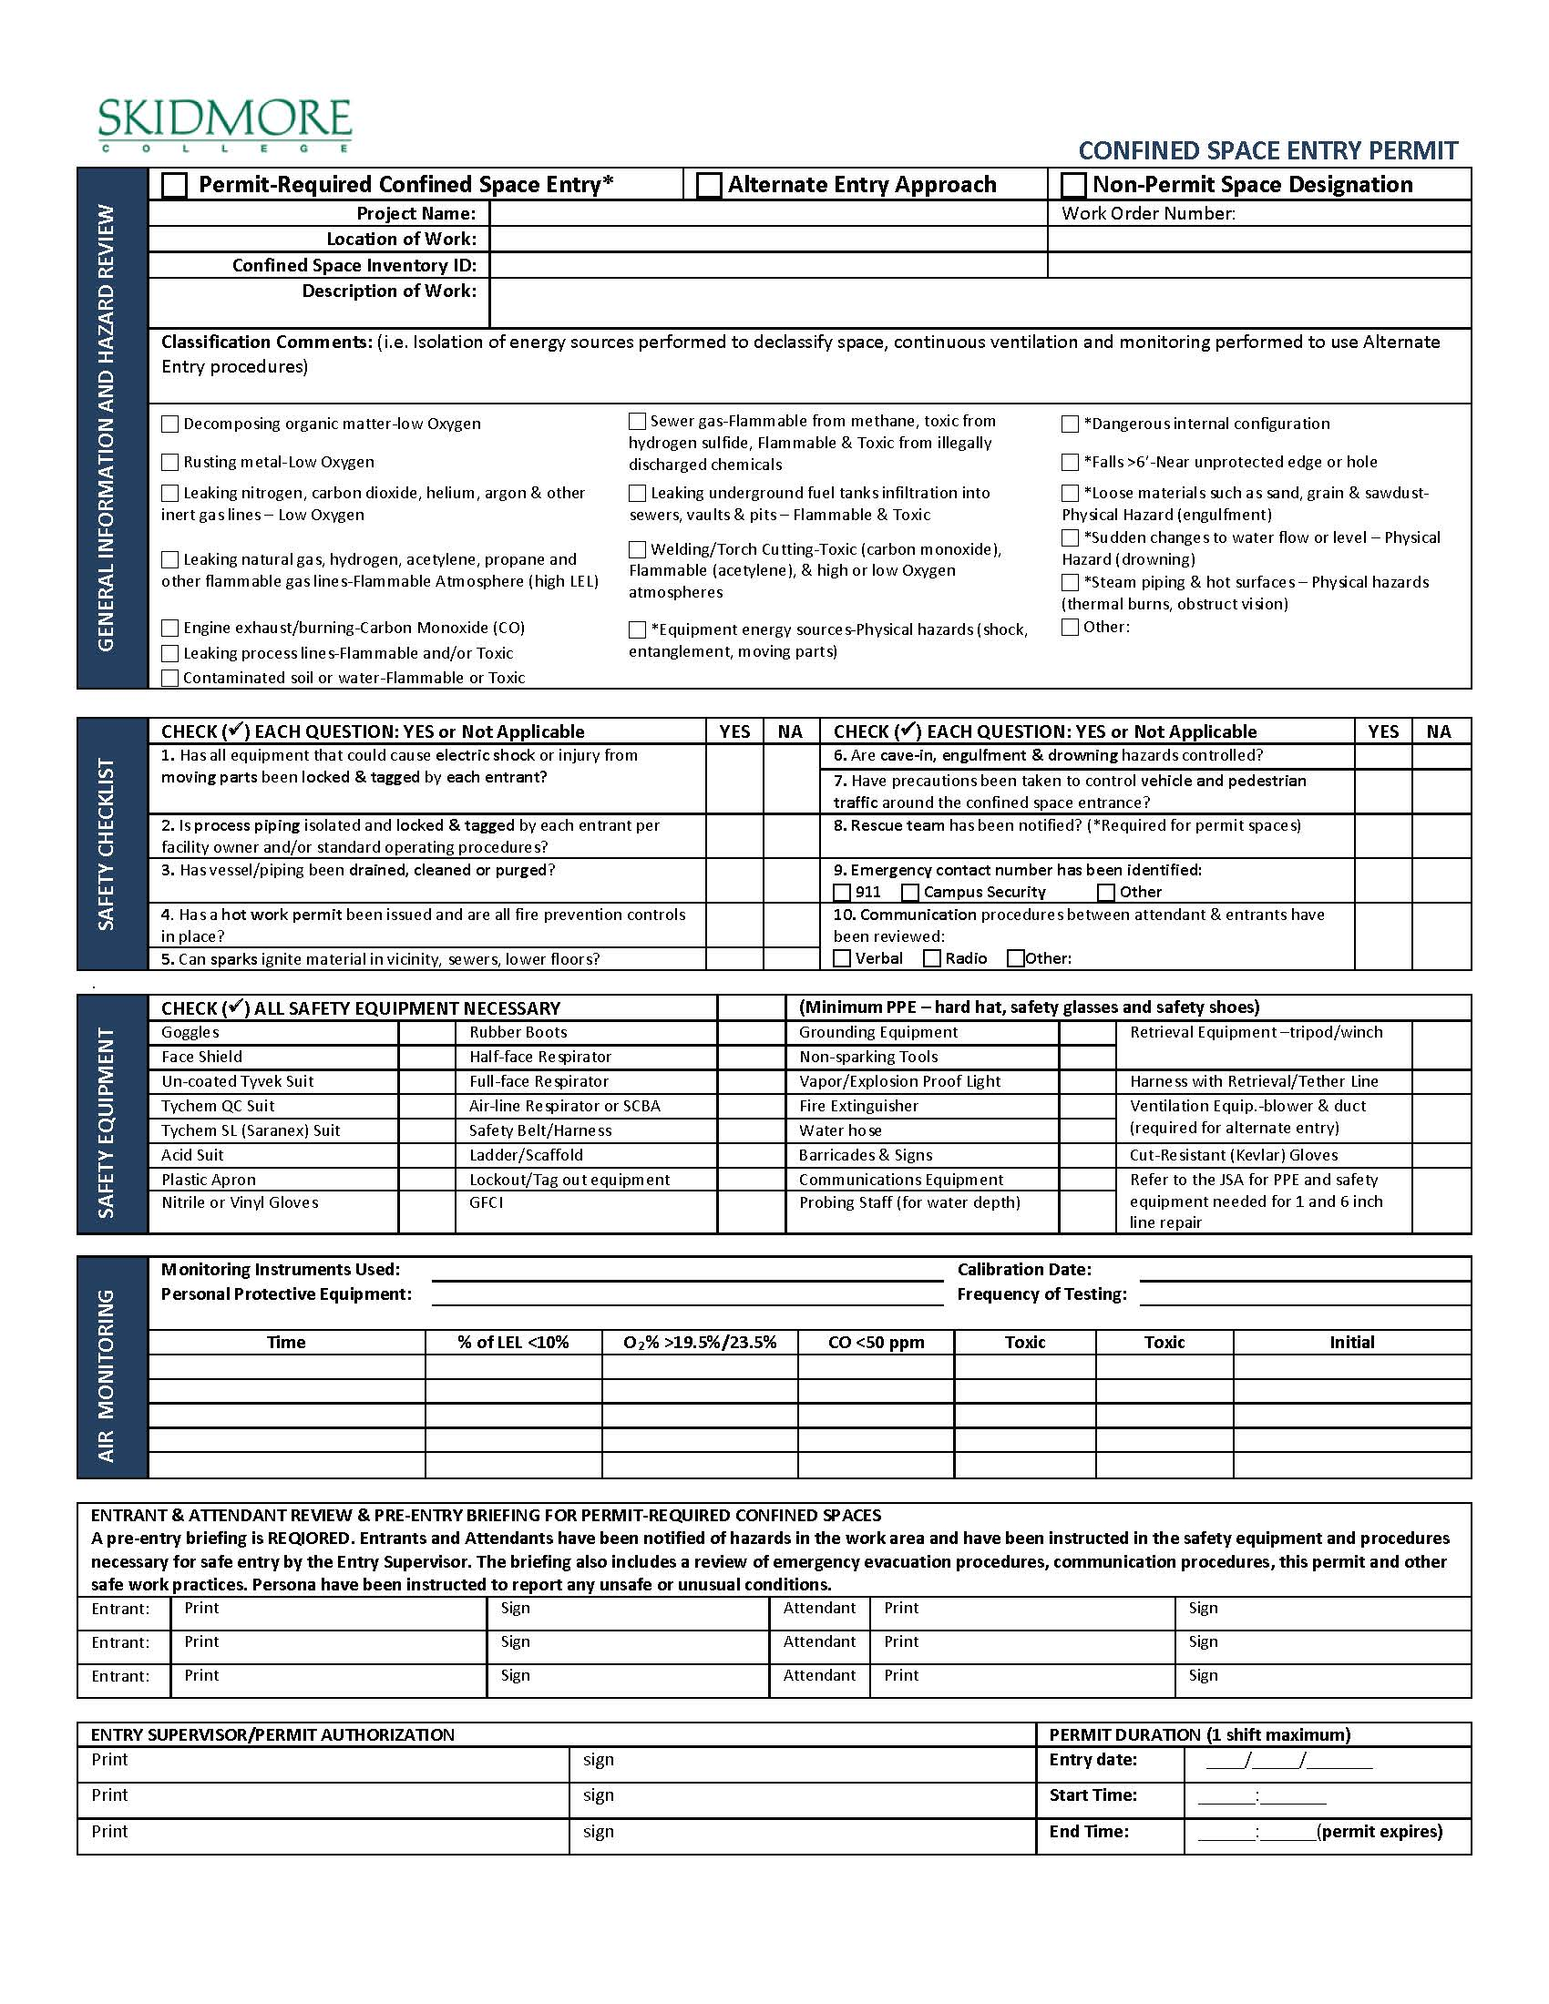
FORMS:
Skidmore’s Confined Space Entry Permit

Slide 51
FORMS:
Skidmore’s Confined Space Entry Checklist

Slide 52
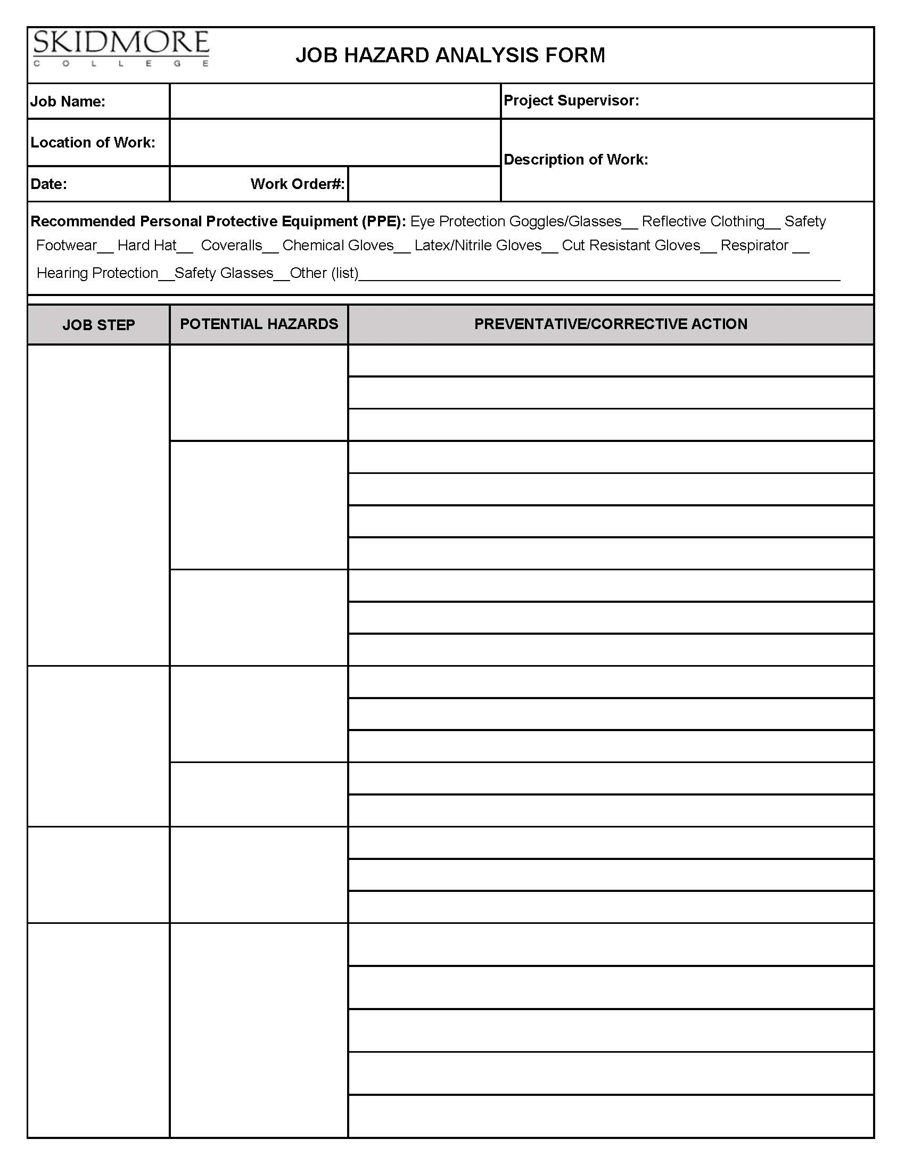
FORMS:
Skidmore’s Job Hazard Analysis Form (JHA)

Slide 53


Skidmore Confined Space Program
  Confined Space Signs/ Labels
Non Permit Confined Space Sign
Permit-Required Confined Space Sign

Slide 54
Questions / Comments?

