Slide 1
Assessment of Civic Engagement
David Karp, Associate Dean of Student Affairs
October 2013

Slide 2
Civic Engagement Defined
Goal III
  “We will prepare every Skidmore student to make the choices required of an informed, responsible citizen at home and in the world.”
  Informed, Responsible Citizen
    Informed, responsible citizens participate in the life of the community. They have the knowledge, skills, and dispositions necessary to build community and effectively evaluate and respond to public issues and concerns.
Civic Engagement
  Civic engagement is based on an understanding of political, economic and civic institutions, democratic principles and practices, and concern for public issues and scientific and cultural literacy. Civic engagement entails research, deliberation, principled advocacy, direct action, or service that enhances quality of life in the local, regional, national or global community. Civic engagement may include one or more of the following:
  Civic Learning
    Civic learning includes foundational knowledge in historical, political, cultural matters that shape our civic life. It fosters a capacity to critically examine complex social, ethical, and environmental concerns from multiple perspectives.
  Civic Skills
    Civic skills include the ability to work cooperatively to solve complex social and environmental issues by forming and expressing opinions, interacting civilly with diverse others to achieve goals, participating in collective decision-making processes, organizing people for action, and implementing policy decisions.
  Community Service
    Community service includes voluntary actions that seek to provide resources or services for the promotion of a community or environmental good.
  Community Research
    Community research is scholarship involving collaboration of faculty and/or students with community partners that is directed toward investigating, assessing, and addressing behavioral, social, educational, cultural, and environmental problems.
  Service Learning
    Service learning is a credit-bearing educational experience that integrates meaningful community service with guided reflection to improve student learning of course content, student sense of social, artistic and environmental responsibility, and responds to an identified community need.

Slide 3
Data Sources
Campus Life Student Survey
  2013
ASCE (Assessment of Service and Civic Engagement)
  2010
NSSE (National Survey of Student Engagement)
  2003, 2007, 2010
FYE student evaluations
  2008, 2010
Service-Learning Faculty Surveys
  2006-2013

Slide 4
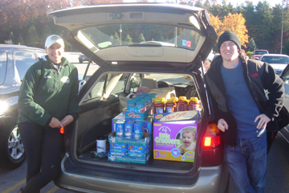
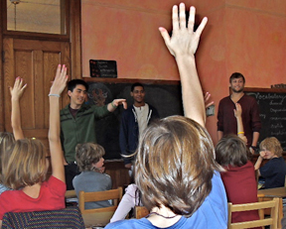
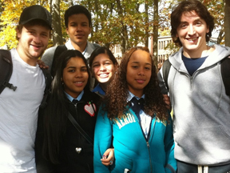
Student Experiences, Attitudes, and Learning Outcomes
What they say and how they compare to our peers

Slide 5
Campus Life Student Survey
February 2013
Random Sample: 400 students on campus
Response Rate: 175 (44%)

Slide 6
Time Allocation

Slide 7
How they spend their time
 | Studying | Co-Curricular Activities | Working for Pay | Volunteering | Socializing/ Relaxing
Athletes |  | More | Less
International |  | Less
Students of Color |  |  | More |  | Less
Females | More |  |  | More
First Years | Less | More | Less |  | More
GLBT
Religious
*Statistically significant differences are noted for comparison groups, e.g., athletes vs. non-athletes, international students vs. U.S. students.

Slide 9
Notes:
Nonmembers may believe they are getting these from other means, such as curricular life. But members strongly believe they are getting valuable skills from their involvement.

Slide 10
Satisfaction with Co-Curricular Experience
Members of service clubs are satisfied with their co-curricular experience. (Benefaction and Environmental Action Club.)

Slide 12
Importance of Civic Engagement
As a personal priority, how important to you is civic engagement?
As a priority for Skidmore, how important? Currently, how much do you think the Skidmore administration makes it a priority?

Slide 13
Comparing Community Service Club Members and Non-members

Slide 14
Their own priorities
Their view of Skidmore’s priorities
 |  | Civic Engagement
Athletes | Self
 | College
International | Self
 | College
Students of Color | Self
 | College
Females | Self
 | College
First Years | Self
 | College | More
Religious | Self | More
 | College
GLBT | Self
 | College

Slide 15
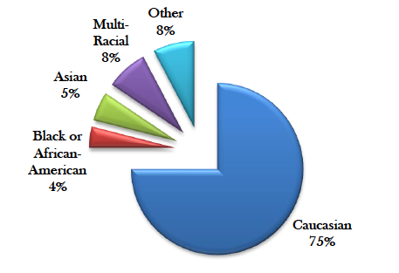
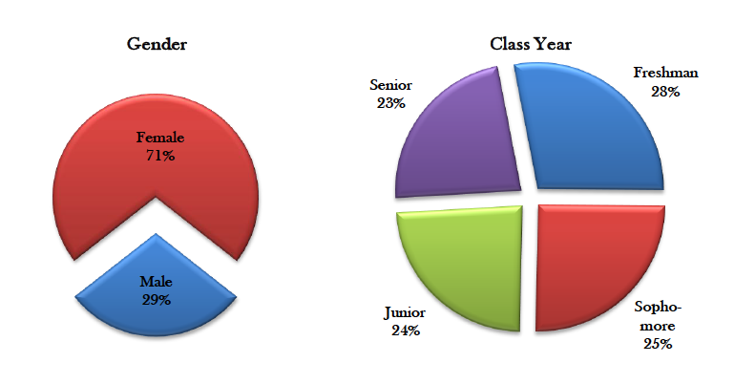
ASCE 2010
The Siena College Research Institute
Survey of all students, November 2010
21% response rate, n=560
Note limitation of large FY sample early in year

Slide 16
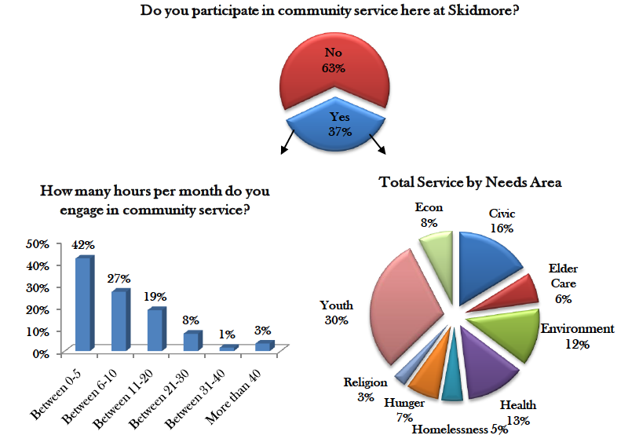
ASCE 2010

Slide 17
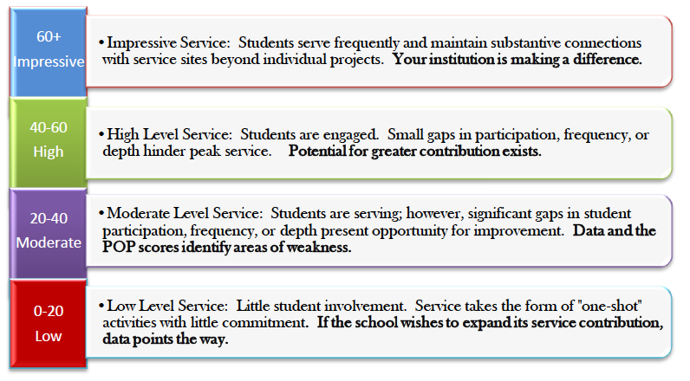
ASCE 2010
POP (Percent of Possible) Score based on three measures
  Number of students doing service
  Frequency of service
  Depth of service (from one-shot to substantive, long-term commitment)

Slide 18
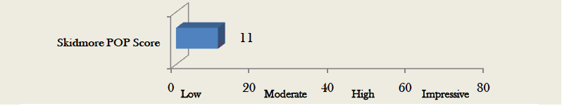
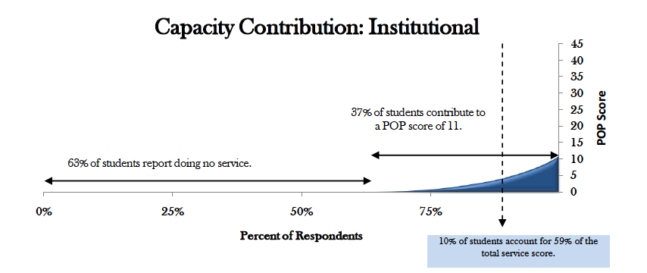
ASCE 2010

Slide 19
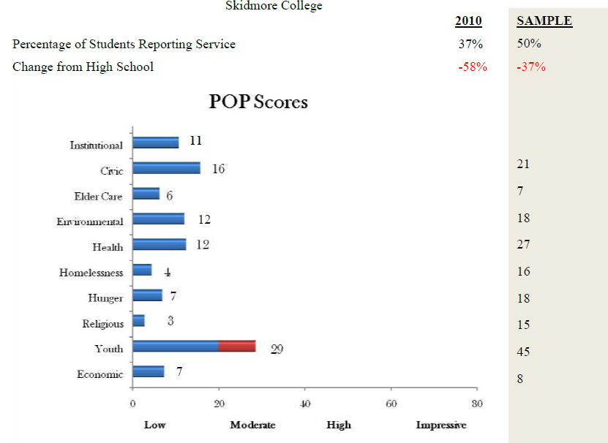
ASCE 2010

Slide 20
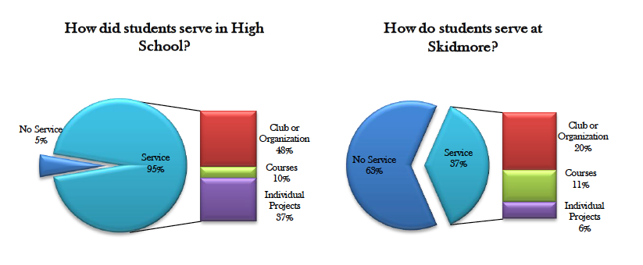
ASCE 2010

Slide 21
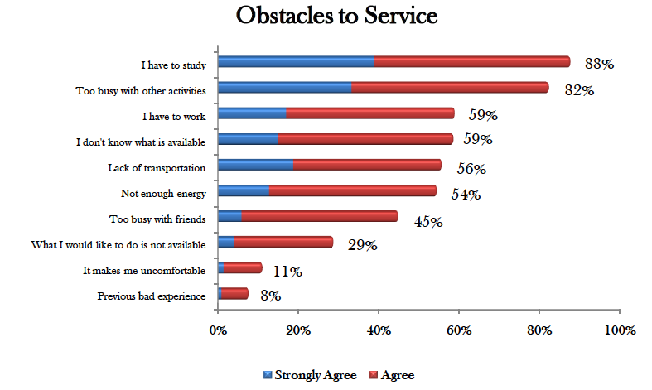
ASCE 2010

Slide 22
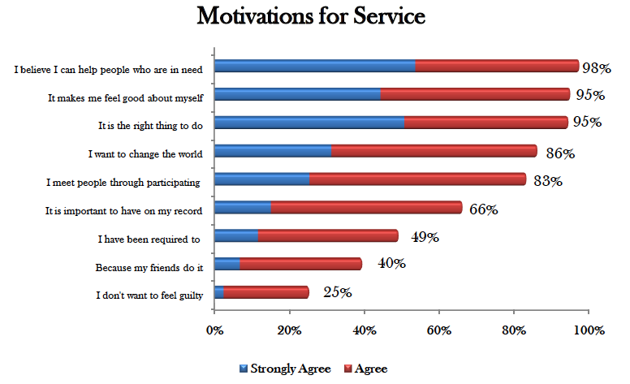
ASCE 2010

Slide 23
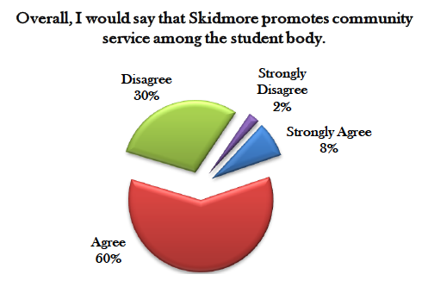
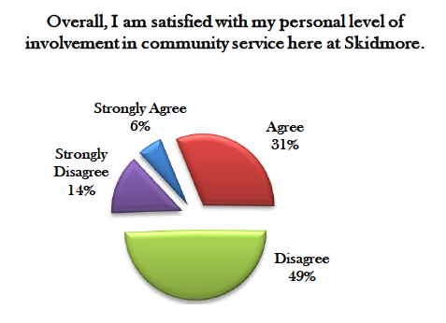
ASCE 2010

Slide 24
NSSE 2010
National Survey of Student Engagement
Survey in Spring 2010
  First years (n=110)
  Seniors (n=112)
Random sample, 50% response rate
Prior surveys in 2004 and 2007
Notes:
Comparison Group 3 Details
This report displays the 2010 comparison group 3 institutions for Skidmore College. The institutions listed below are represented in the 'Selected Peers' column of the Respondent Characteristics, Mean Comparisons, Frequency Distributions, and Benchmark Comparisons reports.
HOW GROUP WAS SELECTED
You selected specific institutions from a list of NSSE 2010 participants.
SELECTED COMPARISON GROUP CRITERIA ª
Basic 2005 Carnegie Classification(s):
Carnegie - Undergraduate Instructional Program(s):
Carnegie - Graduate Instructional Program(s):
Carnegie - Enrollment Profile(s):
Carnegie - Undergraduate Profile(s):
Carnegie - Size and Setting(s):
Sector(s) (public/private):
Undergraduate enrollment(s):
Locale(s):
Geographic Region(s):
State(s):
Barron's admissions selectivity ratings(s):
COMPARISON GROUP 3 INSTITUTIONS
Institution Name
City
State
Alma College
Alma
MI
Assumption College
Worcester
MA
Augsburg College
Minneapolis
MN
Berea College
Berea
KY
Butler University
Indianapolis
IN
Central College
Pella
IA
Centre College
Danville
KY
Coker College
Hartsville
SC
Colgate University
Hamilton
NY
Connecticut College
New London
CT
Denison University
Granville
OH
Drury University
Springfield
MO
Eckerd College
Saint Petersburg
FL
Franklin and Marshall College
Lancaster
PA
George Fox University
Newberg
OR
Goucher College
Baltimore
MD
Hartwick College
Oneonta
NY
Hobart and William Smith Colleges
Geneva
NY
Hope College
Holland
MI
Knox College
Galesburg
IL
Lawrence University
Appleton
WI
Lewis & Clark College
Portland
OR
Neumann University
Aston
PA
New England College
Henniker
NH
Ohio Wesleyan University
Delaware
OH
Randolph-Macon College
Ashland
VA
Rollins College
Winter Park
FL
Saint Michael's College
Colchester
VT
Siena College
Loudonville
NY
Wabash College
Crawfordsville
IN
Wheaton College
Norton
MA

Slide 25
NSSE 2010

Slide 26
NSSE 2010

Slide 27
NSSE 2010

Slide 28
NSSE 2010

Slide 29
NSSE 2010

Slide 30
NSSE 2010

Slide 31
NSSE 2013

Slide 32
Payscale Survey of Alumni
Peer List | Percent Alumni with High Job Meaning
Union College | 61%
Bates College | 59%
Trinity College | 54%
Wheaton College | 49%
Vassar College | 47%
Franklin and Marshall College | 47%
Dickinson College | 46%
Sarah Lawrence College | 46%
Kenyon College | 43%
Colgate University | 42%
Oberlin College | 42%
St. Lawrence University | 41%
Connecticut College | 39%
Skidmore College | 35%
Gettysburg College | 34%
Hamilton College | n/a
Bard College | n/a
This is the percentage of people who answer “Very much so” and “Yes” to the question: “Does your work make the world a better place?”
Notes:
I noticed that engineering schools tend to score high, which may explain Union. Bates and Trinity are big on civic engagement.
http://www.payscale.com/college-salary-report-2014/full-list-of-schools

Slide 33
Service Learning in the FYE
Fall 2008
  Survey of First Year Students (N=169)
  9 SL seminars
  11 Non-SL seminars
Fall 2010
  Survey of First Year Students (N=676)
  8 SL seminars
  38 Non-SL seminars
Important differences
  Rotation of faculty (testing SL, not quality of faculty)
  Faculty-defined vs. student-defined service
    More students said they were in an SL seminar than possible
  Much larger 2010 sample
Statistics
  All findings statistically significant for both 2008 and 2010 (p<.05)

Slide 34
FYE Service Learning
Human Dilemmas
  College readiness and access
  Partnership with Bronx high school
Music Between Us
  Fundraiser for Skidmore Cares
Dangerous Earth
  Educational campaign about disaster preparedness
Race in the Obama Era
  IGR dialogues, campus climate
American Liberty
  Death penalty clemency project
The Making of the Hudson
  Sustainability projects with community partners

Slide 35
Service Learning in the FYE
Student Evaluations: Academic Engagement

Slide 36
Service Learning in the FYE
Student Evaluations: Academic Engagement

Slide 37
Service Learning in the FYE
Student Evaluations: Civic Engagement

Slide 38
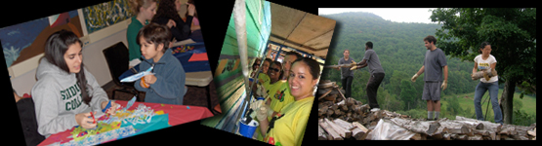
Institutional Investment and Change
Where we were, where we are, and how we compare to our peers

Slide 39
Infrastructure
Office of Community Service Programs
  Student Affairs
  1 FTE (Michelle Hubbs)
    Converted from .5 FTE in 2007
  1 VISTA beginning Fall 2011
Faculty with service placement responsibilities
  Social Work, Field Coordinator
  Education Studies, Director of Student Teaching
  Environmental Studies, Coordinator
Responsible Citizenship Task Force
  Co-chairs, Associate Dean of Faculty and Associate Dean of Student Affairs
  Fall 2008-Spring 2011
  To be IPPC subcommittee beginning Fall 2011
BenefAction
  Student club

Slide 40
Service-Learning Courses

Slide 41
Service Learning by Division
2005-2011 (n=267 courses)
Top SL Majors:
Education Studies
Management and Business
Social Work

Slide 42
Faculty (2005-2011)
Long term stability of SL courses
78 faculty have taught SL courses
49 tenure track
  63% of SL faculty
55 currently employed/long-term
  70% of SL faculty

Slide 43
Courses and Enrollment
63 SL courses AY 2010-2011
  4% of total courses
1177 students enrolled in SL courses in AY 2010-2011
  This does not account for duplication (students who take more than one SL class)

Slide 44
Infrastructure

Slide 45
National Reputation
Recognition
  Listing in Guide to Service-Learning Colleges and Universities.
  President's Higher Education Community Service Honor Roll 2009 and 2010.
    This award “annually recognizes institutions of higher education for their commitment to and achievement in community service.”
  Carnegie Elective Classification in Community Engagement 2010.
    The most reputable and comprehensive benchmarks for civic engagement in higher education.
    Skidmore is one of 311 institutions that have obtained this classification.
Lists and “clubs” we do not make
  U.S. News “Academic Programs to Look For: Service Learning”
  Washington Monthly “Liberal Arts Colleges: Social Mobility, Research, Service”
  Bonner Scholars (Service Scholarship and Leadership Program)
  Project Pericles (Model civic engagement programs, invitation only)

Slide 46
Key Findings: Student Experience
Most students come to Skidmore with civic engagement experience
Most expect and wish to continue their service
Less than half of our students participate in service
10% of students account for most of the service
Service is primarily co-curricular

Slide 47
Key Findings: Service Learning
Significant increase in SL courses over 5 years
Most SL courses are:
  Taught by tenure-track/long-term faculty
  Pre-Professional and Interdisciplinary (26% in traditional liberal arts disciplines)
Consistent pattern of positive learning outcomes in SL Scribner Seminars
  Academic engagement (e.g., active involvement)
  Civic engagement (e.g. concern and commitment)

Slide 48
Issues
Peers:
  Greater investment in civic engagement resources
  Greater involvement by students
  Greater satisfaction with civic learning outcomes
Broader consideration of civic engagement:
  Civic learning coursework
  Community-Based Research
  Service-learning developmental sequencing

