Slide 1
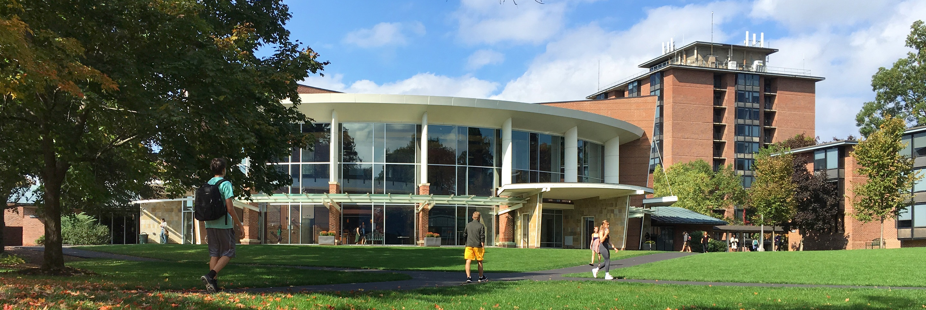

Campus Master Plan
Steering Committee Kick-off | March 18, 2021

Slide 2
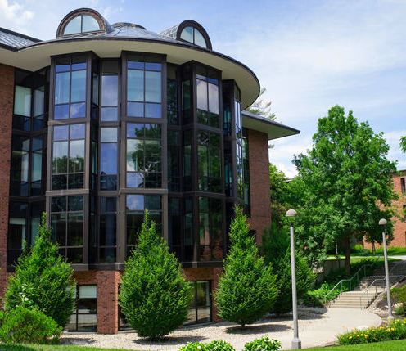
Agenda
Schedule Overview
Focus Group Structure
Discussion Questions
Project Kick Off

Slide 3
Schedule Overview
01

Slide 4



Schedule
Observe + Assess (29 weeks)
Envision + Test (17 weeks)
Synthesize (20 weeks)
MARCH – MAY 2021 | JUNE – SEPTEMBER 2021 | OCTOBER – JANUARY 2021 – 2022 | FEBRUARY – MAY 2022 | MAY 2022
Purpose: Project Kick-off Interviews & Listening Sessions | Purpose: Campus Tours Analysis Summary, Drivers, & Planning Principles | Purpose: Concept Plan & Initial Precinct Scenarios Refined Precinct Scenarios | Purpose: Draft Plan & Phasing / Implementation Final Plan | Purpose: Documentation
Meetings & Workshops: Steering Committee Campus Master Plan Task Force Focus Groups (TBD) Open Forums with Faculty, Staff, and Students Community Engagement | Meetings & Workshops: Steering Committee Campus Master Plan Task Force Board of Trustees Update Focus Groups (TBD) Open Forums with Faculty, Staff, and Students Community Engagement | Meetings & Workshops: Steering Committee Campus Master Plan Task Force Board of Trustees Update Focus Groups (TBD) Open Forums with Faculty, Staff, and Students Community Engagement | Meetings & Workshops: Steering Committee Campus Master Plan Task Force Board of Trustees Update Community Engagement | Final Deliverable: Master Plan roll-out to stakeholder groups and campus community

Slide 5
Engagement
Anticipated In-person Meeting / Workshop
Virtual Meeting / Workshop
Touch point / check-in / scheduling

Slide 6
Focus Group Structure
02

Slide 7
Initial List of Stakeholders (provided by the Task Force)
Staff Groups
Student Groups
Faculty Groups
Student Affairs Leadership Team
Athletic Team Coaches
Athletic Department Staff
Student Academic Support Staff
Starbuck Center Staff
Area Coordinators
Dining Staff
Administrative Support Staff
SGA
Office of Student Diversity Programs (OSDP) Leaders
Student Athlete Advisory Committee (SAAC)
Peer Academic Coaches (PAC)
Peer Health Educators (PHE)
Students with Disabilities
Res. Life Student Staff
CDC Career Corps
Sustainability Office Student Leaders
Environmental Action Coalition (Club)
Sustainability Commission (SGA)
Apartment/Residence Hall residents
By division
By department/program
By building
By interest groups
Academic Spaces
Teaching Spaces
Research Spaces
Faculty Offices and Gathering Spaces
Other Groups
Student Support
Campus Safety
Alumni
Advancement
Marketing and Communication / Neighbors / Bookstore
Alumni Affairs
Financial Services
Human Resources / Retirees
Facilities
Town Officials
Dining Services
Conference and Events
Board of Trustees
Academic Advising
Registrar
Off-Campus Study and Exchange (OCSE)
Opportunity Program (OP)
Unique Buildings
Library
Tang
Case Center
Dining Hall
Jonsson Tower
White Hollow Farm
Boat House
Starbuck Center
Faculty Support
Sponsored Research Office (SRO)
Academic Safety
Center for Leadership in Teaching and Learning (CLTL)
Greenberg Child Care
Early Childhood Center

Slide 8
Proposed Focus Groups - DRAFT
For each of these focus groups we want a variety of campus stakeholders to offer diverse viewpoints about existing conditions and the future potential of the campus.
Program Drivers
Physical Drivers
Cross-Cutting Drivers
Academics (could be multiple subgroups)
Spaces used and adequacy for teaching, collaboration
Student Life
Dining, student services, student organizations, academic support
Residential Life
Housing inventory, goals for cohort living and types of offerings, common spaces
Athletics & Recreation
Facility needs, promoting overall student well-being, impact on “school spirit”
Administration & Workplace
Office spaces used and locations, amenities, collaboration
Campus Mobility
Pedestrian, bicycle, vehicular, service, bus, wayfinding, parking, safety
Facilities & Infrastructure
Building conditions, infrastructure needs
Real Estate
Relationship with town, off-campus properties, future growth
Diversity, Equity, & Inclusion
Welcoming spaces, non-traditional students,
student services
Sustainability
Culture, campus practices, technologies used
Health & Wellness
Accessible services, impact of recreation,
campus open spaces, safety

Slide 9
Program Drivers
Academics
What sets Skidmore apart from other institutions? How do the academic programs contribute to this? What advantages or opportunities for improvement do your programs afford?
Do the current locations of academic space, administrative units, research space, and support services function well collectively?
Which buildings and academic space do you think function well (age, form, layout) and which ones do not? Do your current classrooms, laboratories, research space, and other spaces adequately support your activities? How or how not?
Do the different units within Skidmore collaborate well with each other? Do the current facilities help encourage collaboration and interaction? Are there areas for informal collaboration? Is there enough conference space for formal collaboration?
How are instructional delivery at Skidmore methods likely to change over the next decade? What new information and learning technologies do you expect to use? How will these impact space and/or adjacencies?
What functions of the library do you, your staff, and your students use on a regular basis?
Thinking 10-20 years out, what do you predict will be the defining aspects of Skidmore College? How does the long-term vision for your programs fit with this?

Slide 10
Program Drivers
Student Life
What sets Skidmore apart from other institutions that you think is especially important?
Which buildings do you think function well (age, form, layout) and why? Which buildings do not function well and why?
What campus amenities (food, recreation, bookstore, etc.) do you, your staff, and your students use on a regular basis? Are there amenities that require leaving campus to access? If so, would it be beneficial to have those amenities on campus?
Where do students study, meet, and collaborate with other students or with faculty?
Are student services (financial aid, bursar, student health and wellness, advising) provided in a way that is accessible and intuitive for a broad range of students? Are there opportunities to improve the way these functions meet the needs of students?
How can Skidmore be a better neighbor to surrounding communities or neighborhoods? How do the surrounding areas influence the campus? Where do strong synergies exist? How can they be improved?

Slide 11
Program Drivers
Residential Life
What are your goals for student housing, such as cohort living, percentages of students living on campus vs off, types of offerings, program, etc.?
How well does your housing inventory support your mission, vision, and values?
Which buildings do you think function well (age, form, layout) and why? Which buildings do not function well and why?
How is housing currently assigned and how well does this system work? Where on campus do different students tend to live?
What are the challenges of your current student housing neighborhoods?
How well does your common space inventory support programming and community?
If you could start fresh with your student housing, what would you do differently? Where is the ideal place on campus for student housing?
Thinking 10-20 years out, how might the demographics of students on campus change? How may this impact the quantity and types of student housing in demand?

Slide 12
Program Drivers
Athletics & Recreation
What are the most defining aspects of Skidmore’s culture? How do the College’s athletics and recreation programs contribute to this campus-wide culture?
What are key facility needs to support athletics and recreation today? Are there sports or other programs that could be added or changed in the future, and what facility needs could these include?
Thinking beyond the College’s athletics and recreation facilities, are there other compelling physical needs on campus that you can identify?
Which institutions do Skidmore’s athletic teams regularly compete against? Are there facilities, programs, or other qualities at these institutions that allow them to successfully recruit and retain student athletes?
How does recreation at Skidmore go beyond sports and physical activity to promote overall student well-being?
How would you describe the sense of “school spirit” on campus as it relates to athletics and recreation? Thinking about the College’s campus and strategic direction, how should the identity and energy surrounding these programs evolve?

Slide 13
Program Drivers
Administration & Workplace
What sets Skidmore apart from other institutions that you think is especially important?
Does your department or division use multiple spaces on campus? If so, are they conveniently located to each other? Do the current locations of academic space, administrative units, and support services function well collectively? Are there departments or functions that could be relocated to improve synergies or efficiencies?
Which buildings do you think function well (age, form, layout) and why? Which buildings do not function well and why?
Where do you spend most of your time on campus? How long are you on campus at a time?
What campus amenities (food, recreation, bookstore, etc.) do you, your staff, and your students use on a regular basis? Are there amenities that you leave campus to access? If so, would it be beneficial to have those amenities on campus?
What functions of the library do you, your staff, and your students use on a regular basis? Can you find study, collaboration, and meeting space on campus when you want it?
Thinking 10-20 years out, how might the way in which faculty, staff, and students collaborate change? How might this impact the design, layout, and function of the workplace environment?

Slide 14
Physical Drivers
Campus Mobility
What are the primary challenges in navigating the campus? Are there physical barriers that make navigating the campus more challenging?
What defines the entry and arrival experience to campus? What message does this send to different audiences arriving on campus? How could this experience be improved?
What mode(s) of transportation do you typically use to get to Skidmore (drive, transit, walk, bike)? At what location(s) do you typically enter?
    Pedestrian: Where is it difficult to access by foot? What route(s) do you typically take in walking on or near Skidmore? Are there additional pedestrian connections that would make it easier to navigate the campus?
    Bike: Where is it difficult to access by bike? What additional facilities or amenities would you like to see added to the bike infrastructure on and near the campus? What services are needed to support the bike network?
    Vehicular: Are there places where you think traffic should be restricted (all day or part of the day)? What connections/movements would improve campus wayfinding?
    Service: Are there places where there are substantial service/delivery conflicts (with pedestrians, cyclists, or private vehicles)?
  How does the Skidmore community use transit to reach, navigate, or travel between the campus and the town? How can transit be improved?

Slide 15
Physical Drivers
Facilities & Infrastructure
Which buildings do you think function well (age, form, layout) and which ones do not?
What kind of infrastructure systems support the campus? Are any of these nearing the end of their useful life cycle? What infrastructure investments are needed to support the growth of the College.
Is there a general consensus on how to address buildings that are in poor condition? Renovation, renewal, demolition, etc.?
What planned building and infrastructure projects do we need to know about or take into consideration?
How important is resilience as we consider long-term decisions about the campus’s future development?

Slide 16
Physical Drivers
Real Estate
What sets Saratoga Springs apart from other college towns that you think is especially important? Are there elements missing that would make the College more attractive to potential students, faculty, and staff?
Are there any planned projects in the area that would have an impact on the Skidmore campus, directly or indirectly? Does the town have future aspirations that would have an impact on the Skidmore campus?
What are of the implications of co-College development? What is the appetite for different public-private development models?
What properties should the College purchase if the opportunity arises? Are there college-owned properties that could be redeveloped?
What space does the College currently lease? Would the College consider leasing additional space if it improved its ability to use on-campus facilities?
What creative delivery strategies exist?
What are future off-campus growth possibilities?

Slide 17
Cross-Cutting Drivers
Diversity, Equity, & Inclusion
What are the first impressions of Skidmore to different types of visitors and how does this set it apart from other institutions? How would you define the aesthetic of the campus and what type of prospective student does this attract? Are there students who may not find the campus welcoming and what could be done to improve this?
What type of spaces on campus allow different types of students to come together, either formally or informally? Do students of different ethnicities, gender identities, and sexual orientation have access to spaces to socialize and build identity?
Do you see the number of non-traditional students increasing, decreasing, or remaining the same? How will this impact Skidmore’s campus differently? What facilities might different types of students (first generation, commuter, part-time) need that do not exist today?
Are student services (financial aid, bursar, student health and wellness, advising) provided in a way that is accessible and intuitive for a broad range of students? Are there opportunities to improve the way these functions meet the needs of students?
How has the role of student health and counseling services evolved in the past decade? What changes do you see in the future and how will they impact specific facility needs? Does the campus include spaces for students to engagement in passive recreation in a way that allows them to “unplug” and develop healthy coping habits?

Slide 18
Cross-Cutting Drivers
Sustainability
What does sustainability mean to you?
What sets Skidmore apart from other institutions from a sustainability perspective that you think is especially important? How could this change in the coming 10-20 years?
Does Skidmore incorporate sustainability into its culture?
What opportunities for sustainability (energy, environment, transportation, landscape, etc.) and resilience planning exist at Skidmore?
Is sustainability promoted or passively experienced on the campus?
Are there examples of sustainable technologies you have seen on other campuses that could be employed at Skidmore?
Which impact areas are the most critical in informing the physical master plan?
Beyond energy, water, waste, and transportation, how else do you see sustainability affecting the physical master plan?
How can we get students involved in the process?
How do third-party ranking systems affect the planning process and outcomes?
Who are the right stakeholders to have in the room to achieve sustainability goals at Skidmore?

Slide 19
Cross-Cutting Drivers
Health & Wellness
Are student services (financial aid, bursar, student health and wellness, advising) provided in a way that is accessible and intuitive for a broad range of students? Are there opportunities to improve the way these functions meet the needs of students?
Are there health and wellness services or programs for faculty and staff on campus?
How does recreation at Skidmore go beyond sports and physical activity to promote overall student well-being?
How do the different open spaces on campus contribute to the overall campus experience? Are there areas that could be improved?
Where are the best places to walk on campus? Where is it difficult to access by foot? What route(s) do you typically take in walking on or near Skidmore? Are there additional pedestrian connections that would make it easier to navigate the campus?
Are there places where people don’t feel safe? Where they feel very safe? What defines/contributes to each? For any of these locations, does the feeling of safety change depending on time of day or time of year?
How has the role of student health and counseling services evolved in the past decade? What changes do you see in the future and how will they impact specific facility needs? Does the campus include spaces for students to engagement in passive recreation in a way that allows them to “unplug” and develop healthy coping habits?

Slide 20
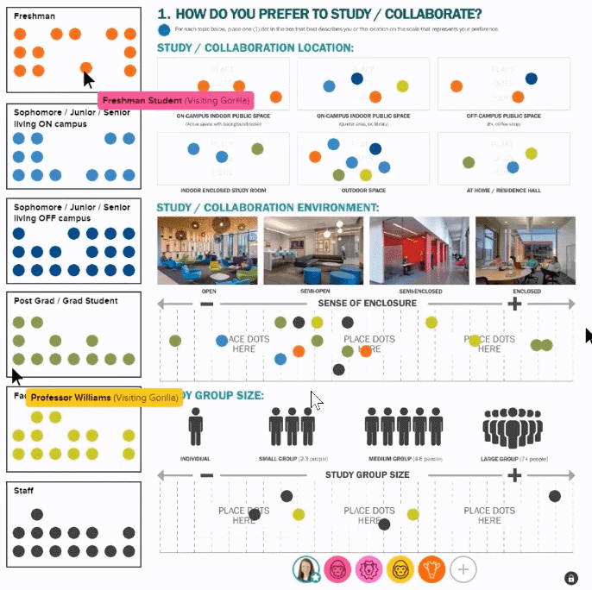
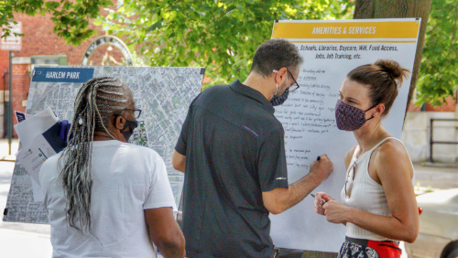
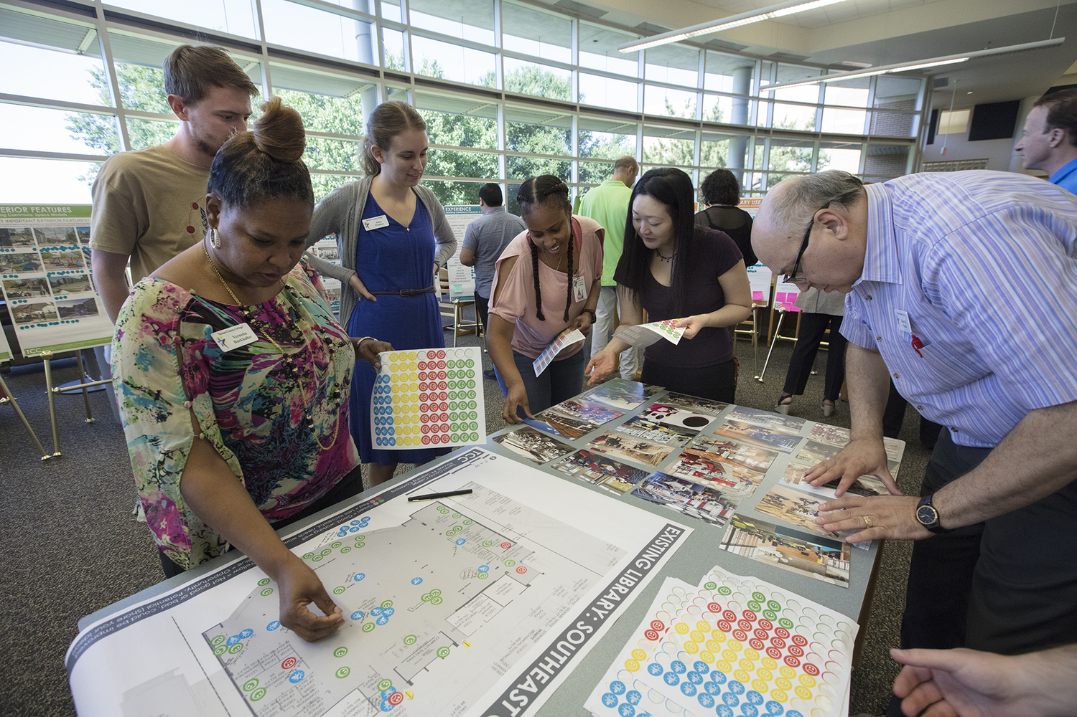
Proposed Open Forums
In addition to the topical focus group sessions, we plan on engaging the entire campus community through open forums.
The listening sessions provide a major opportunity for the campus community to provide their diverse inputs.
Open Forums will potentially include:
  Student Open Forum
  Faculty and Staff Open Forum
  Community Open Forum

Slide 21
Next Steps
Work with Task Force to put stakeholders into each focus group.
Determine how to address unique buildings that might not be addressed in the program drivers.
Schedule focus groups for the last week of April.

Slide 22
Discussion Questions
03

Slide 23



Project Goals & Outcomes
What are your goals for the Master Plan process?
What are the campus’ greatest strengths and weaknesses?
What are the key drivers of the Master Plan?
What are your goals for the Master Plan and process?
What would determine a successful plan and process for you?
What do you see as the key drivers of the Master Plan?

Slide 24
