Slide 1

Safeguarding Quality, Equity, and Inclusion as Learning Moves Online
AAC&U Webinar Series
March 27, 2020

Slide 2
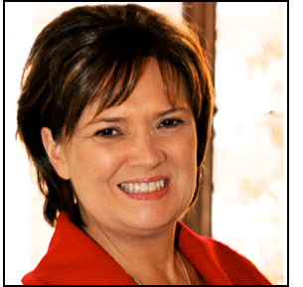
WELCOME
Lynn Pasquerella
President, AAC&U
Moderator

Slide 3
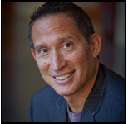
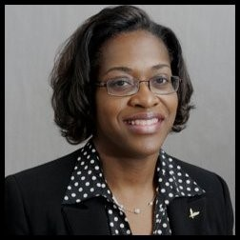
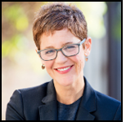
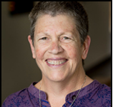
Panelists
José Bowen
Senior Scholar,
AAC&U
Gail Hollowell
Associate Professor,
Dept of Biological & Biomedical Sciences,
North Carolina Central
University
Stephanie Doscher
Director, Office of Global Learning Initiatives, Florida
International University
Cia Verschelden
Vice President, Academic and Student Affairs, Malcom X College, City of Colleges of Chicago

Slide 4





Thank you to our sponsor!

Slide 5
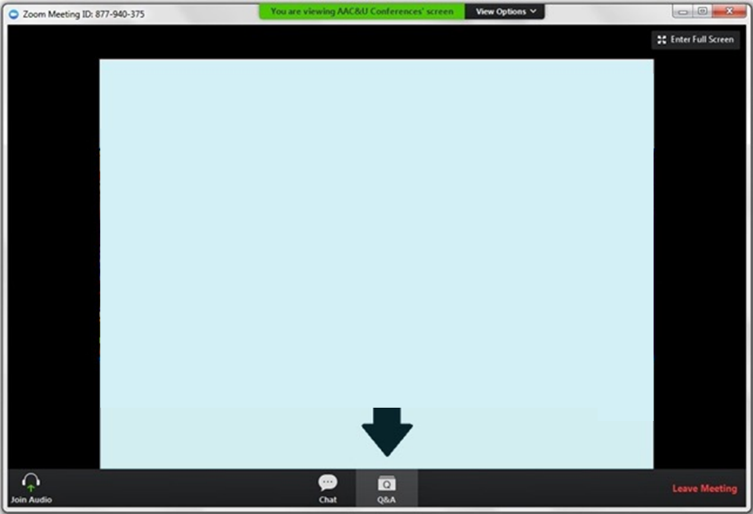
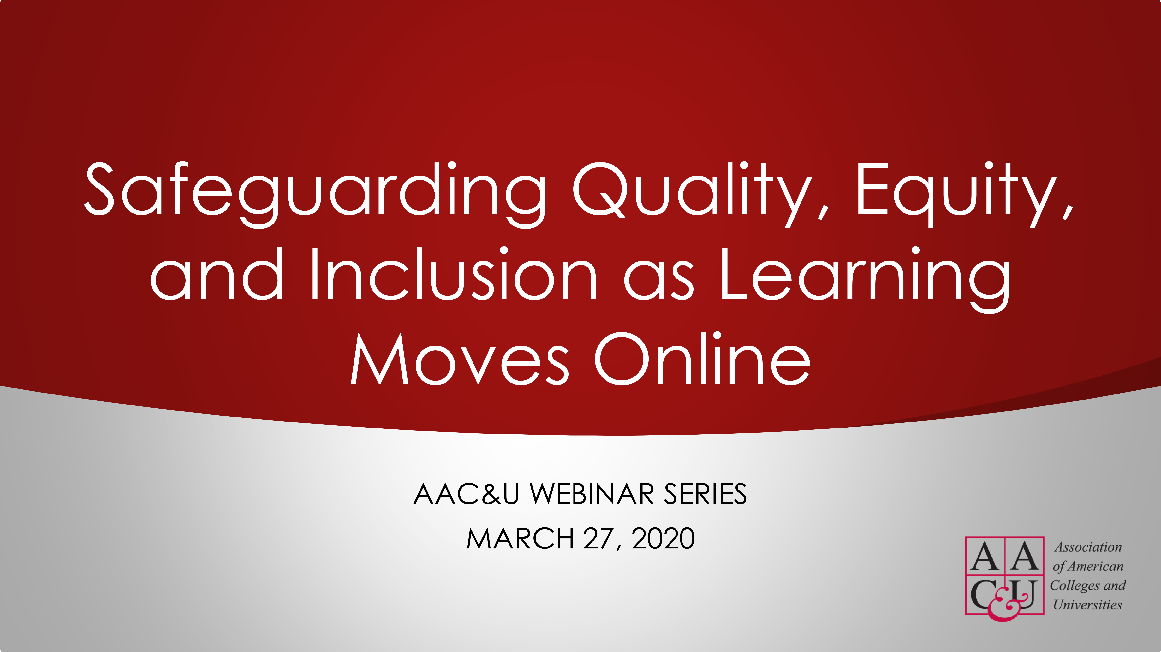

Use Q&A for:
Panel discussion
Use Chat for:
Technology support
#AACUonline
Slides and webinar recording will be posted online: www.aacu.org/webinars/safeguardinglearningonline.

Slide 6
José Bowen
Senior scholar, AAC&U

Slide 7
Short Term Online Risks
Inequity: In technology, support, experience, outcomes
Relationships: How we treat students now will matter more than what content we deliver.
Quality: first time emergency conversion to online lectures vs well-designed online experiences

Slide 8
Demonstrating Value and Equity in a New Era
Why is [Insert Your Institution] better and more expensive than ”Online U”?
Relationships, Engagement, Motivation & Communication
Collaboration
Global and Inclusive
Integration and Design

Slide 9
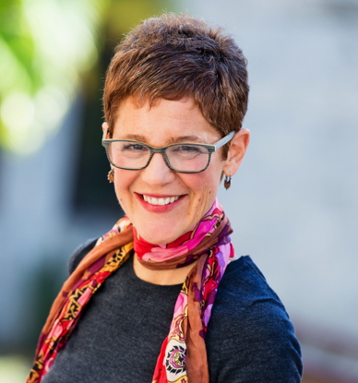
Stephanie Doscher
Director, office of global learning initiatives, Florida international university

Slide 10

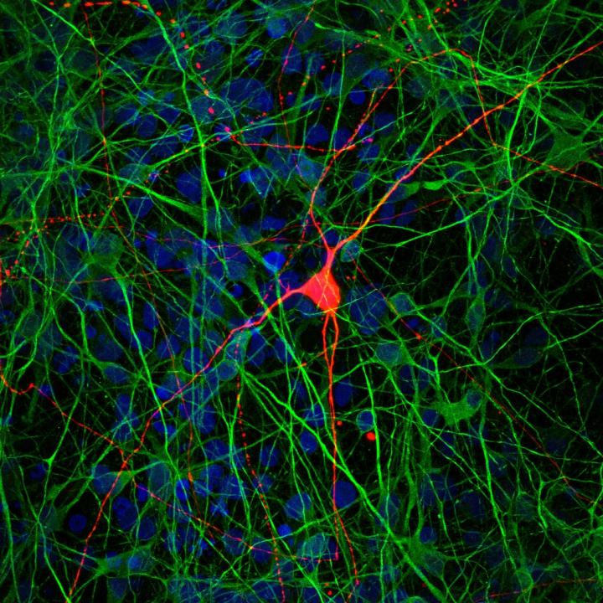

Slide 11
Global Perspective: Establish Social Presence
Icebreaker activities
Digital storytelling
Share cultural orientations

Slide 12
Global Awareness:
Structure Interdependence
Learning to Collaborate, Collaborating to Learn (Salmons, 2019)
Collaborative tasks
Team roles, role play
Collaborative apps, e.g. Perusall, Slack

Slide 13
Global Engagement:
Promote Connection-making
Collaborative dialogue prompts
Mind mapping
Reflect on relationship of course content to students’ personal, professional, civic lives
Connect local and global, combine parts of different ideas to make new ideas

Slide 14
Gail Hollowell
Associate professor, department of biological and Biomedical sciences, north Carolina central university

Slide 15
Transcripts and Videos
ADA Compliance
Open Educational Resources

Slide 16
Cia Verschelden
Vice president, academic and student affairs, Malcolm x college, city of colleges of chicago

Slide 17


Bandwidth

Slide 18

Uncertainty steals bandwidth

Slide 19
Uncertainty increased due to…
Lost wages
No breakfast and lunch programs for children in school
At home in neighborhoods where it’s not safe to be outside
Childcare, home-schooling challenges
Inadequate or no health insurance
Dependence on public transportation
Lack of the technology
Poverty, racism, classism, homophobia, xenophobia,…

Slide 20
Increasing Certainty for Students
Communicate often and consistently
Be patient and kind – to students and to yourself
Daily check-ins using a variety of modalities
Use LMS to clarify expectations and access to resources
Frequent feedback – with offers of support and connection
Don’t assume all students have access to technology
Assurance that you’re there to help students succeed
Give grace – maintain learning goals

Slide 21

Use Q&A for:
Panel discussion
Let’s Chat!

Slide 22
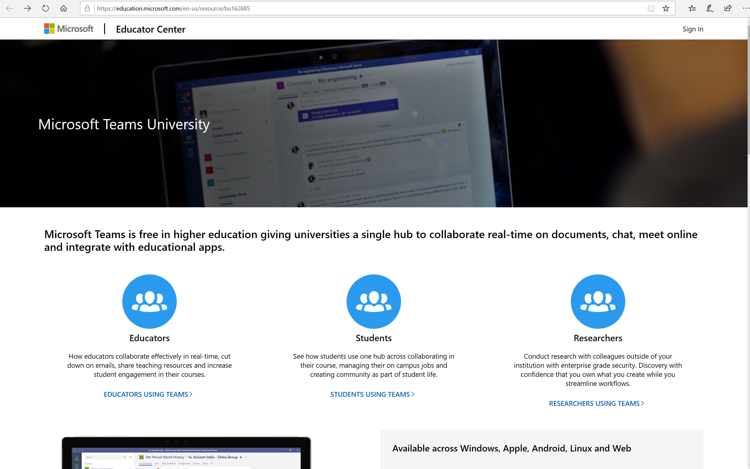
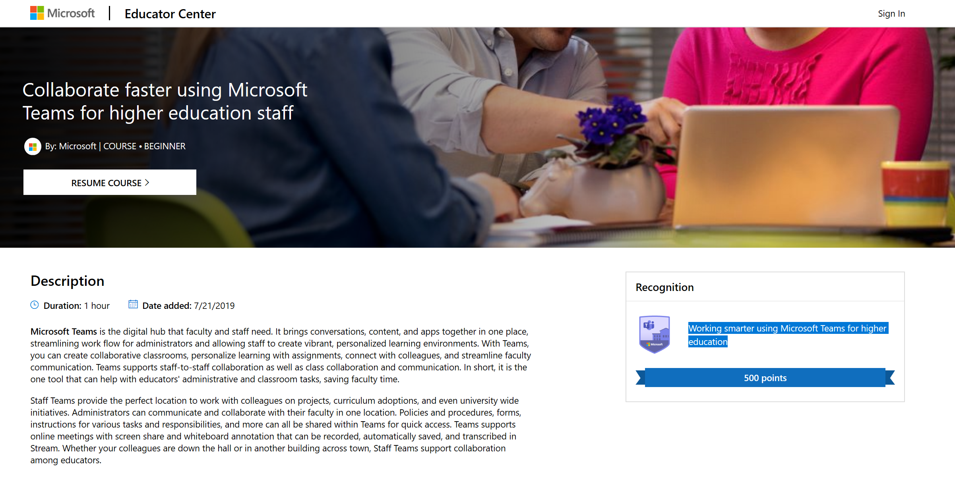
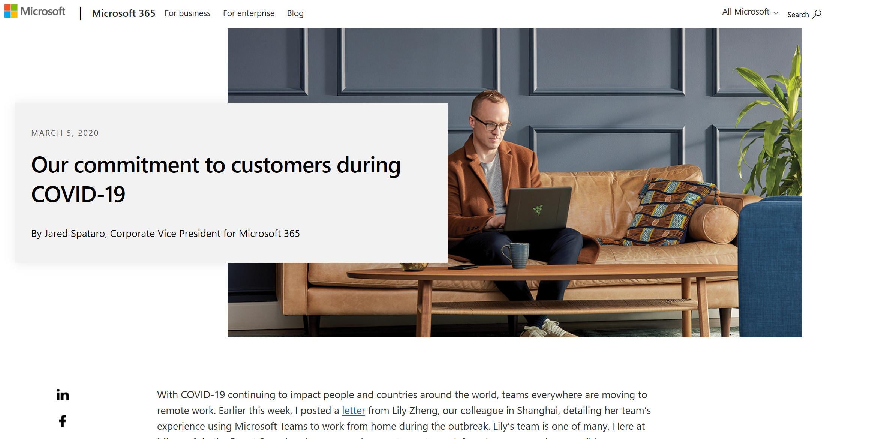
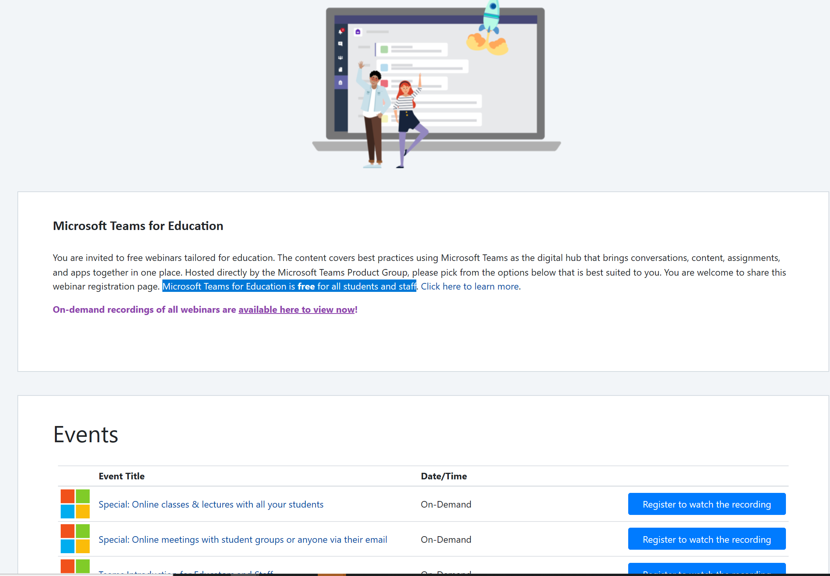
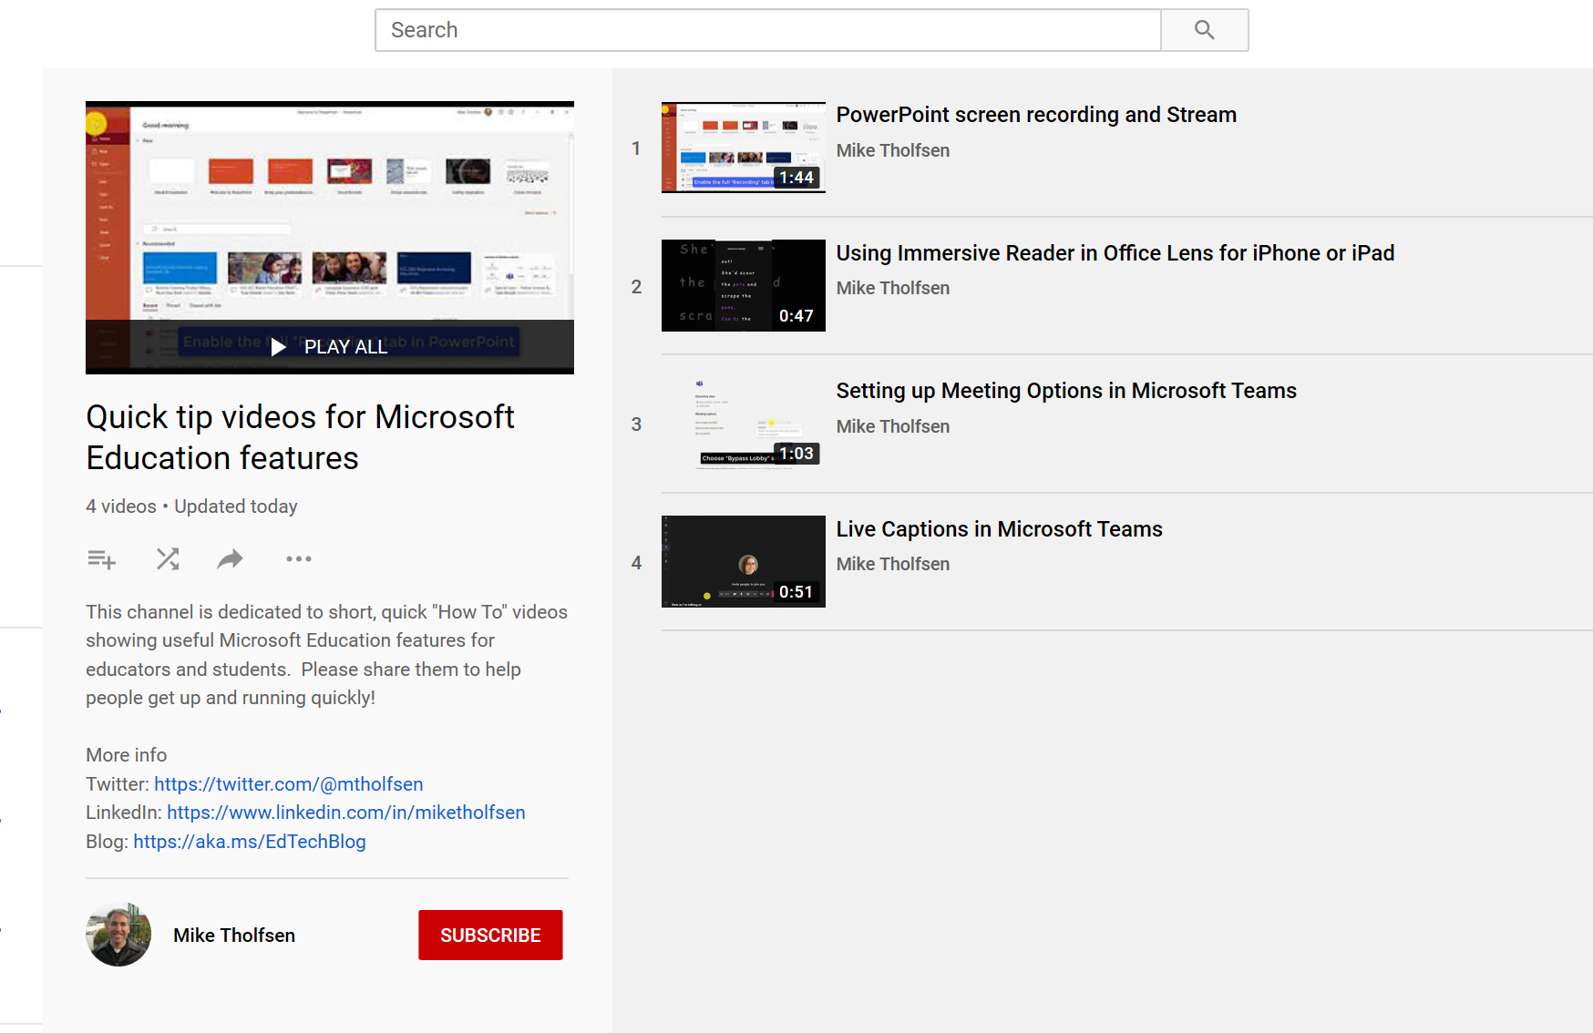
Microsoft Teams University
On-line course specific to Higher Ed
Guides, Videos, and Resources
for Educators Students, Researchers; Microsoft Teams for Education is free for all students and staff.
Collaborate faster using Microsoft Teams for higher education staff; Free on-line course in Microsoft Educator Center Estimated duration: 1 hour
Microsoft
COVID-19 Response
Office Tips for Remote Learning
Microsoft Teams for Education
Education-specific
Webinars including
“Online classes and Lectures with all your students”, and “Online meetings with student groups, or anyone with their email”
Resources for Remote Learning
Snack Videos on YouTube with tips for using MS Office in remote learning scenarios. Duration: 2 Mins each

Slide 23
Upcoming AAC&U Webinars
Tuesday, March 31, 2:00-3:00 p.m.
Supporting Non-Tenure-Track Faculty: Innovative Campus Models
More information online at
www.aacu.org/events/webinar
All webinars are in US Eastern Time. All webinars will be recorded.
Webinar recordings are available online a few weeks after the webinar.

Slide 24
Thank You & Be Well!

Slide 25
Safeguarding Quality, Equity, and Inclusion as Learning Moves Online
AAC&U Webinar Series
March 27, 2020

