Slide 1
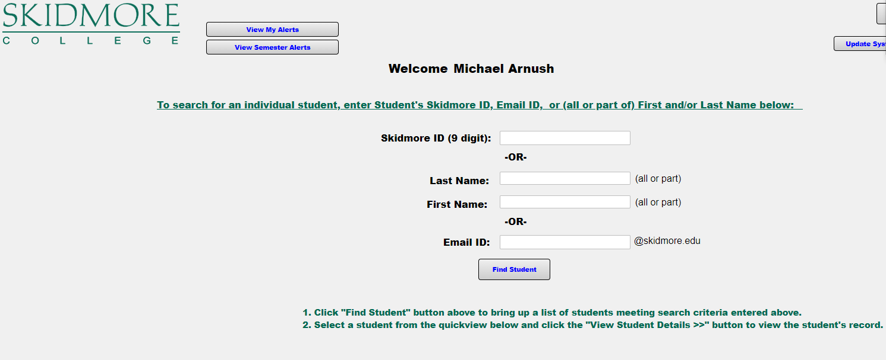

skidmore.edu/advising/academic-alerts

Slide 2
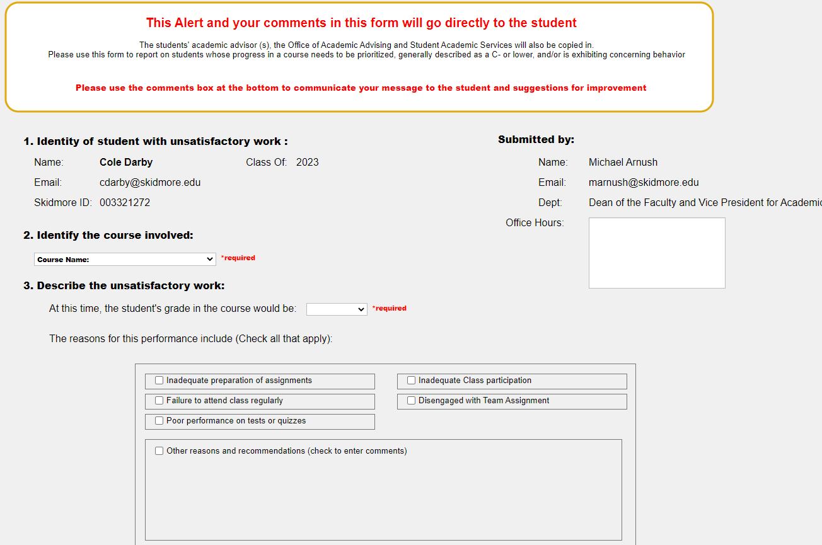

Slide 3
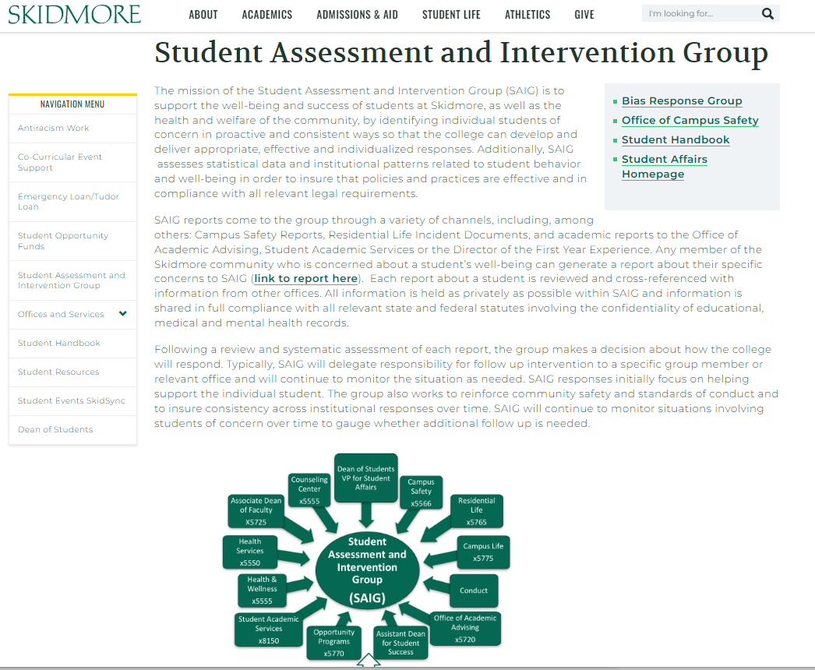
skidmore.edu/dean-students/saig.php

Slide 4
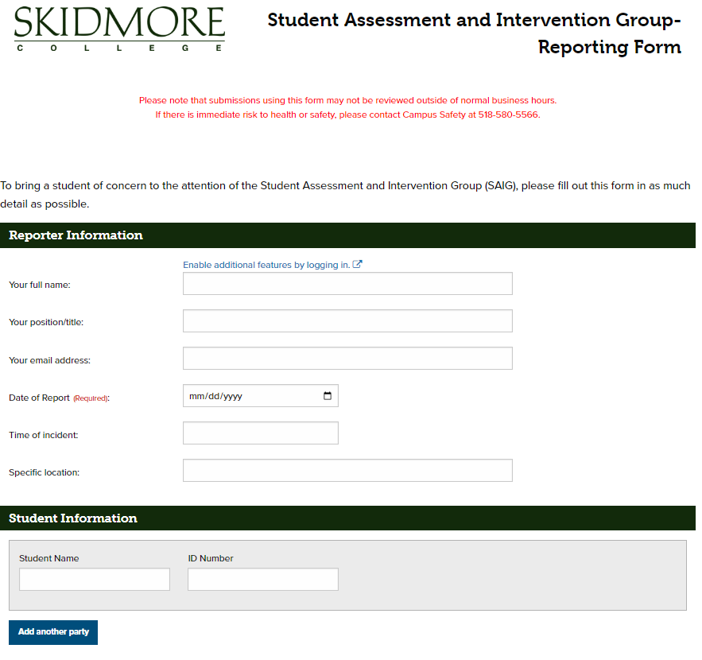

Slide 6


