Slide 1
Preliminary Budget Update
March 3, 2023

Slide 2
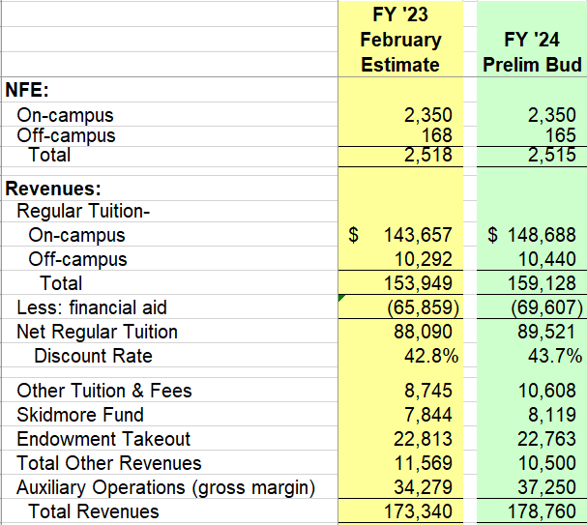
Preliminary FY’24 Budget – Revenue Detail

Slide 3
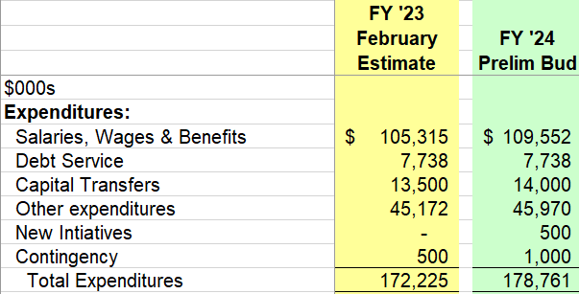
Preliminary FY’24 Budget – Expense Detail

Slide 4
Above/Below the line
Operating revenue and expense
  On going year after year operational revenue and expenses
    Tuition
    Endowment Income
    Salaries
    Utilities
    Debt Service
Surplus
  One time expenses
    Capital / infrastructure renovation
    Equipment
    Computer hardware
    Reserves

Slide 5
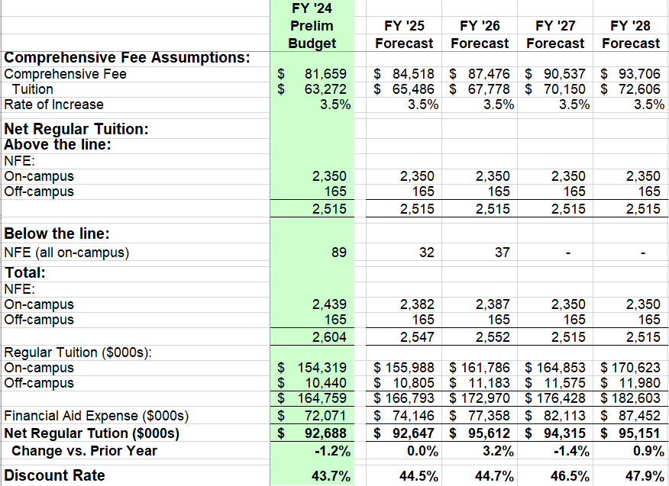
Preliminary Net Tuition Revenue Summary

Slide 6
Forecast Model Parameters ($000s)

Slide 7
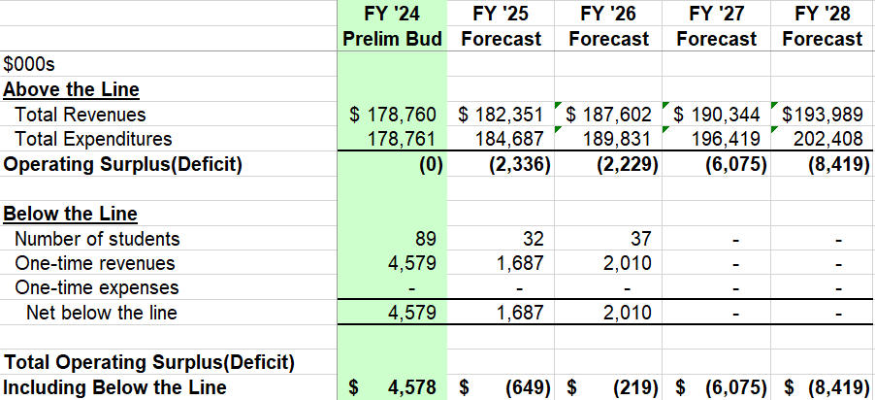
Forecast Model Budget Summary

Slide 8
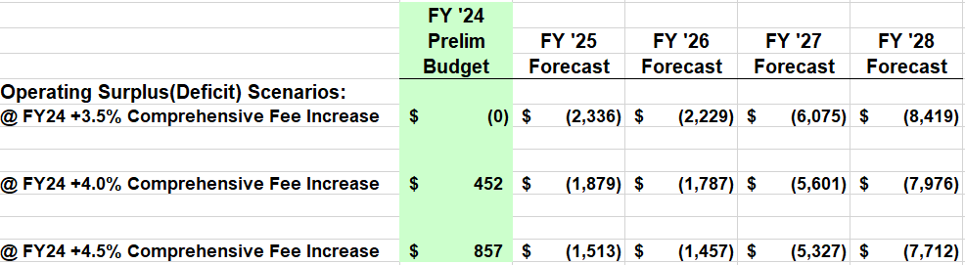
Operating Budget Impact of
FY ‘24 Comprehensive Fee Increase Assumptions

Slide 9
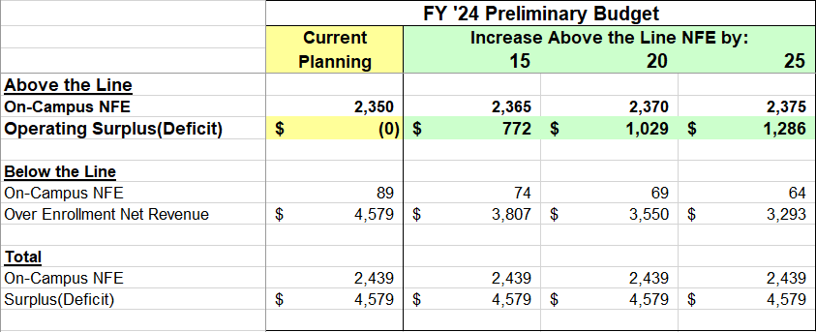
Operating Budget Impact of
FY ‘24 Budgeted NFE Assumptions

Slide 10
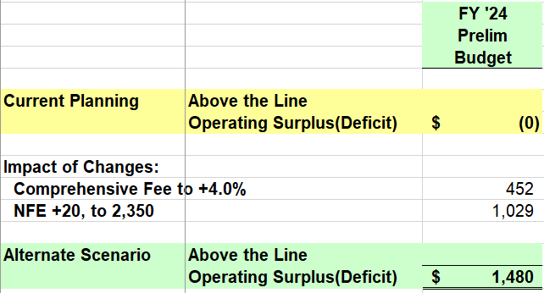
Operating Budget Impact of
FY ‘24 Comprehensive Fee to +4.0% and NFE to +20

