Slide 1
The Shifting Enrollment Landscape
February 2024

Slide 2
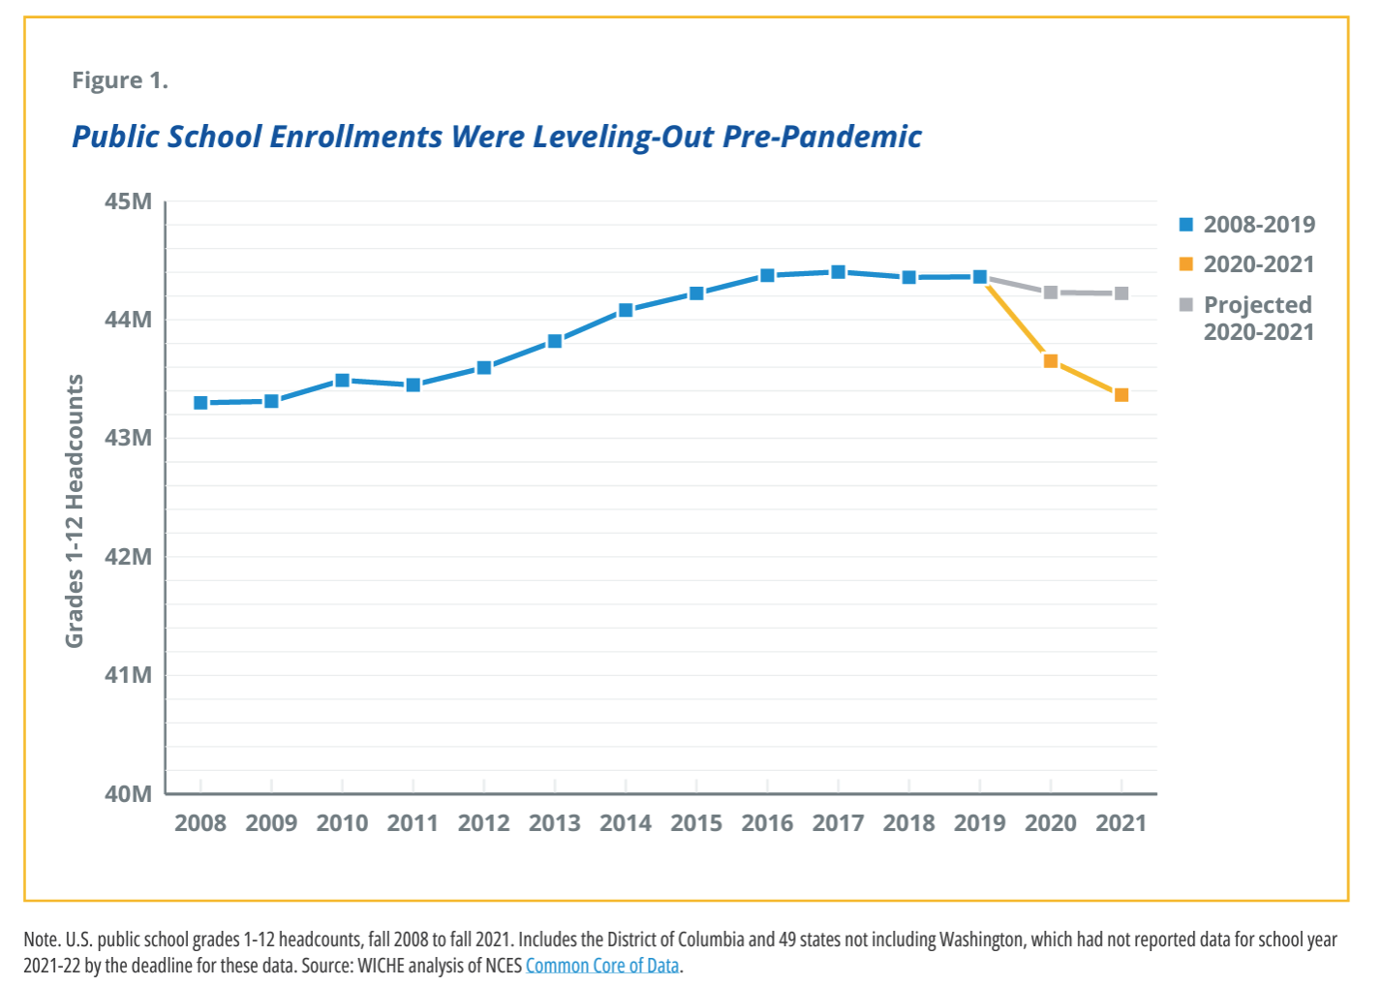
Changing Domestic Demographics
Source: WICHE How the Pandemic Compounds Education Pipeline Challenges, 2023

Slide 3
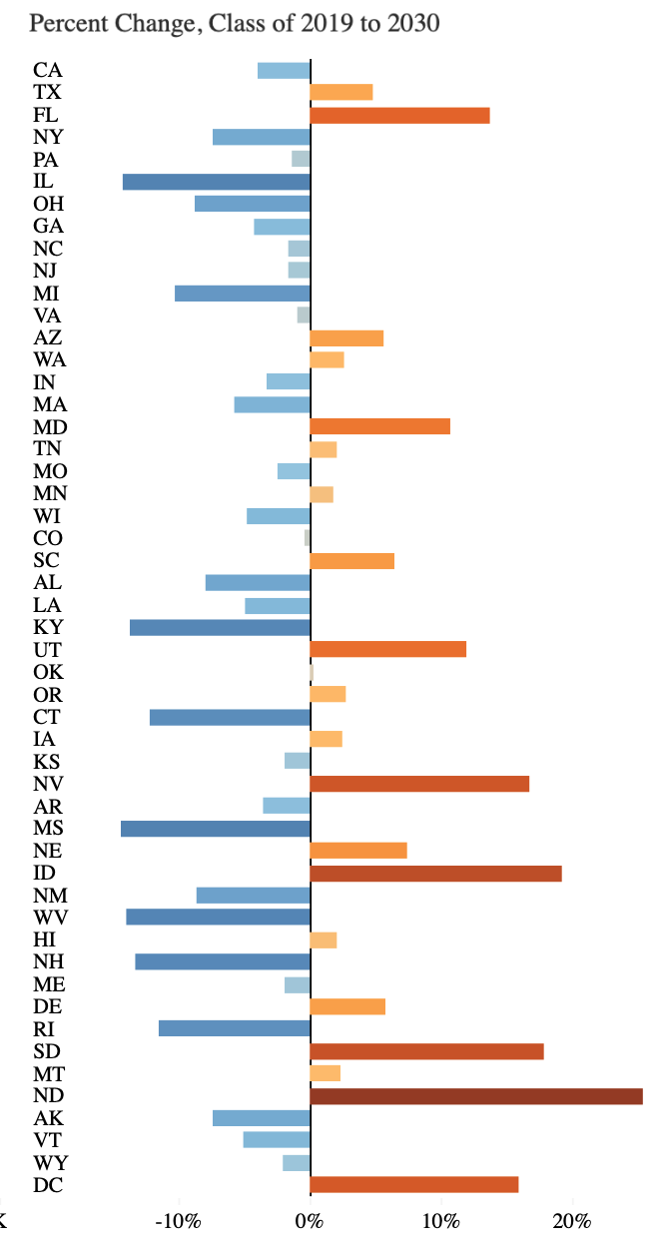
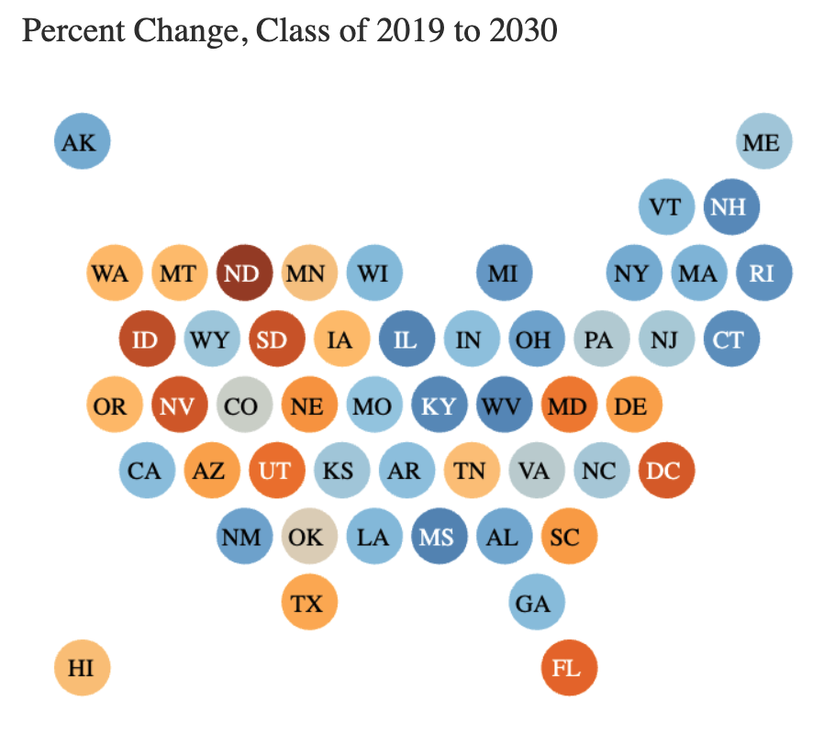
Changing Domestic Demographics
Source: WICHE Knocking at the College Door 2020, 10th Edition

Slide 4
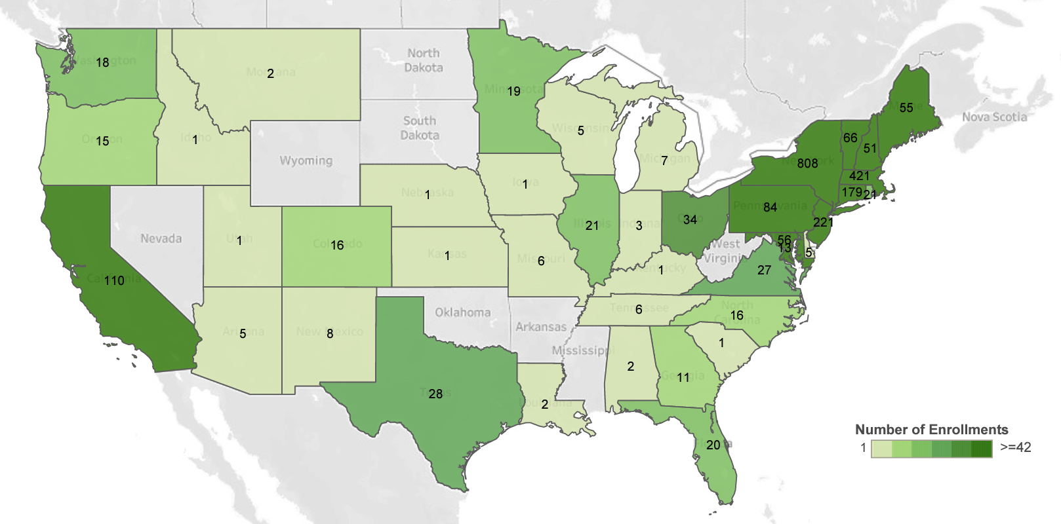
Changing Domestic Demographics
Source: Skidmore Factbook 2022-2023

Slide 5
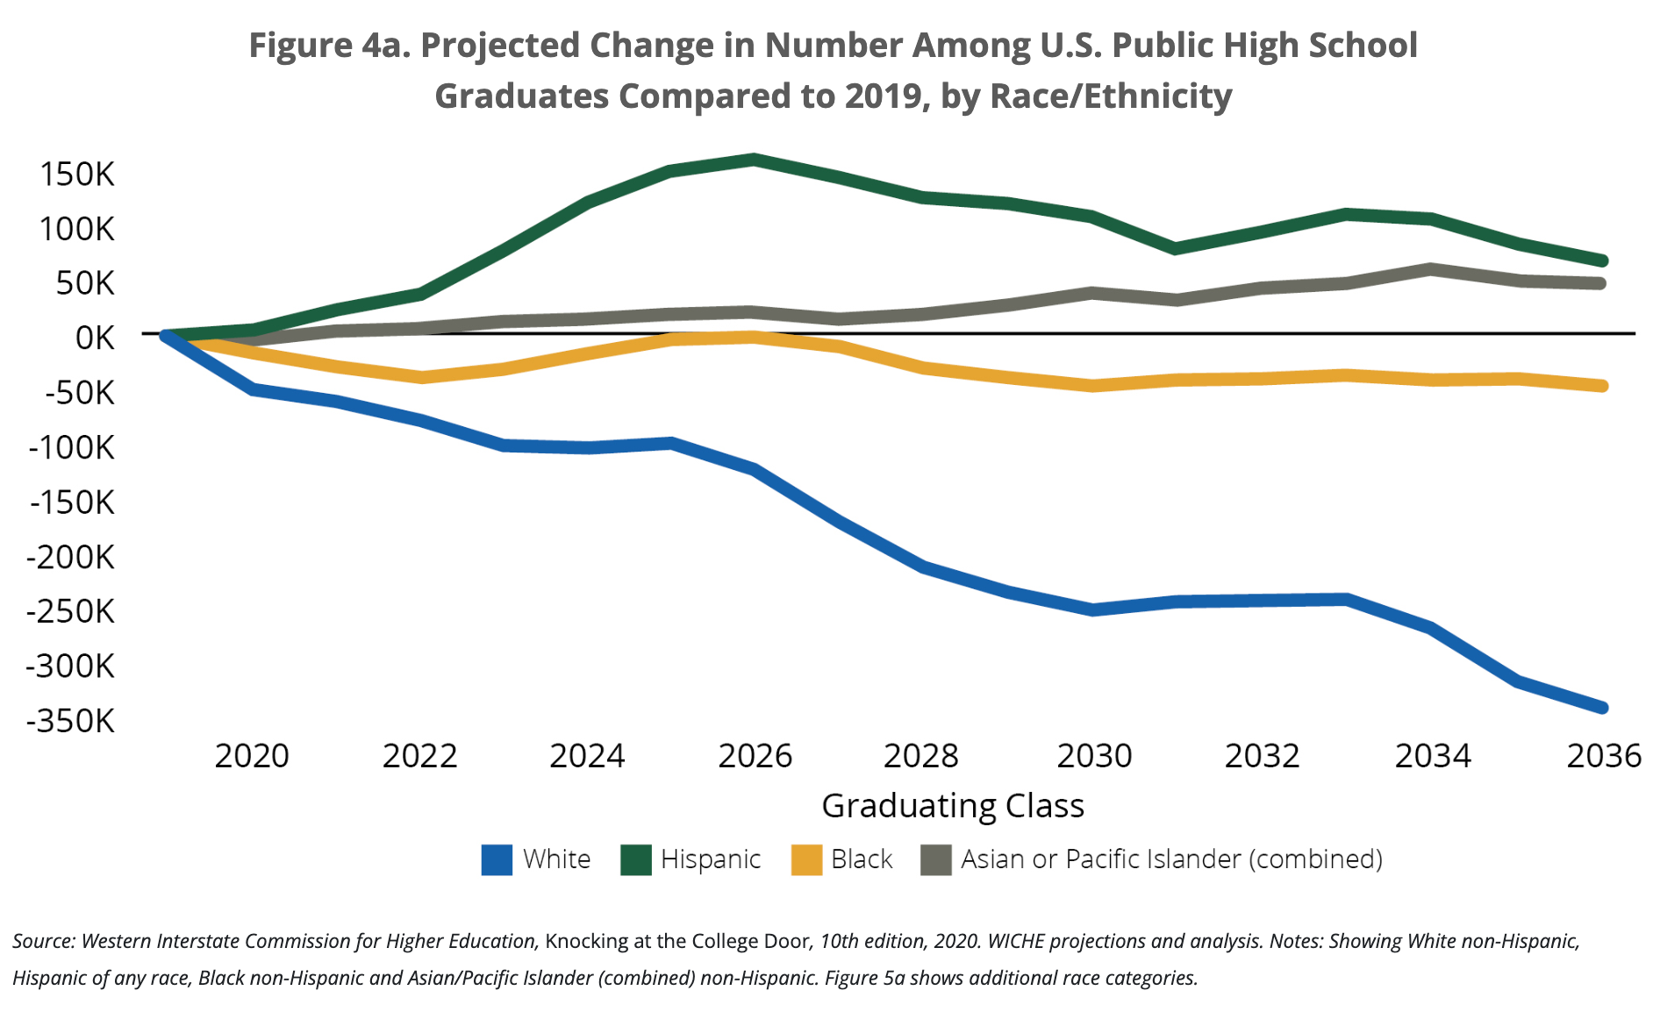
Changing Domestic Demographics
Source: WICHE Knocking at the College Door 2020, 10th Edition

Slide 6
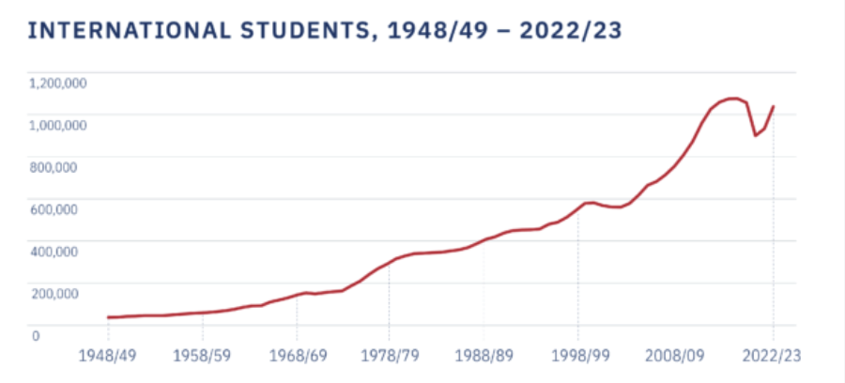
Shifting Global Demand
Source: IIE Open Doors Enrollment Trends, 2023

Slide 7
Increased Financial Need

