Slide 1
Strategic Resources
What is Skidmore’s Financial position, now and in the future?
How do we align our future-oriented strategic priorities with a shared understanding of our financial reality?

Slide 2
Above the Line Budget/Forecast Results ($ in thousands)

Slide 3
How do we work together on the financial forecast and responses?
What I’ve been hearing:
Use existing shared governance structures as much as possible.
Communicate and share options as early as possible on major decisions and parameters.
Share options prior to the decision stage for input and collaboration.

Slide 4
Shared governance structure
IPPC sub committee on budget and finance: add +2 at-large faculty members (use FEC willingness-to-serve process) and +2 staff members (use staff willingness-to-serve process)
→ more voices, perspectives, suggestions
Regular meetings: 2x/month likely
Regular information and collaboration sessions with employee community: late September and early November

Slide 5
What is the Road Map for Skidmore’s future?
What do we want to do? And what can we afford to do?
We continue in a growth mindset — but the headwinds and constraints in our industry are significant.
There will be tradeoffs:
“We can do anything we want; but we cannot do everything we want.”
This work can only be done well if we do it together.
That is a shared commitment.

Slide 6
Strategic Planning:
What’s been done, what lies ahead?
Many meetings and discussions this year: Extended Cabinet, IPPC, Board, faculty and staff meetings, President’s Leadership Council
Outreach and shaping input to come:
Focused discussions this spring, sharing collected feedback in the fall, opportunities for more faculty, staff, and student input throughout next year, possibly surveys or facilitator engagement
The major dates: finished draft to BOT at the February 2025 meeting, finished version for BOT approval at May 2025 meeting.

Slide 7
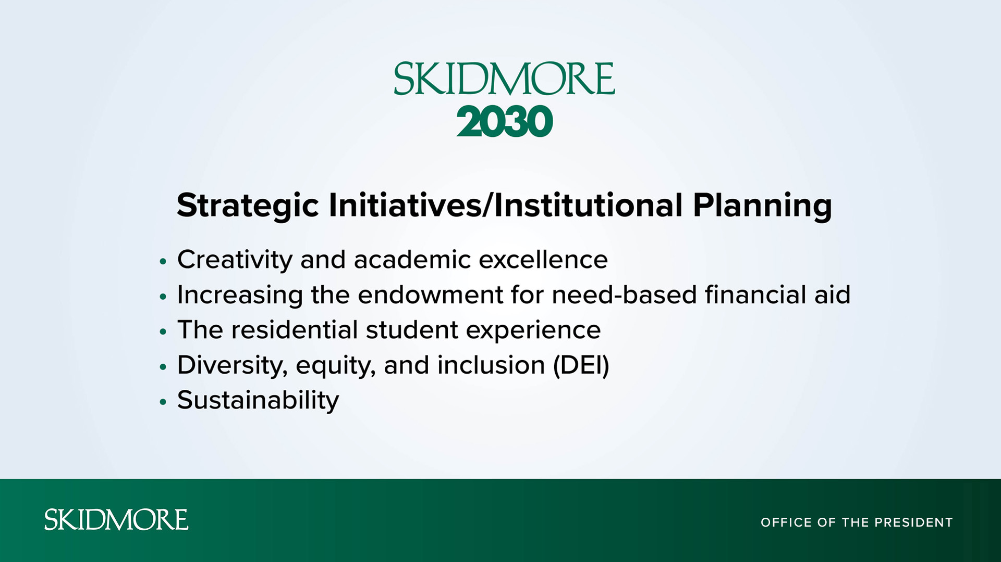

Slide 8
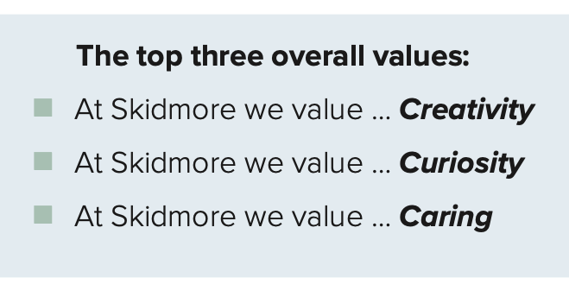
Visions & Values: Living our values survey results
The community was asked to consider and rate six values that emerged during our year-long conversations and from the first survey based on how accurately they felt each represented our community.

Slide 9
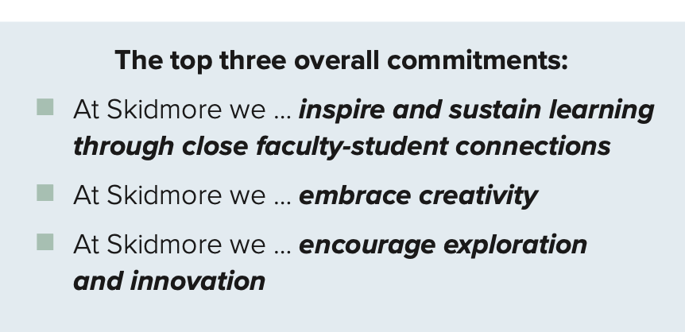
Visions & Values: Shaping our visions survey results
The community was also
asked to consider and
rate eleven community
commitments that
emerged as themes
during our year-long
conversations and
from the first survey
based on how accurately they felt each represented our community.

