Slide 1
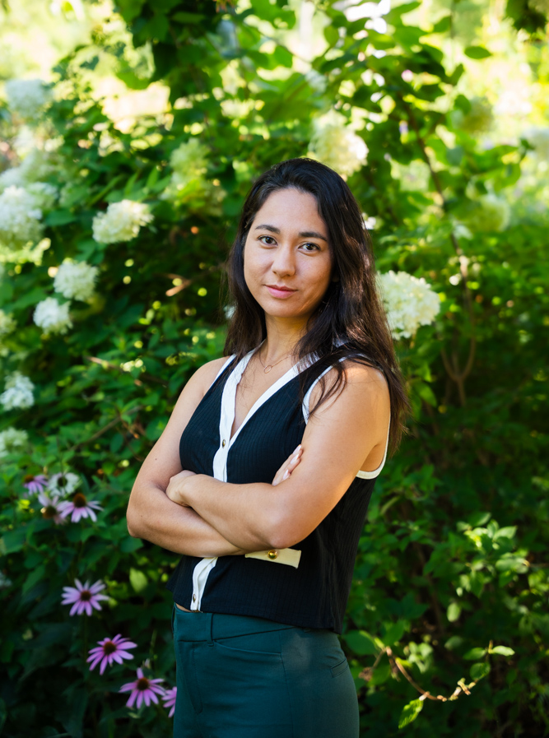


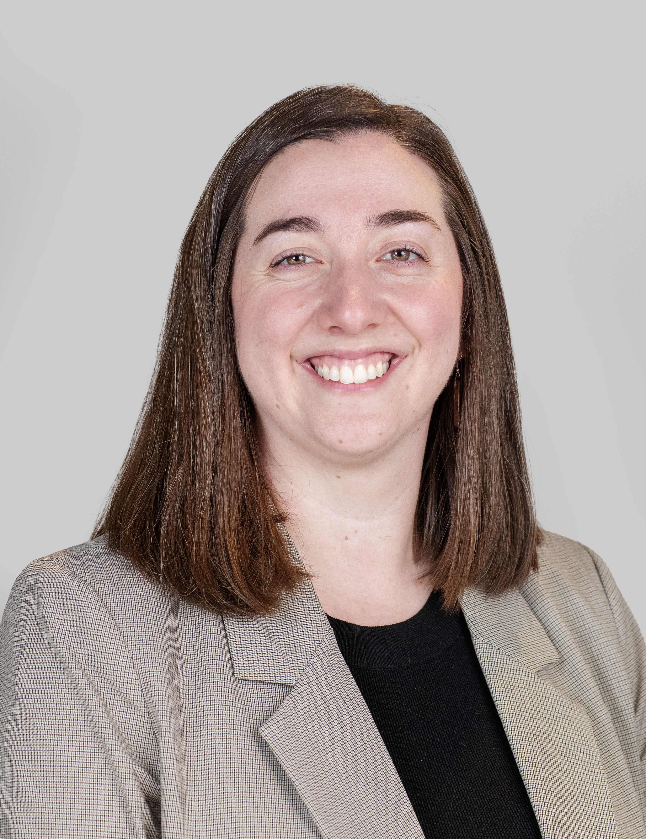
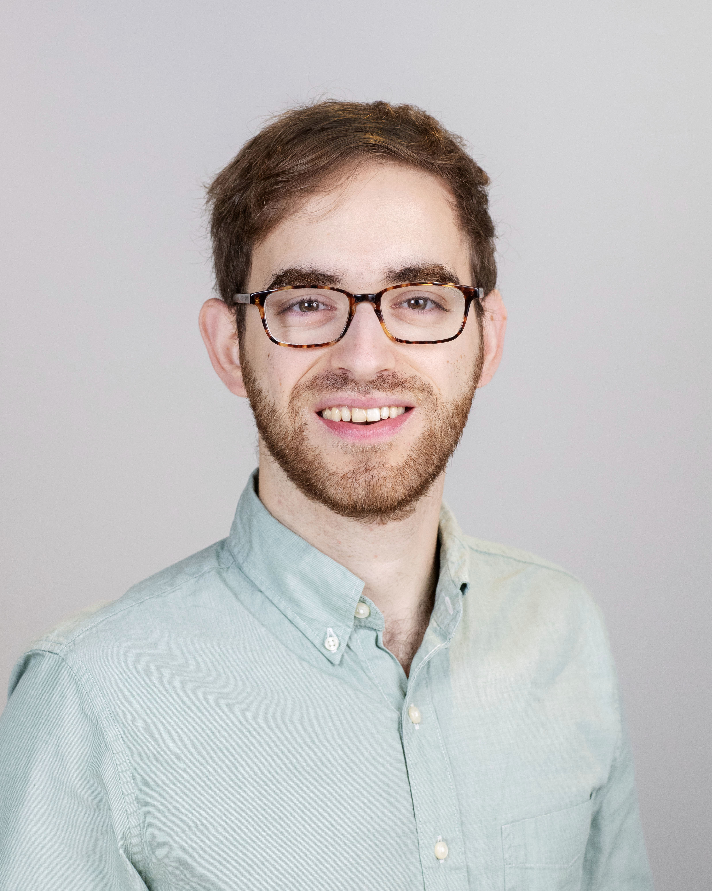
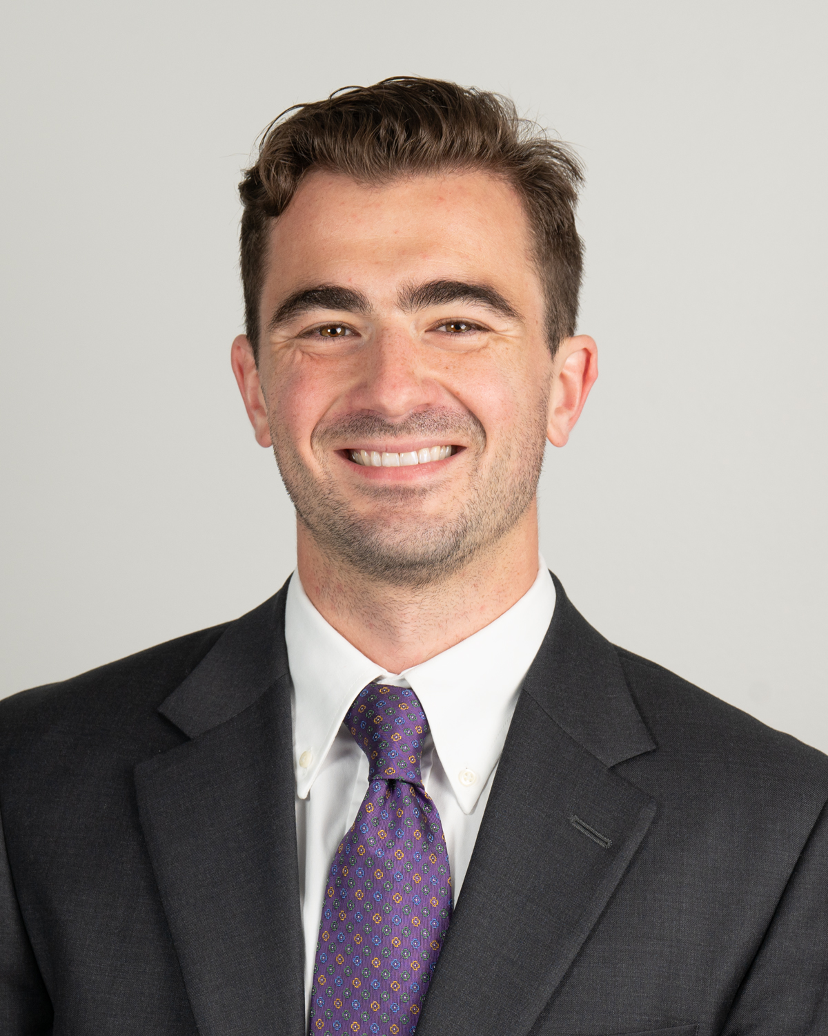
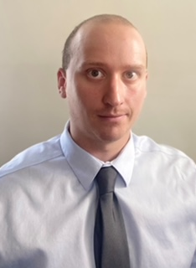
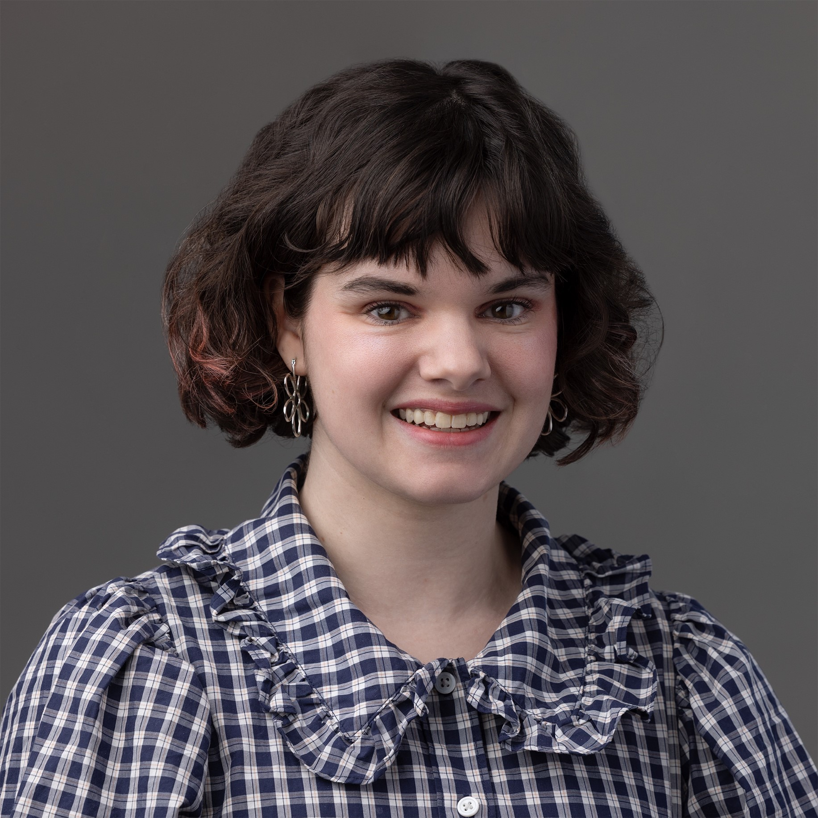
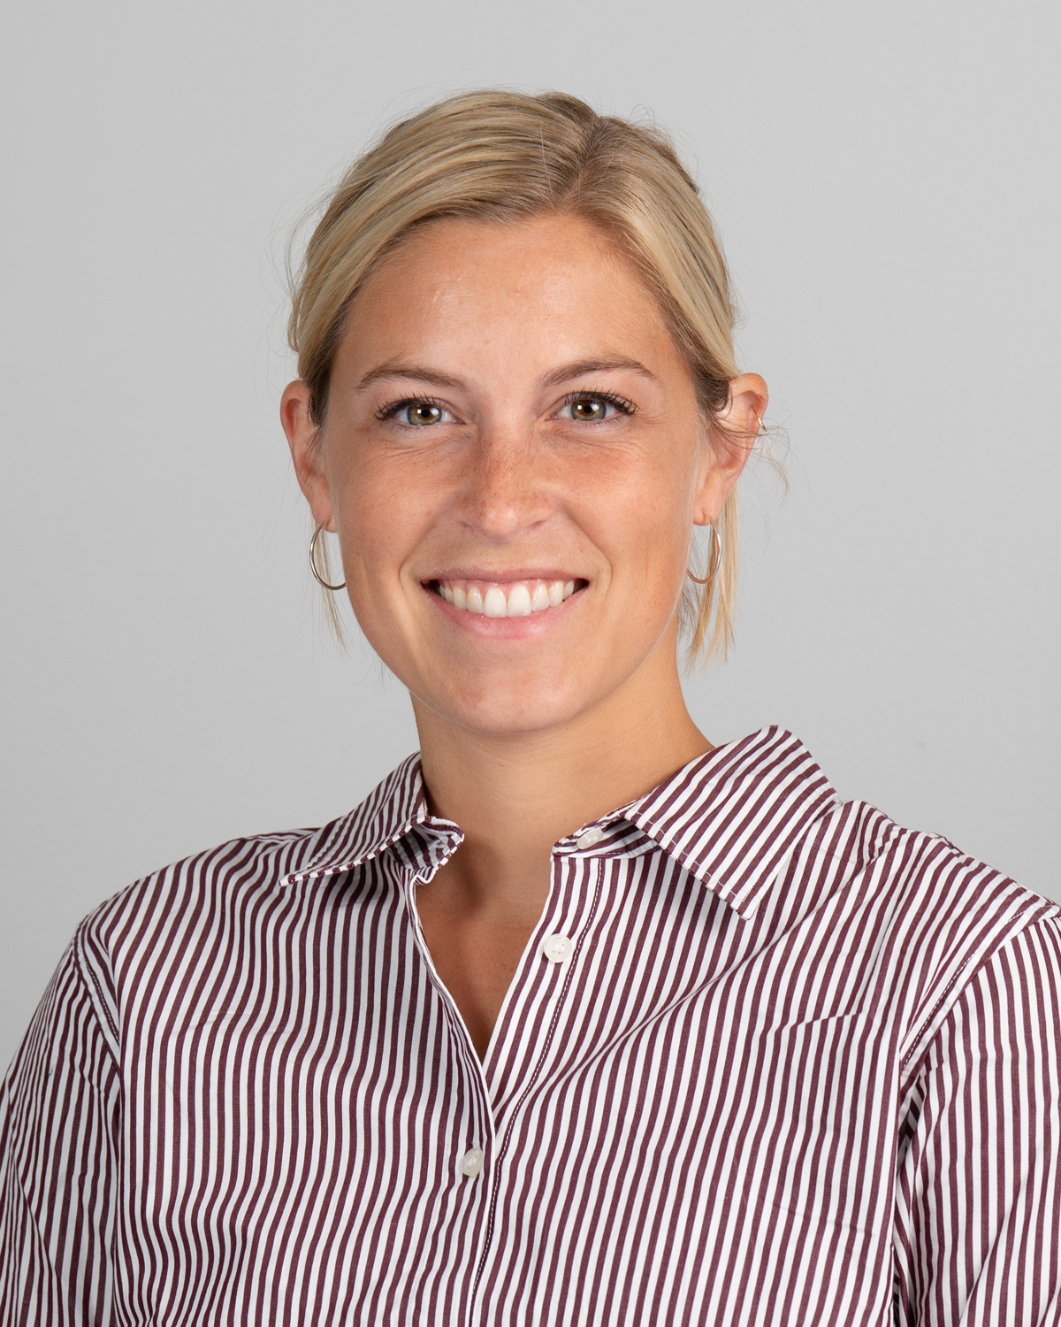
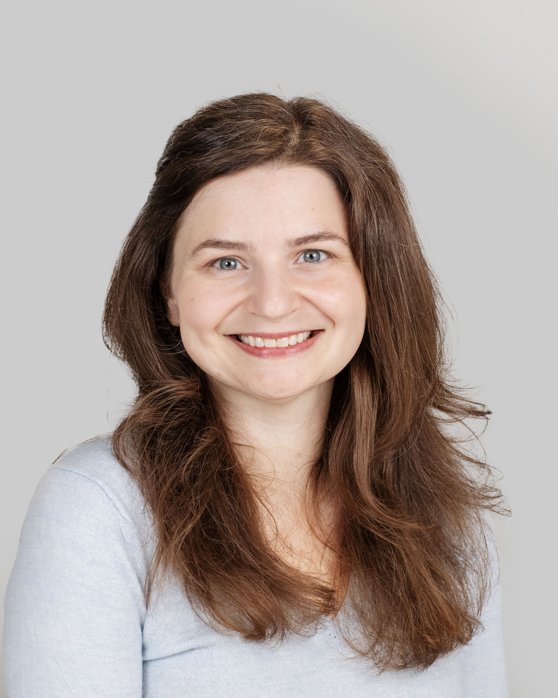
Anoush Hana Aghababian
Visiting Assistant Professor, Classics
Yujeong Ahn
Assistant Lecturer, Art
Jennifer Benaman
Assistant Lecturer, Environmental Studies and Sciences
Katie R. Billings
Assistant Professor, Sociology
Daniel S. Brandes
Assistant Professor, Chemistry
August Bruno
Visiting Assistant Professor, Economics
Christopher J. Cleary
Visiting Assistant Professor, Health and Human Physiological Sciences
Colleen Craven
Assistant Lecturer, Arts Administration
Emily de Wet
Visiting Assistant Professor, Anthropology
Elizabeth Greeniaus
Assistant Lecturer, English

Slide 2
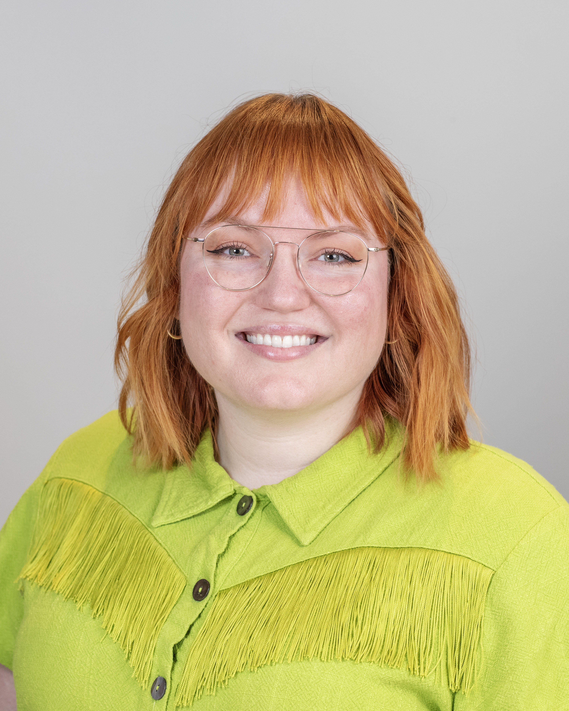
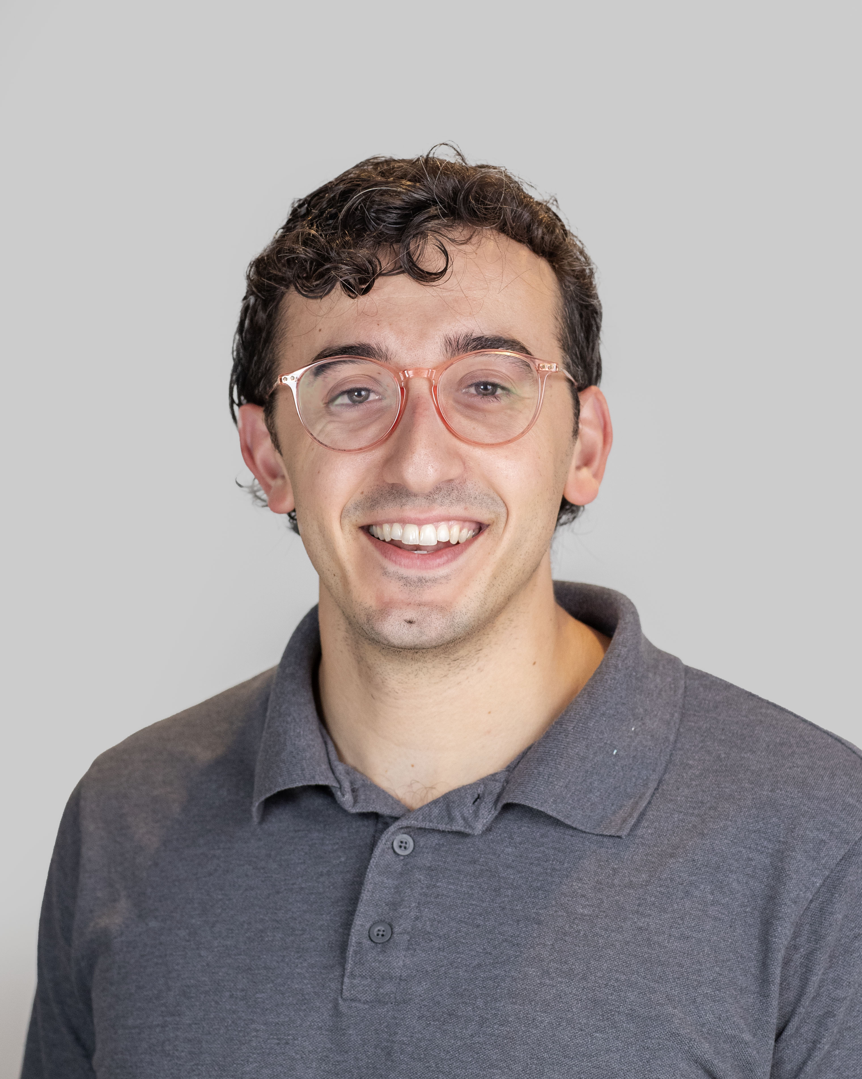
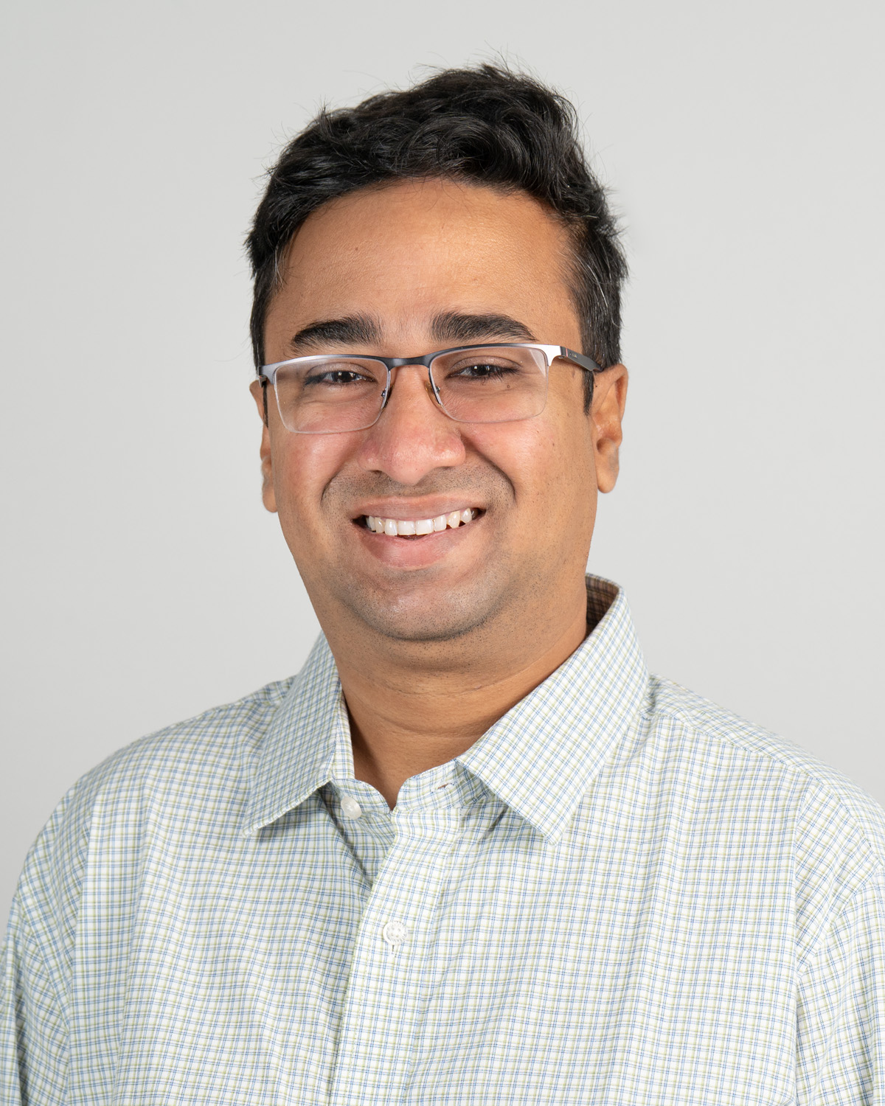
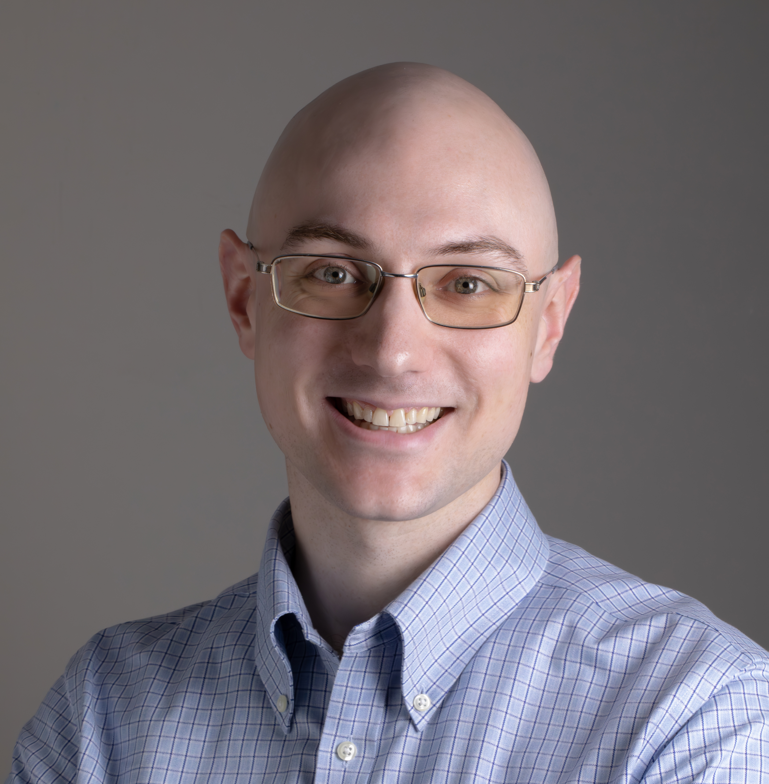
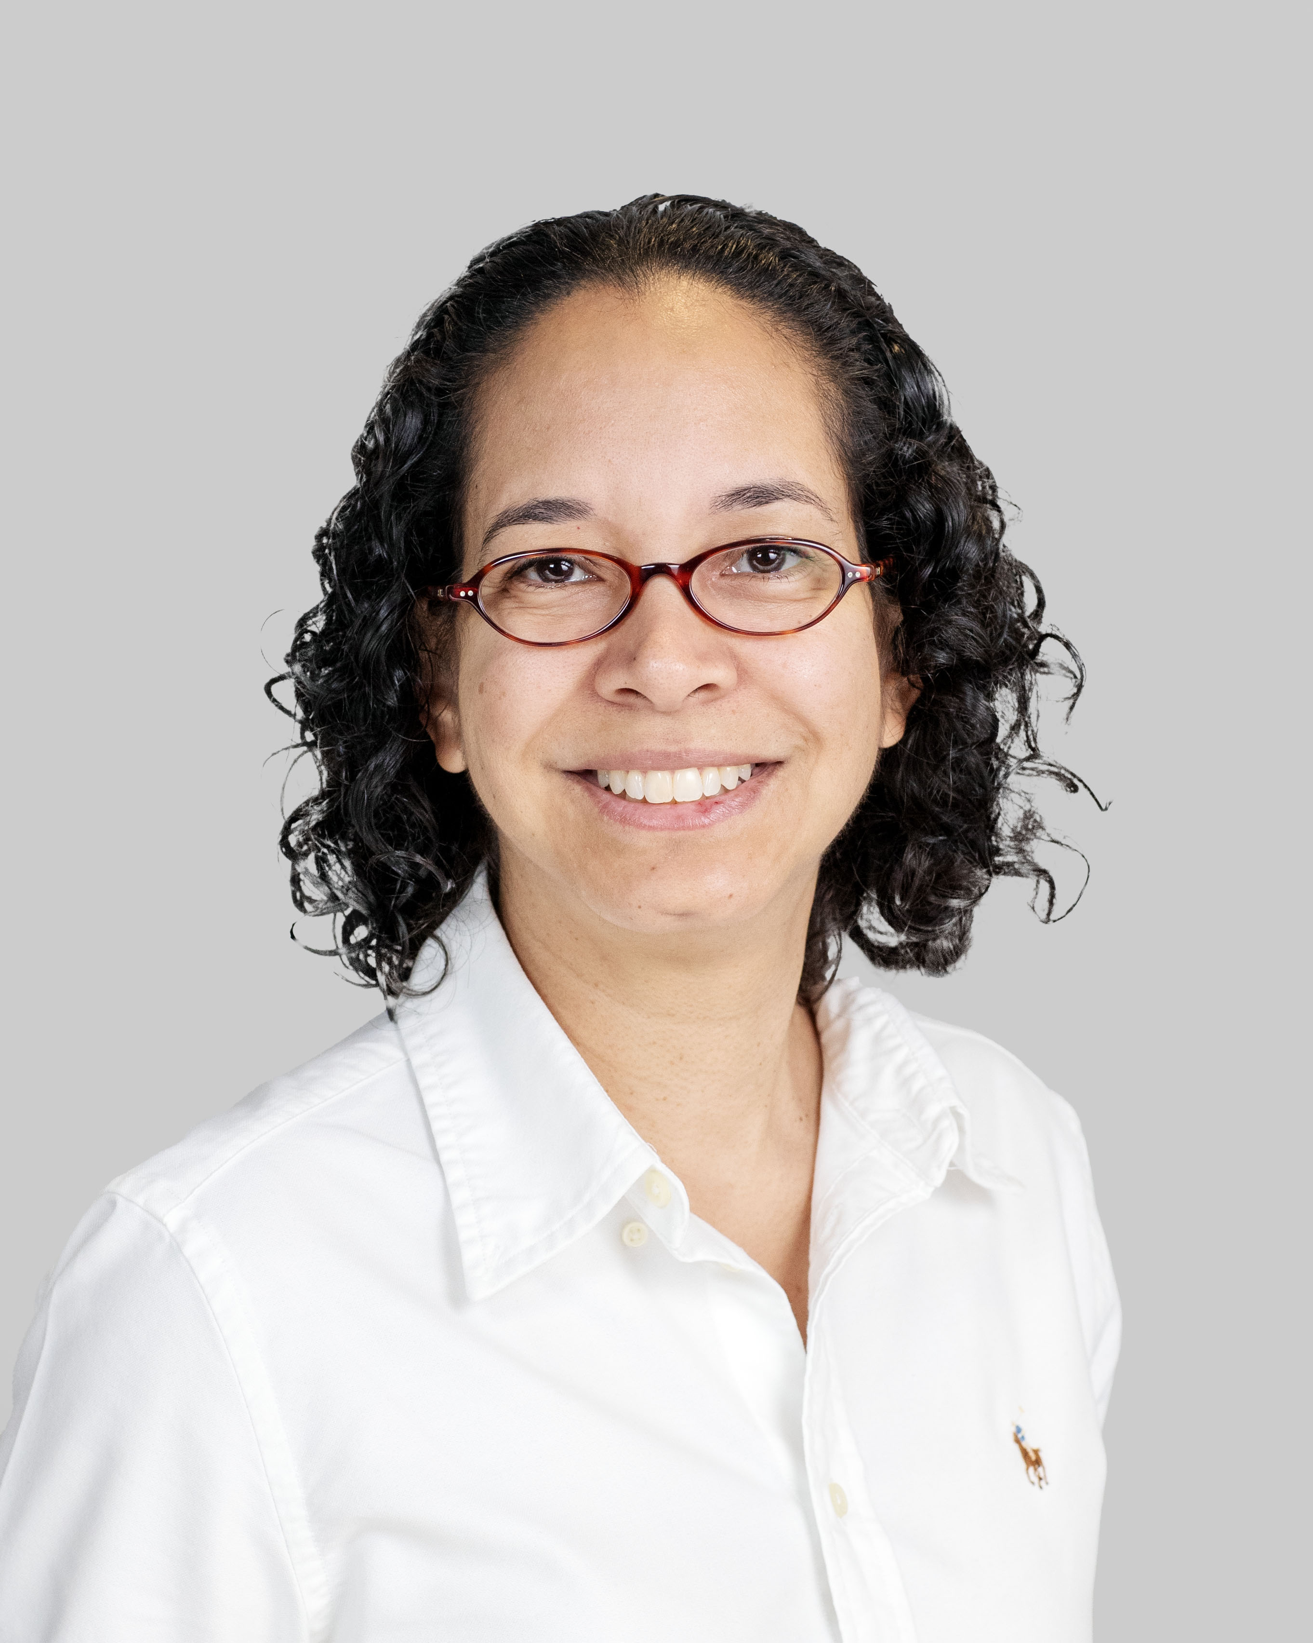
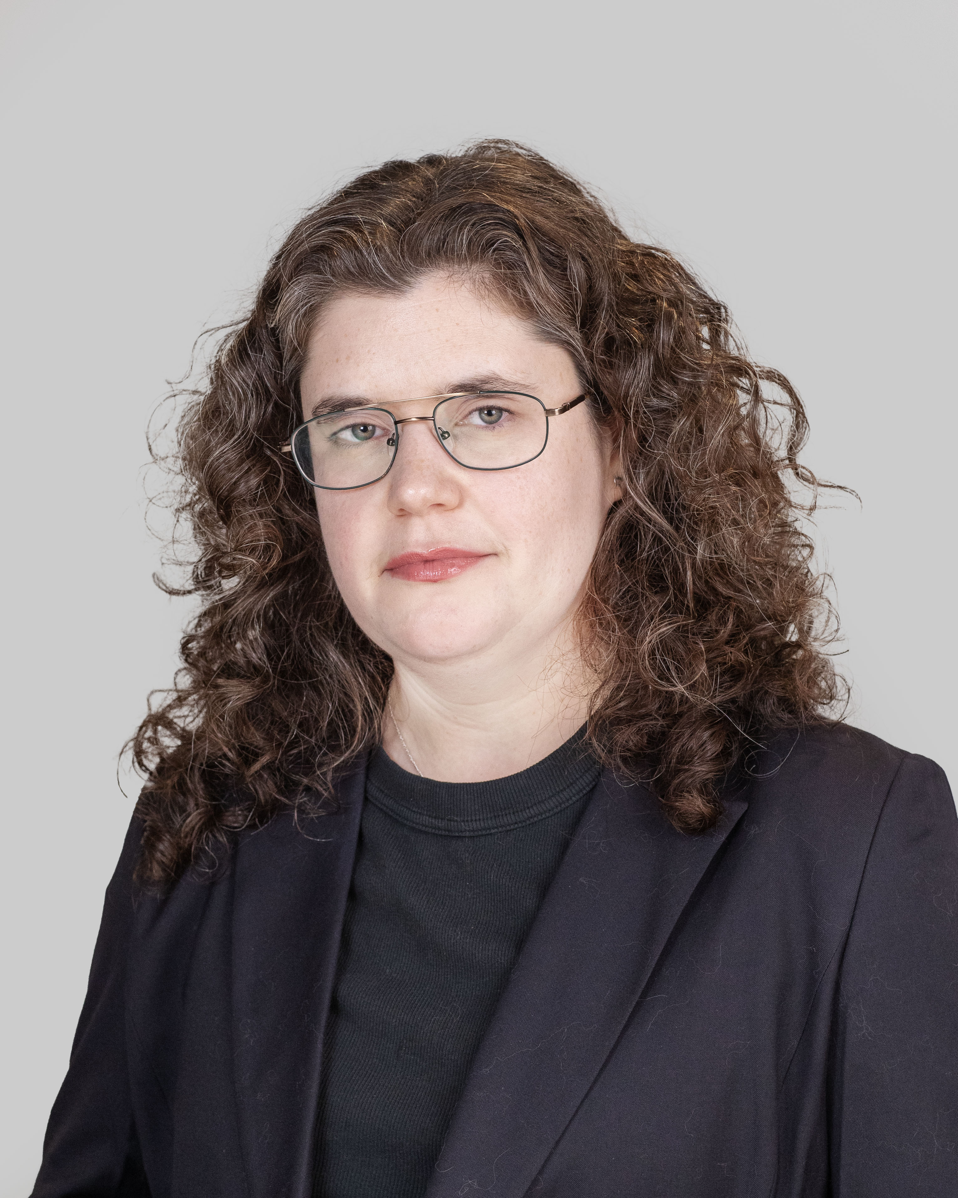
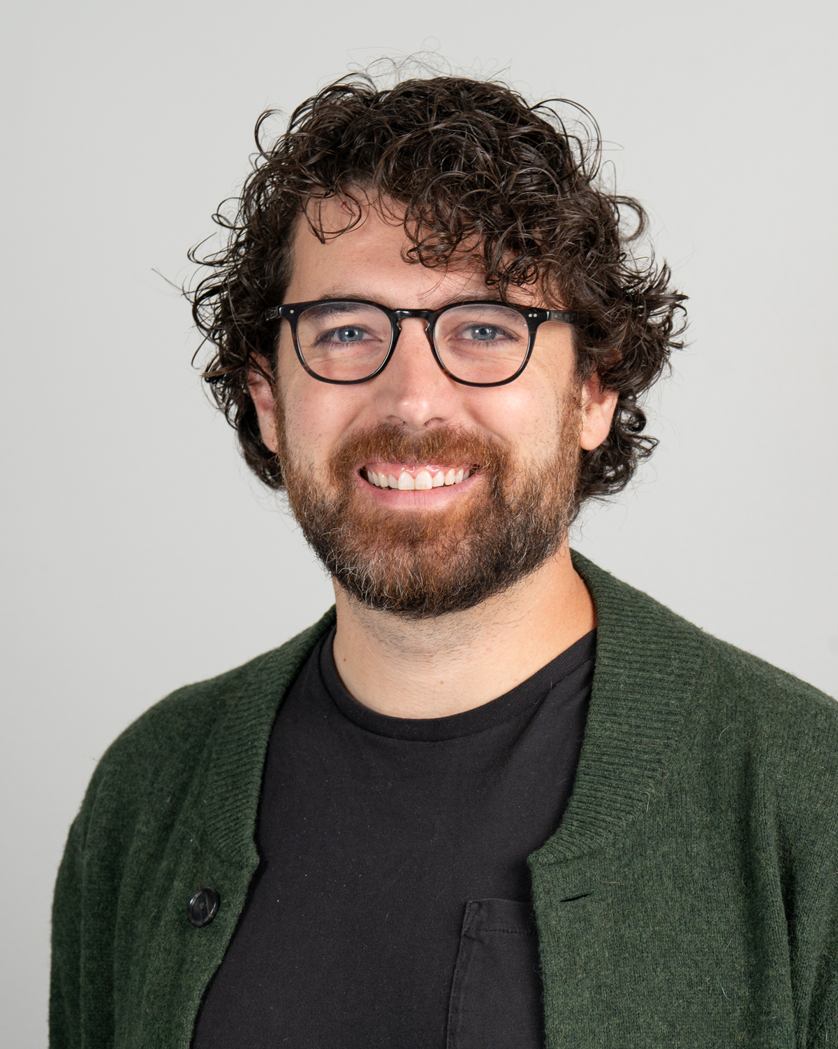
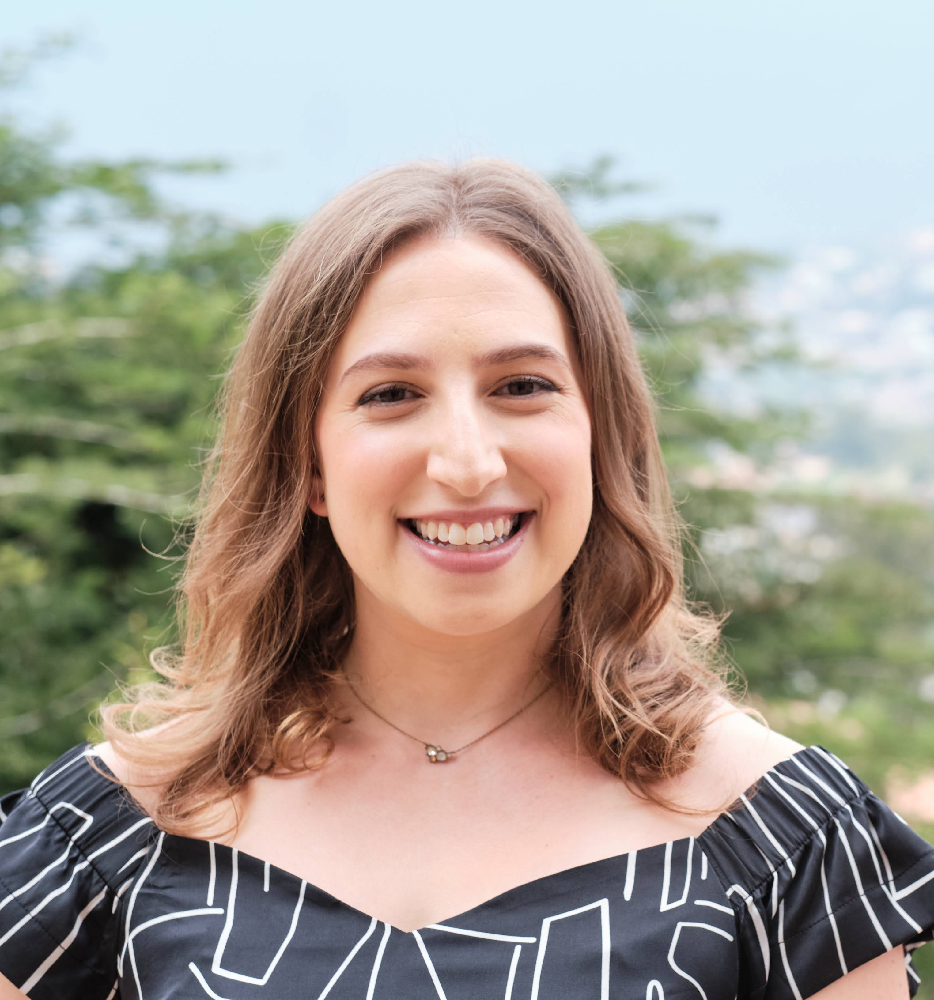

Katherine Grover
Visiting Assistant Professor, American Studies
Samuel Hawke
Assistant Professor, Mathematics & Statistics
Jillian N. Hirsch
Assistant Lecturer, Art
Duncan S. Keller
Visiting Assistant Professor, Geosciences
Mohammad Asif Hasan Khan
Visiting Assistant Professor, Economics
Talia Lieber
Visiting Assistant Professor, Art History
Violeta Lorenzo
Associate Professor, World Languages and Literatures
Sara Lyons
Assistant Professor, Theater
Michael Magliocca
Assistant Lecturer, Theater
William Mason
Associate Professor, Music

Slide 3
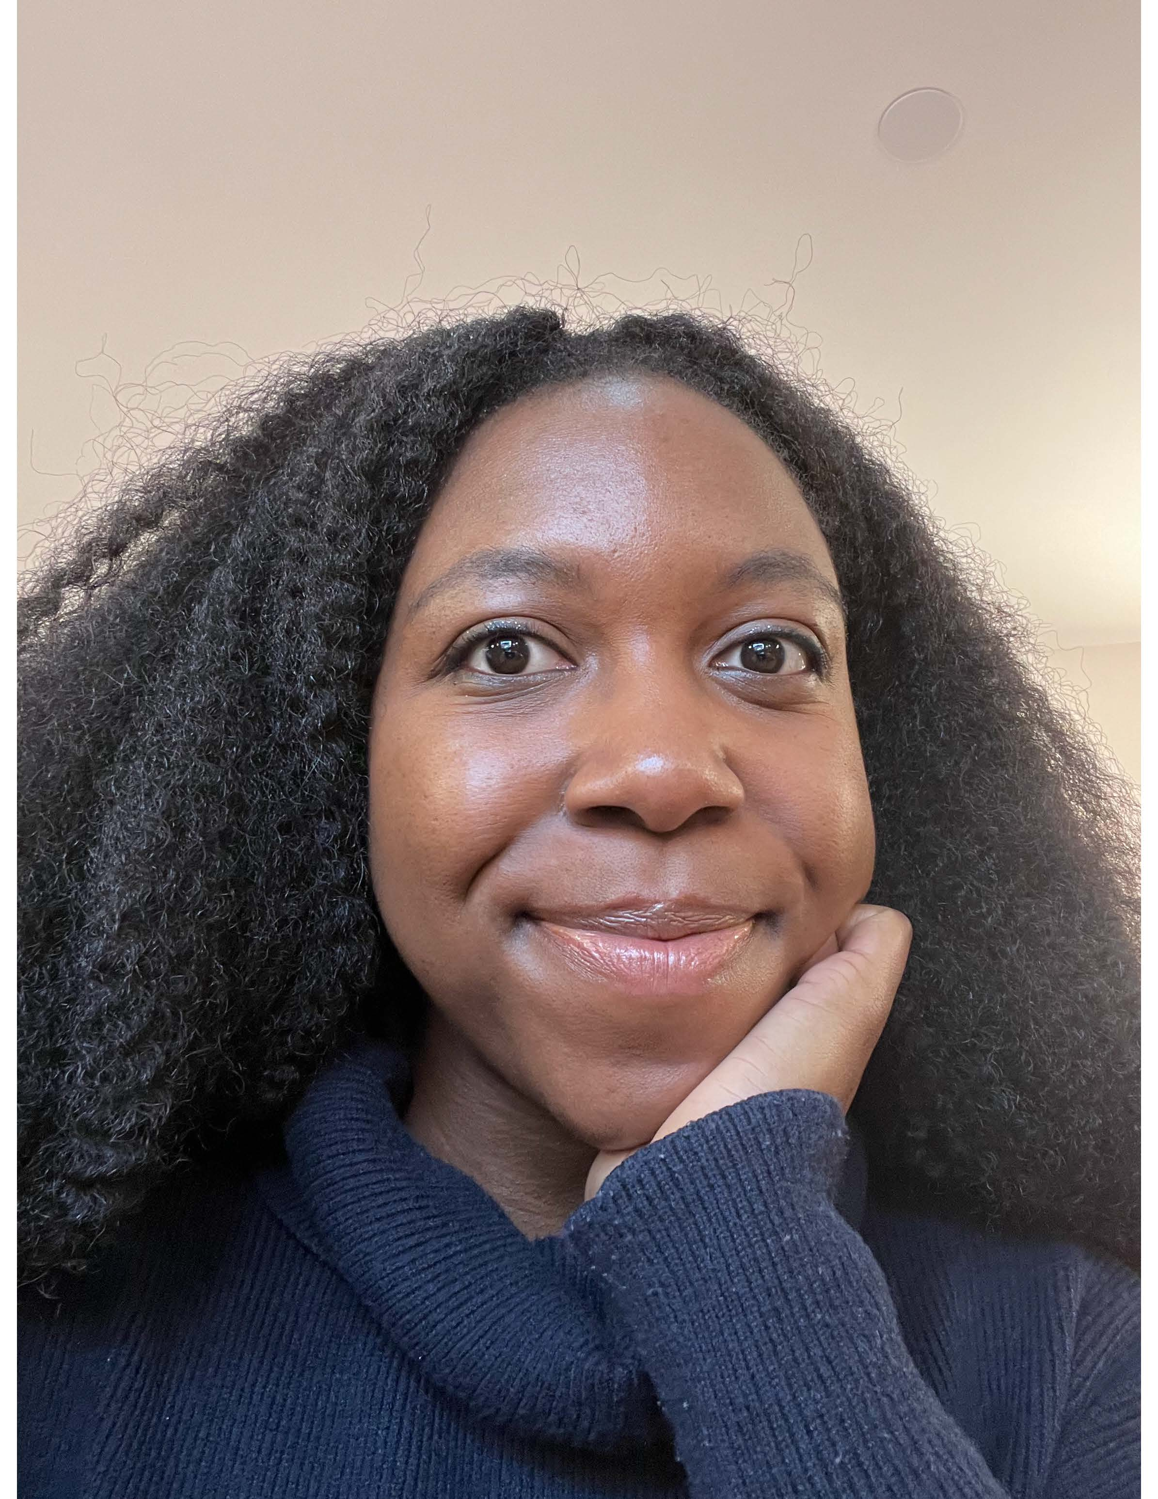
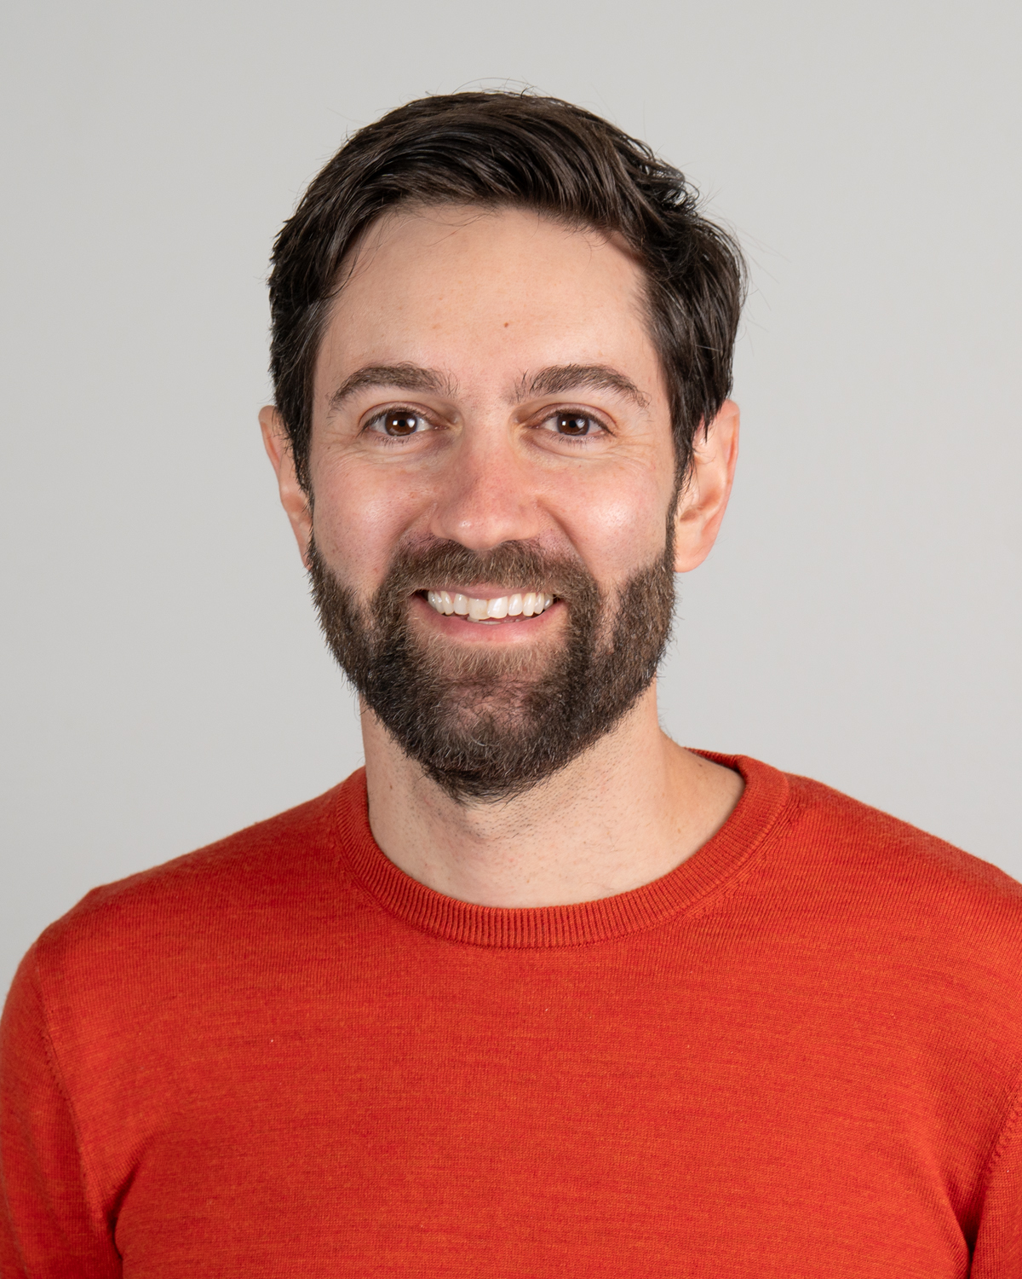
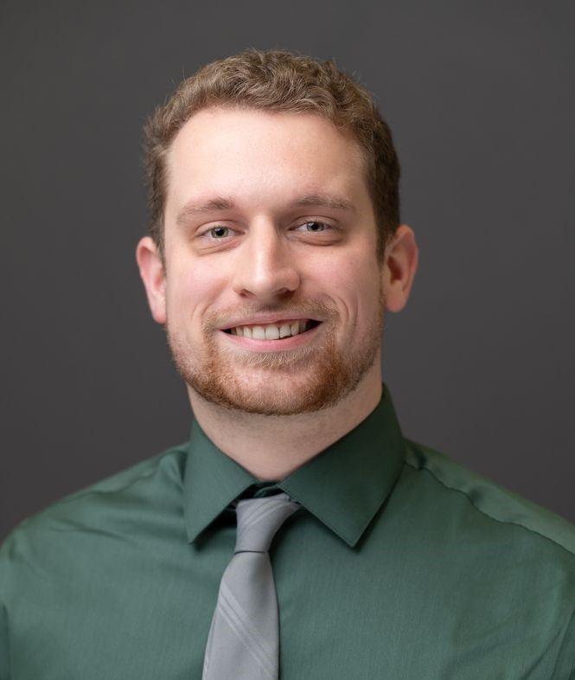
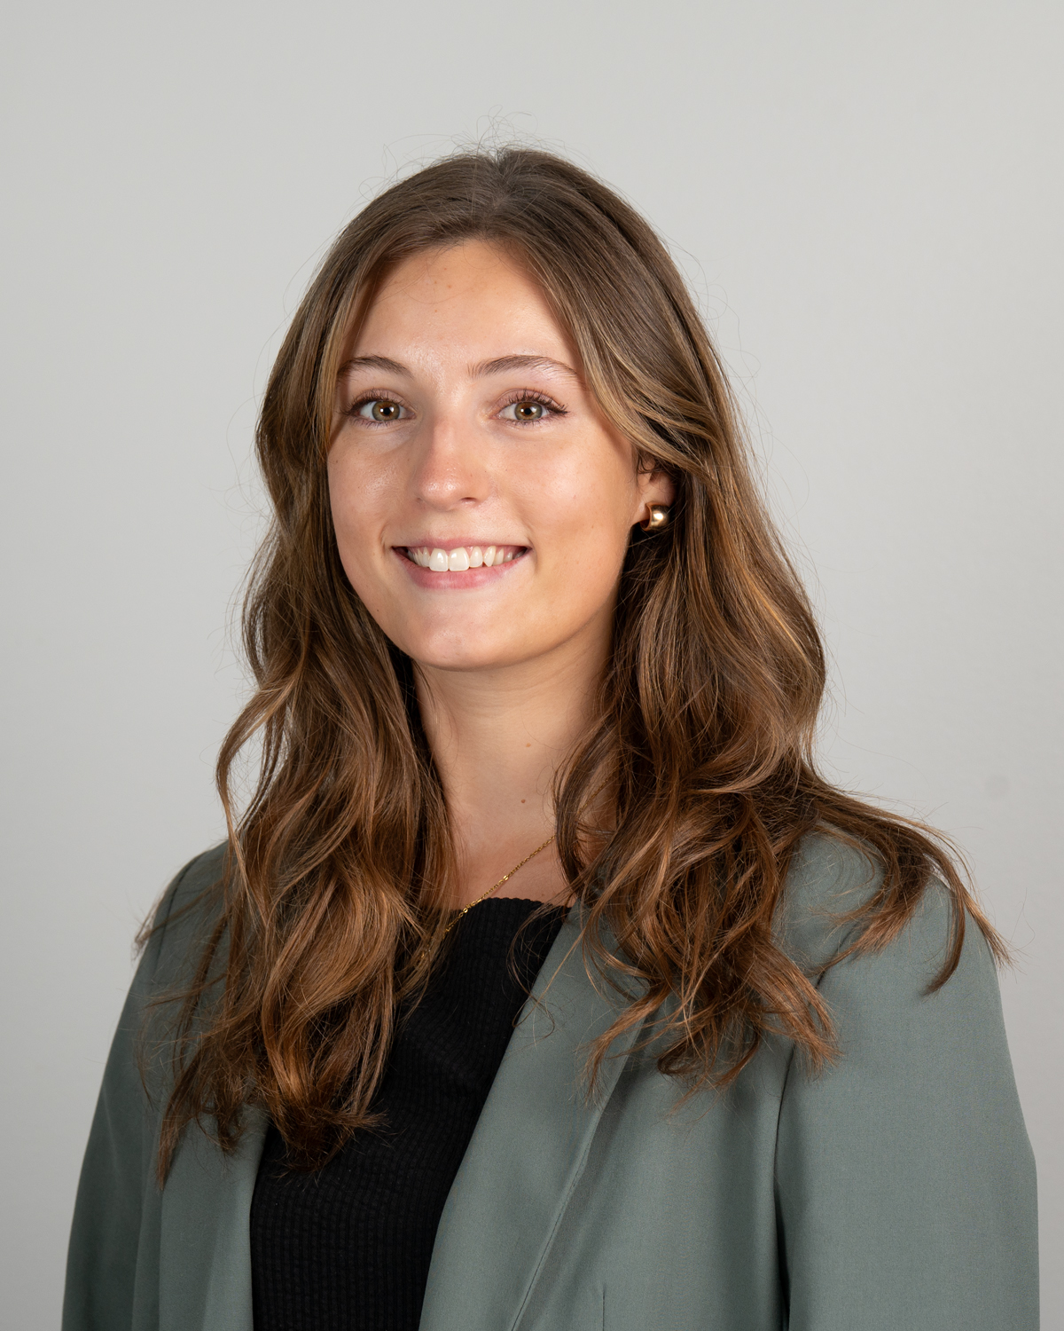
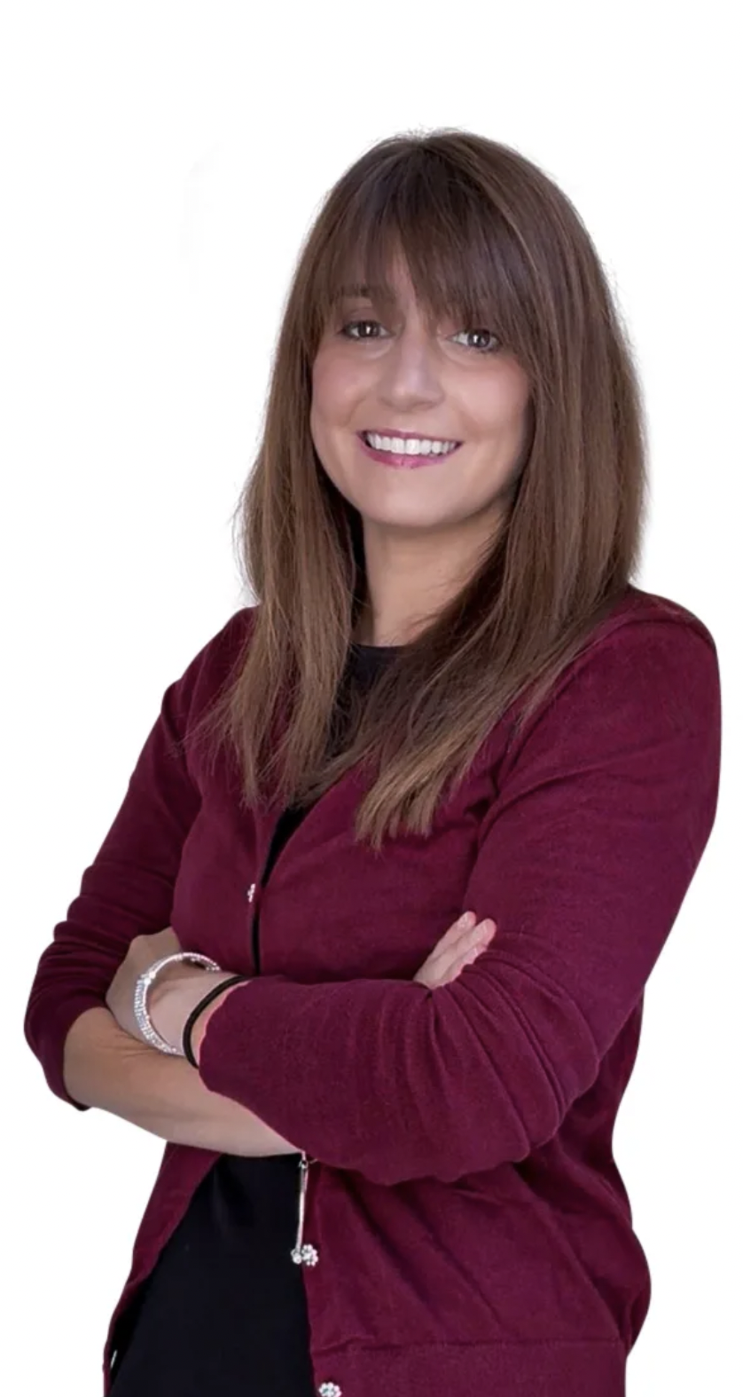
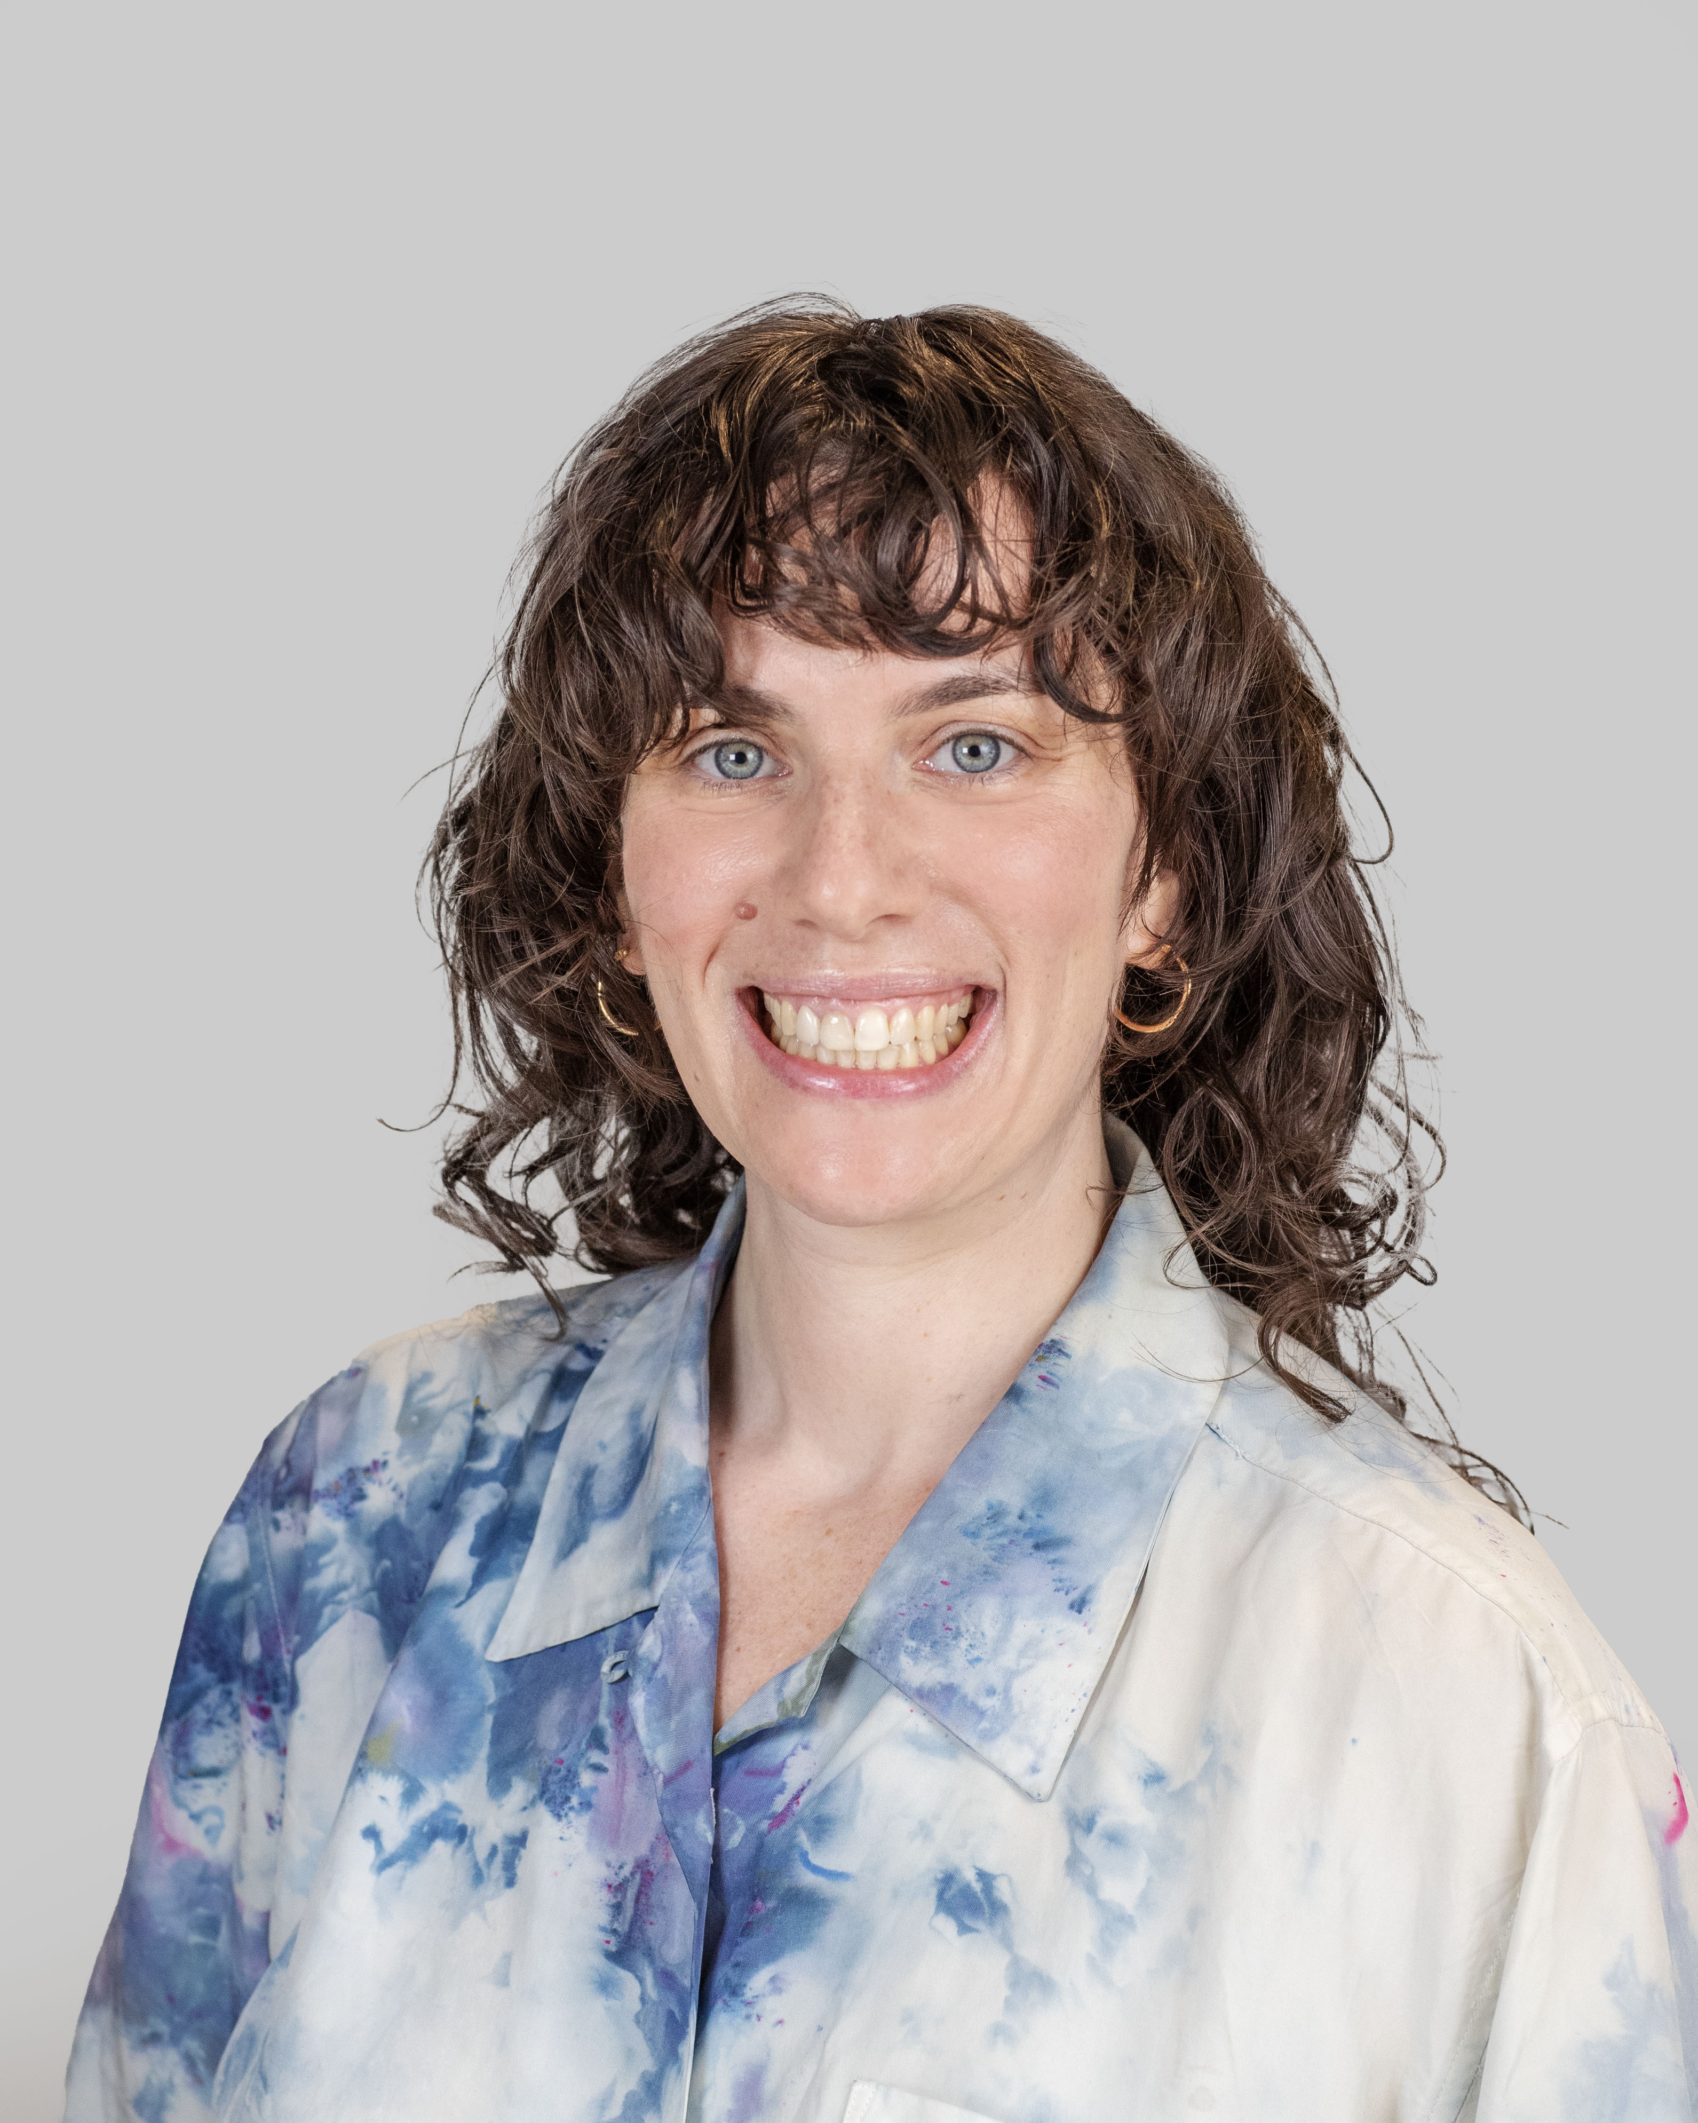
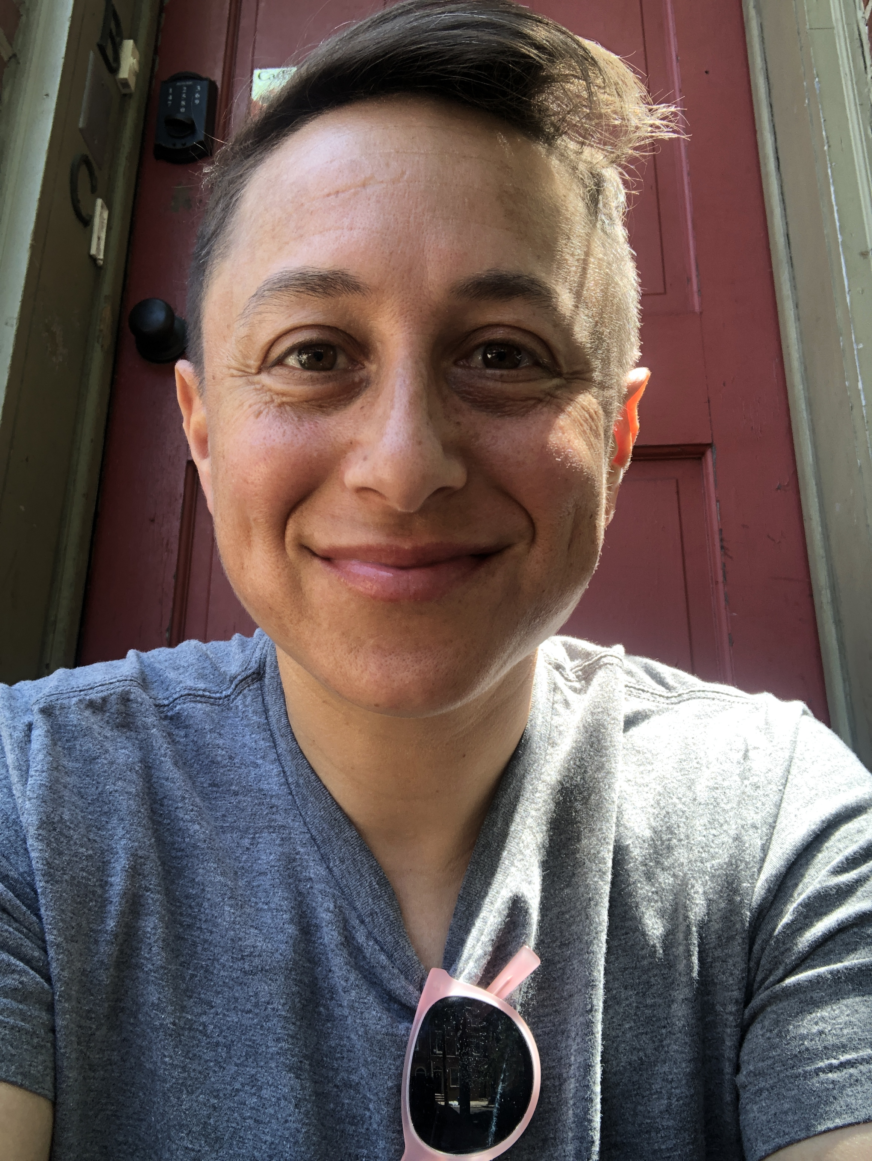
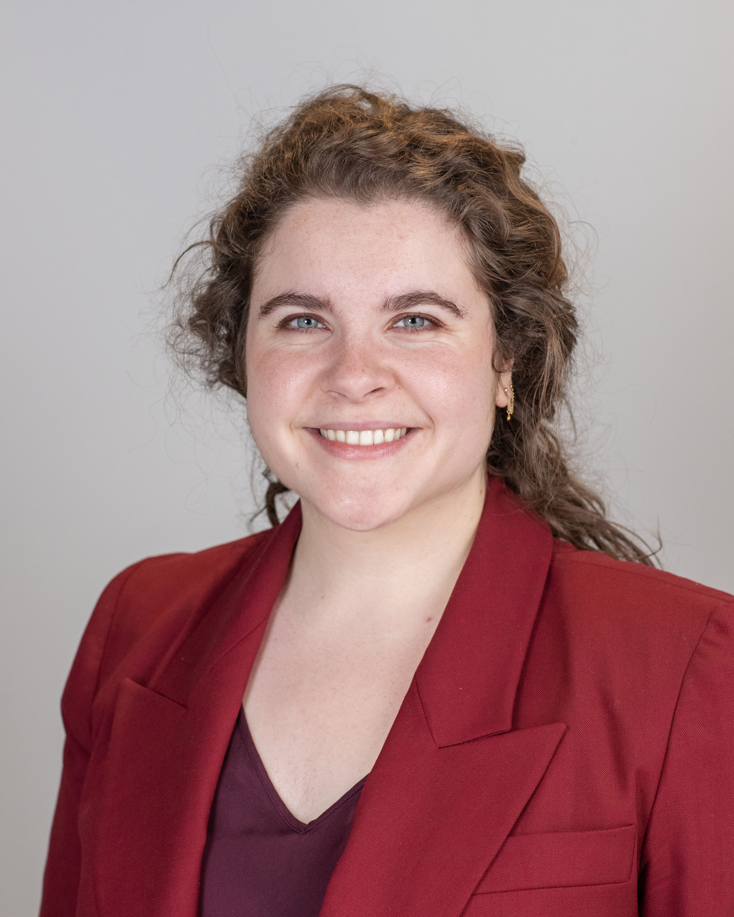
Thai-Catherine Matthews
Assistant Professor, English
Mark Mayer
Assistant Professor, English
Alec Mertin
Visiting Assistant Professor,
Mathematics & Statistics
Georgia Mills
Assistant Professor, Music
Kristen Morrow
Visiting Assistant Professor,
Political Science
Madeleine Neufeld
Visiting Assistant Professor,
Education Studies
Patrick J. Phillips
Assistant Lecturer, Environmental Studies & Sciences
Joseph Pillari
Visiting Assistant Professor, Art
Jack I. Pryor
Visiting Lecturer, Theater
Alison Renna
Visiting Assistant Professor, Religious Studies

Slide 4
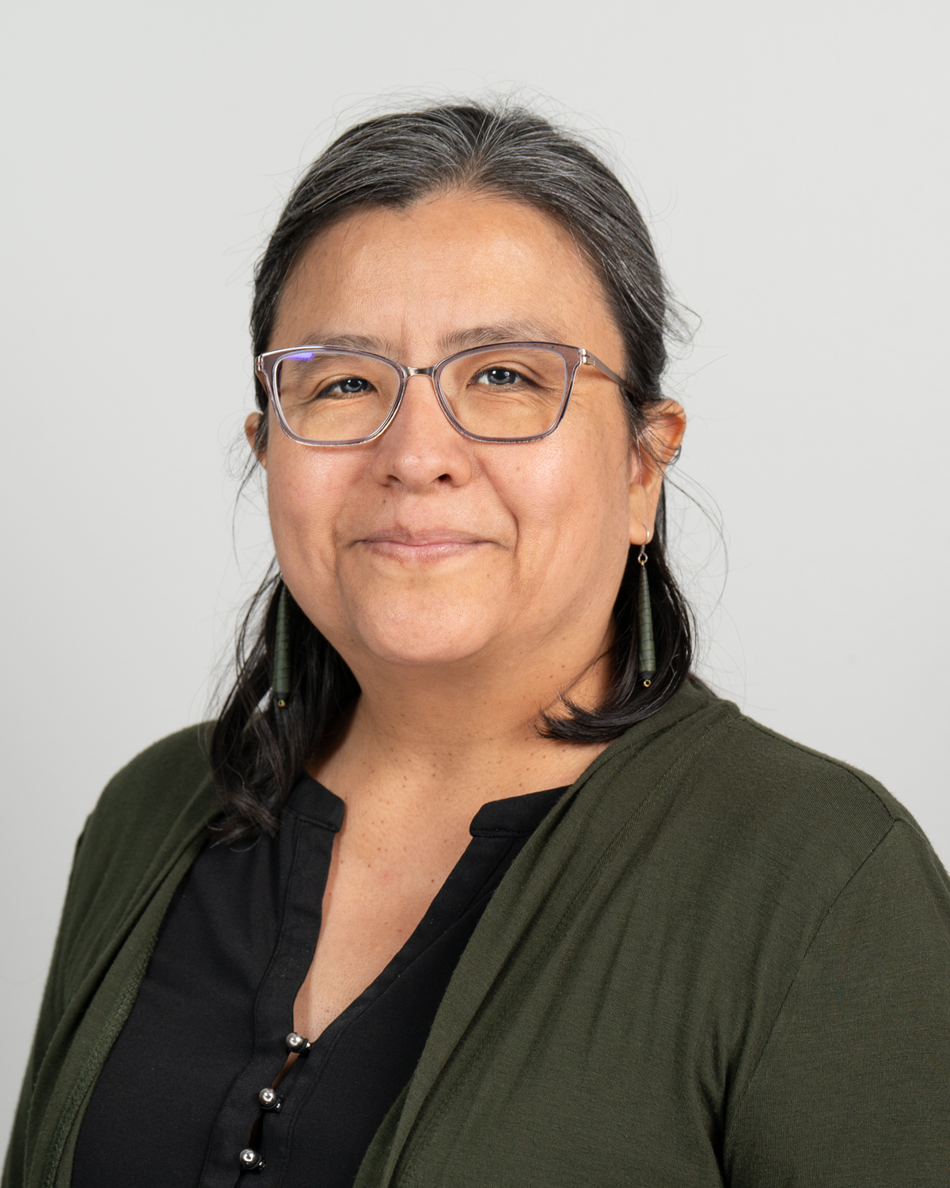
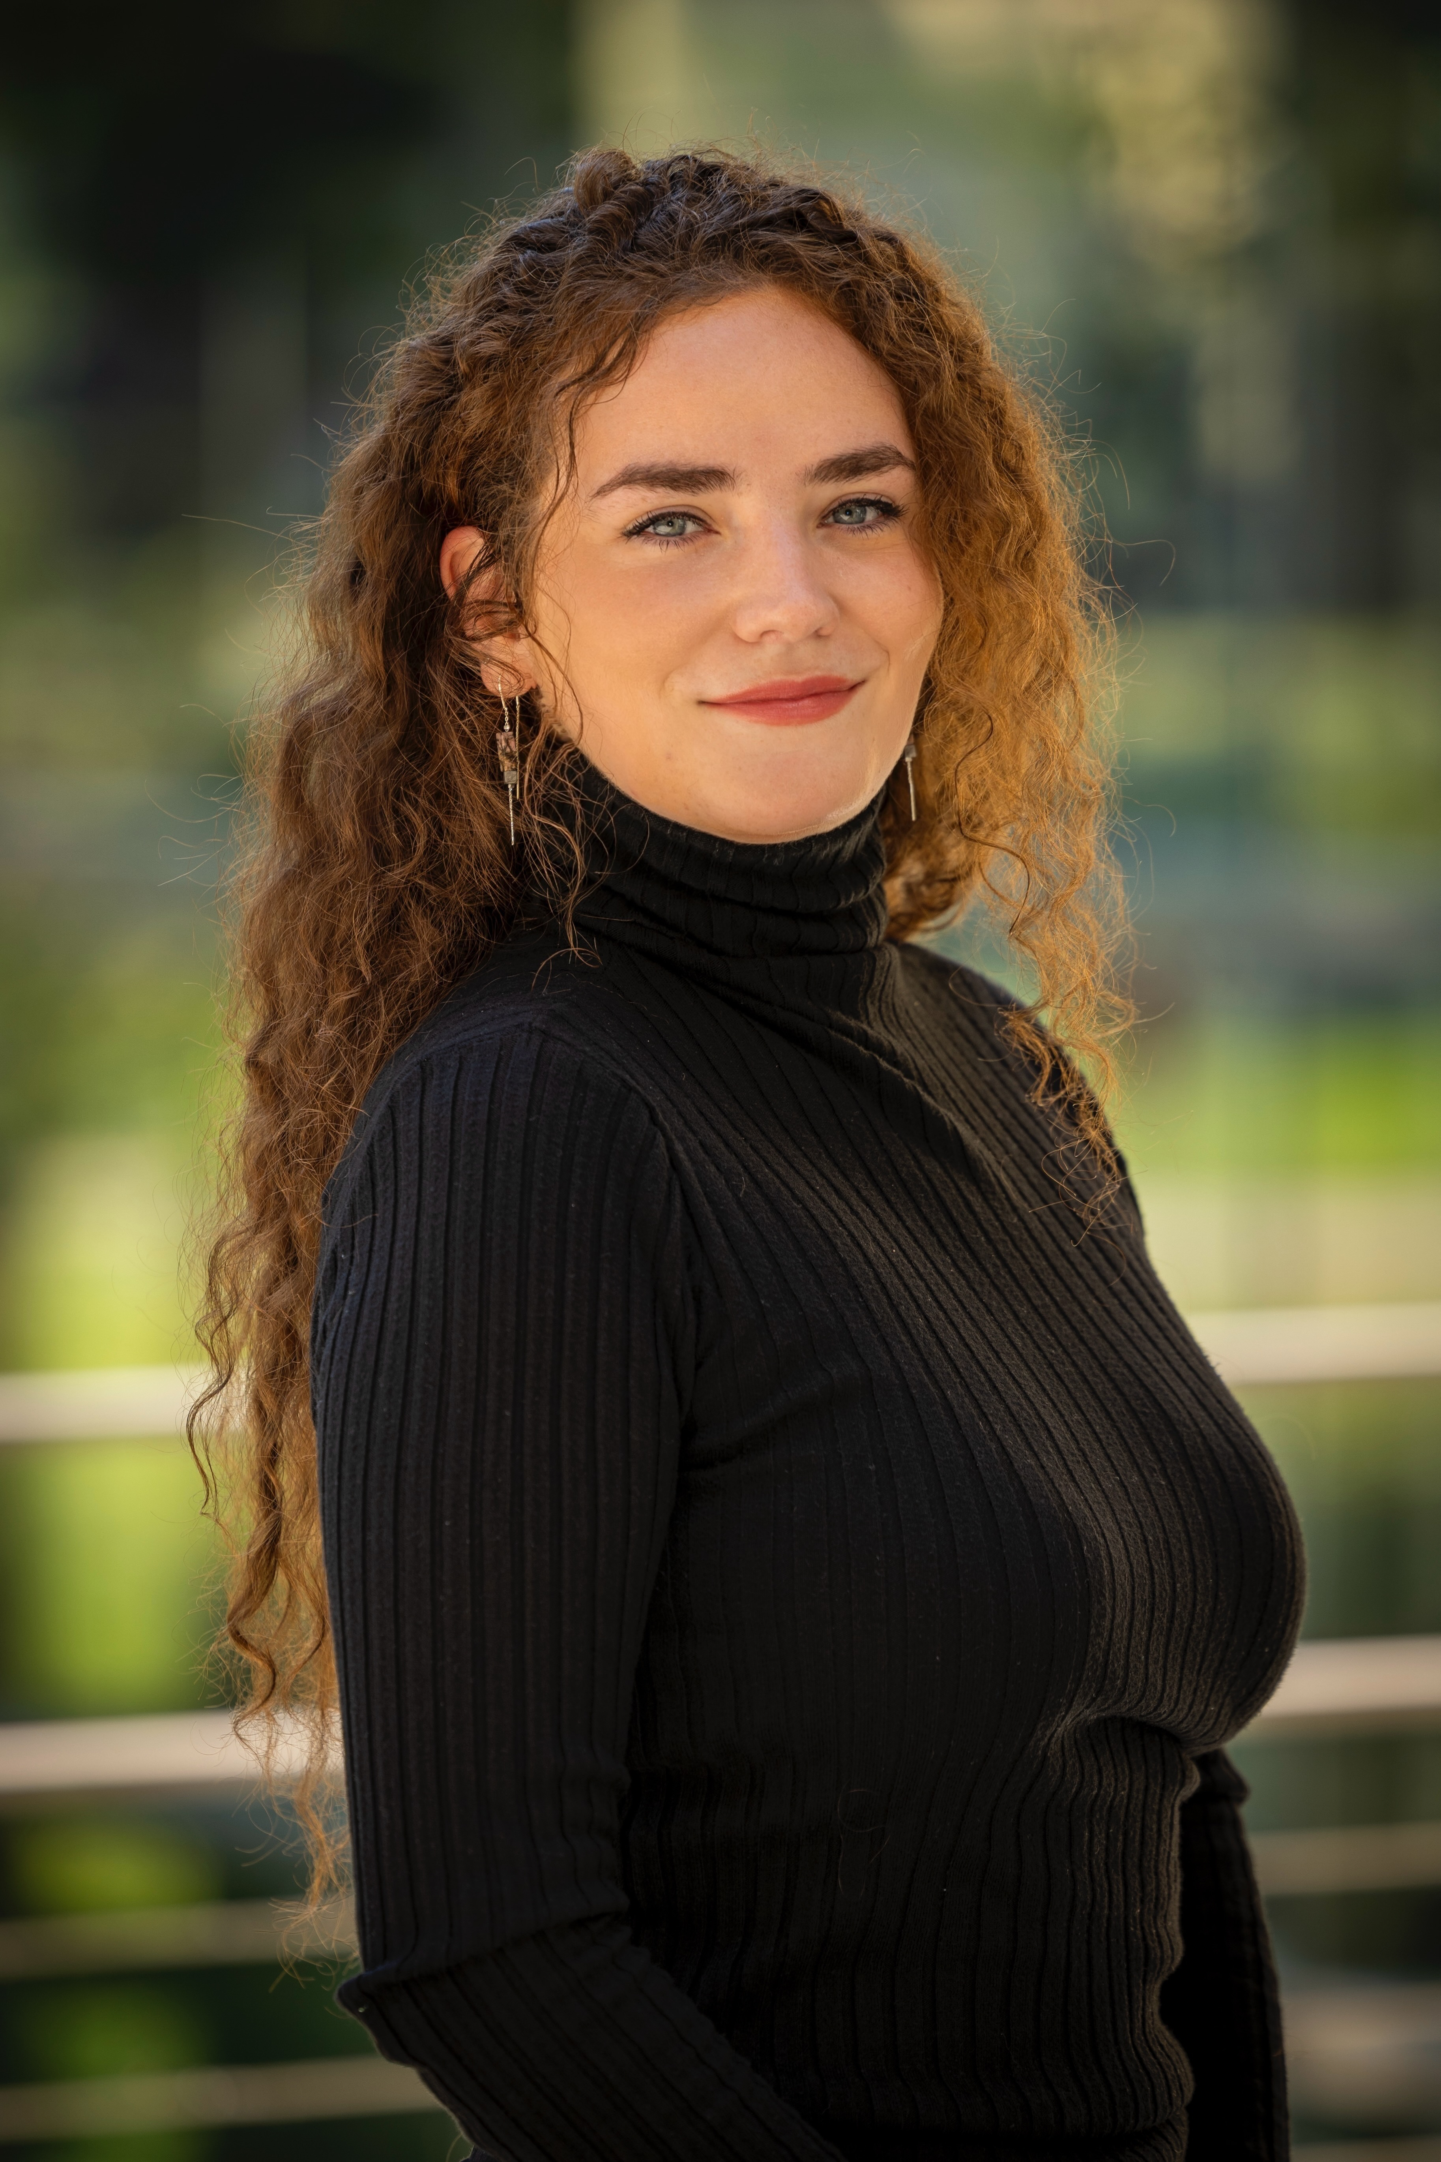
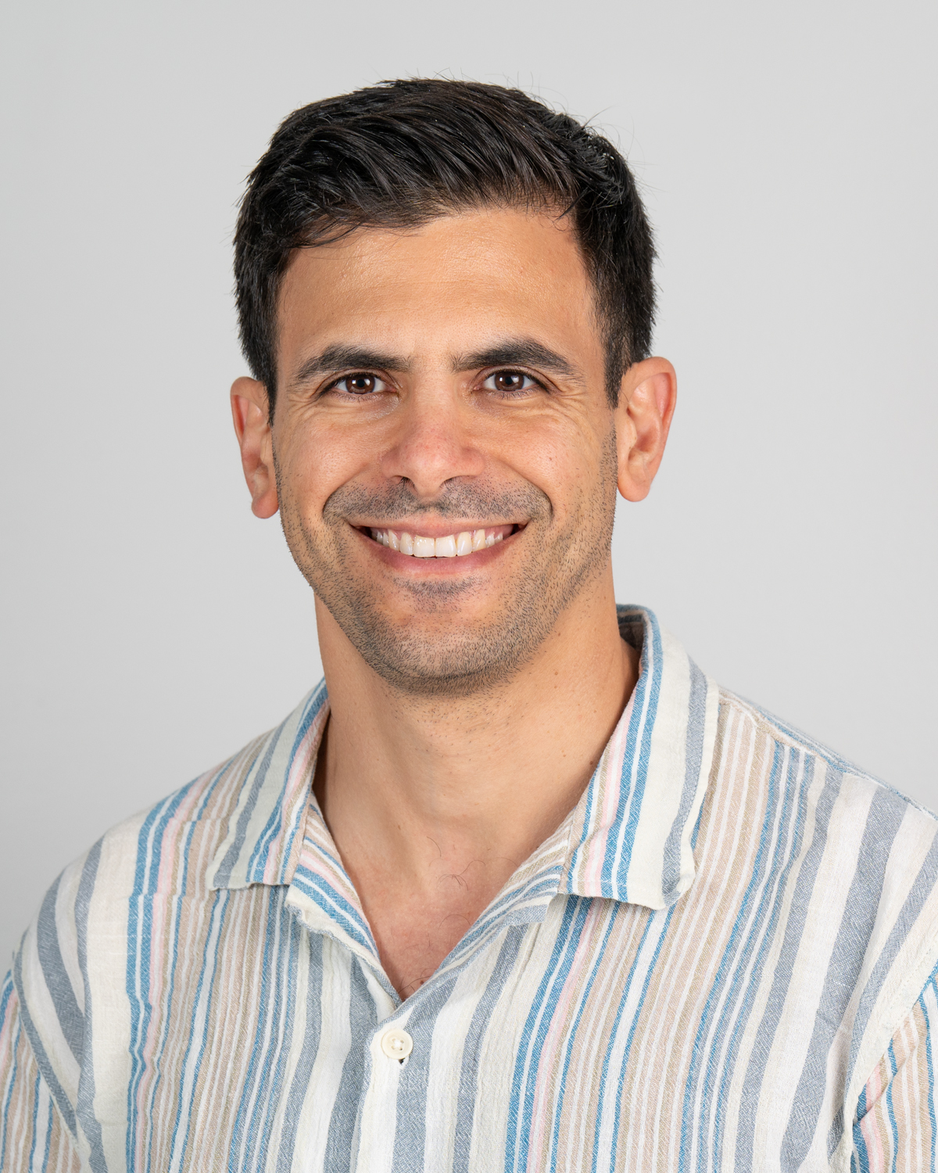
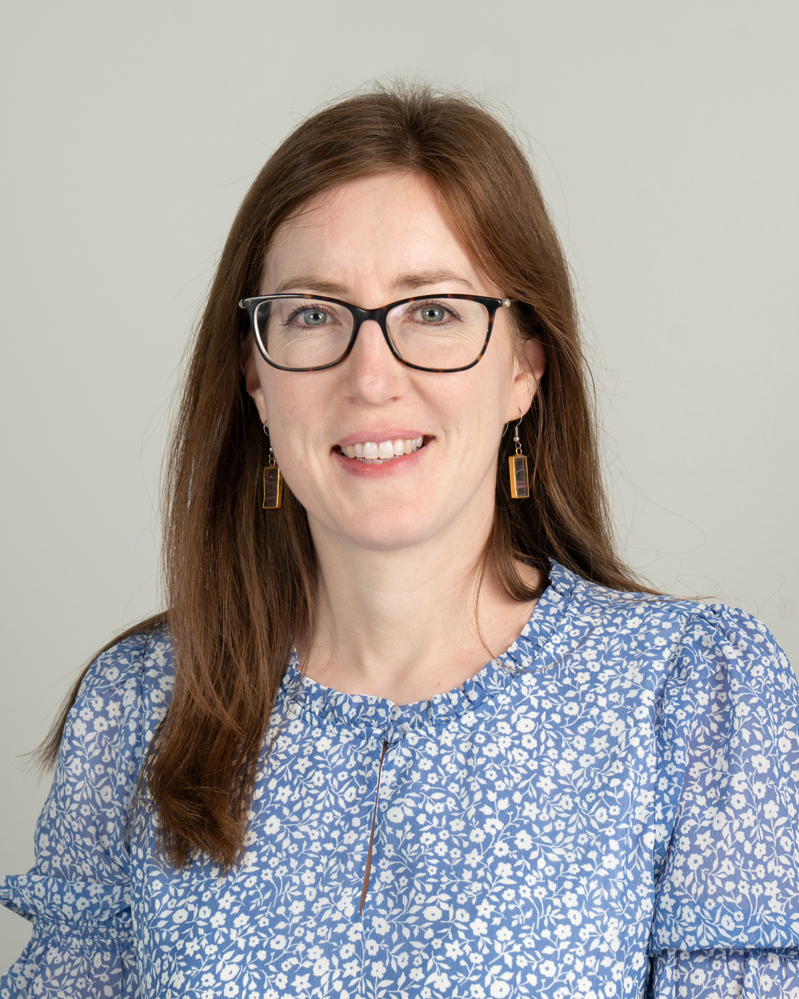
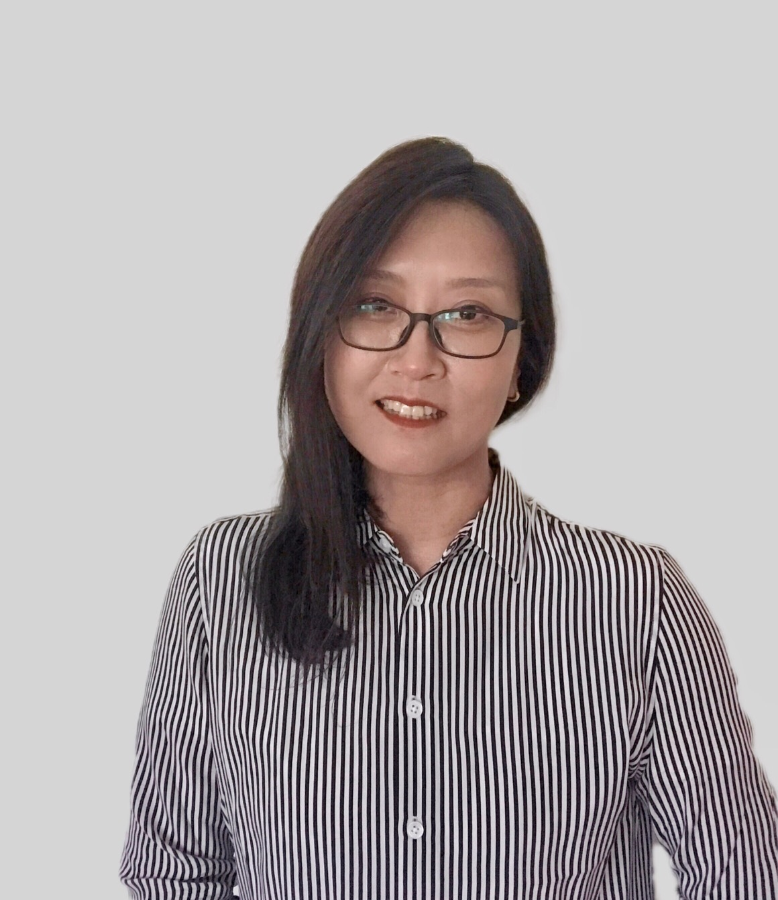
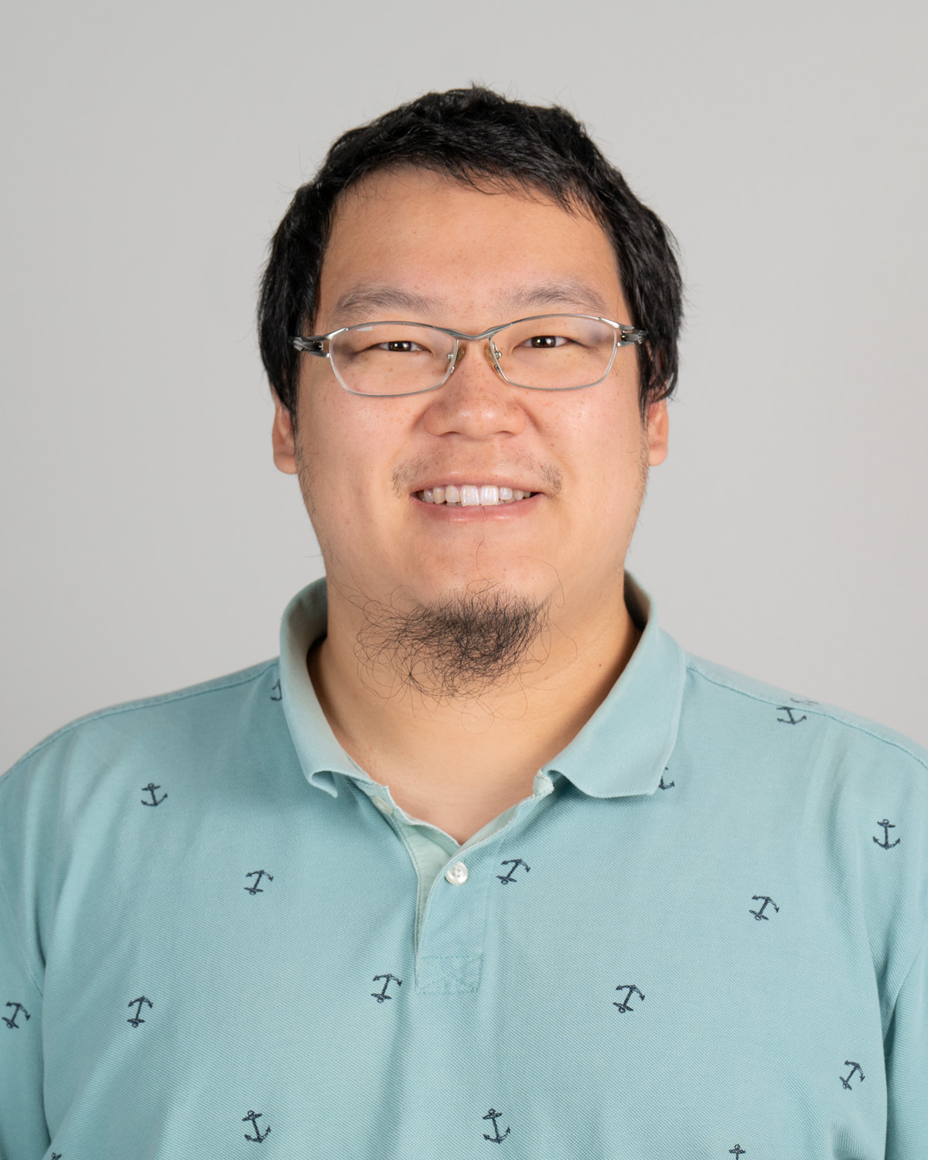
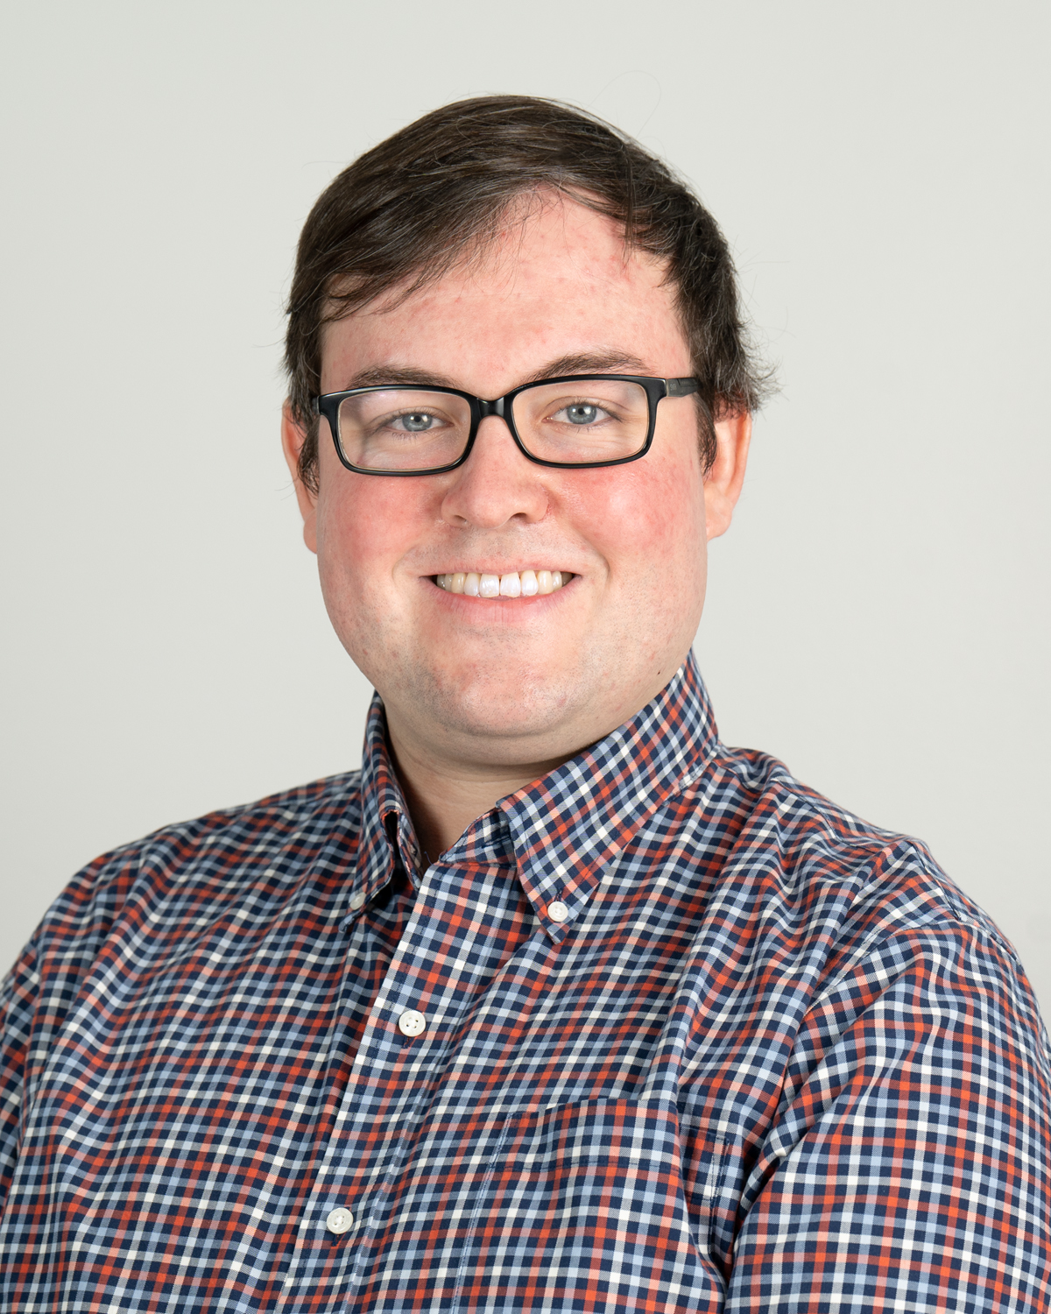
Thomas A.J. Ryan
Assistant Lecturer, Environmental Studies and Sciences
Lena Retamoso Urbano
Visiting Professor,
World Languages and Literatures
Angelique Scully
Accompanist, Music
Krista M. Senatore
Assistant Lecturer, Education Studies
Adam Thal
Assistant Professor, Political Science
Rebecca Thurman
Visiting Assistant Professor, Chemistry
Chelsea Jade Warrick
Assistant Lecturer, Arts Administration
Xiaoshuai Yang
Assistant Professor,
Management & Business
Kaifeng Yang
Visiting Lecturer,
Mathematics & Statistics
Benjamin York
Visiting Assistant Professor, Mathematics & Statistics

