Slide 1
Lockout/tagout for authorized employee
OSHA’s Control of Hazardous Energy
29 CFR 1910.147
29 CFR 1910.133
Administered by
Skidmore College

Slide 2
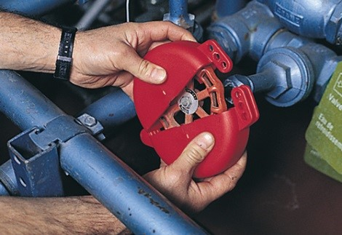
Objectives
Recognize hazardous energy sources
Understand responsibilities to create and maintain safe conditions
Control hazardous energy with lockout/tagout

Slide 3
What is hazardous energy?
How can you protect yourself without knowing what the hazardous energy sources you may encounter?

Slide 4
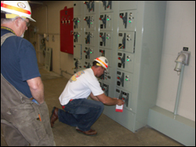
What is hazardous energy?
Often invisible
Can be hydraulic or mechanical
Live or stored
Moving machine or equipment parts

Slide 5

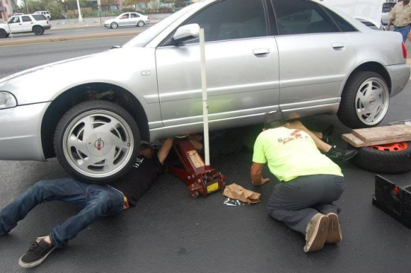
Examples of hazardous energy
Thermal
The force of GRAVITY that could cause machinery to continue to move

Slide 6

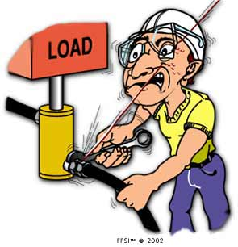
Examples of hazardous energy
Electricity, where the flow of electrical current can cause an unsafe condition;
Pressure of fluids or air, as with pneumatic or hydraulic equipment;

Slide 7

Examples of hazardous energy
Steam, such as when it remains in a pipe after shutoff; and
Chemicals

Slide 8

Hazardous energy injuries
Thousands of injuries each year
80% of workers fail to turn off equipment
Causes:
Unexpected start-up
Release of stored energy
Failure to lockout/tagout

Slide 9
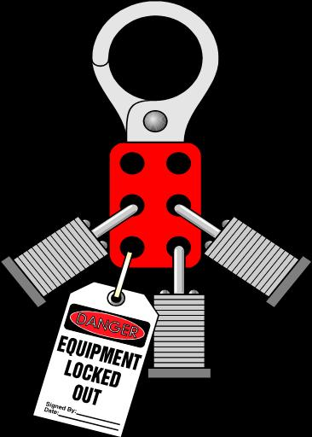
Controlling hazardous energy
Follow lockout and tagout procedures
Prevent machinery or equipment from being turned on
Dissipate energy
Prevent a part of machinery or equipment from moving
Provide means of warning (tag)

Slide 10

Lockout tagout regulations
29 CFR 1910.147
“Authorized employee” who services machinery
“Affected employee” who operates machinery
“Other employee” near machinery and equipment

Slide 11
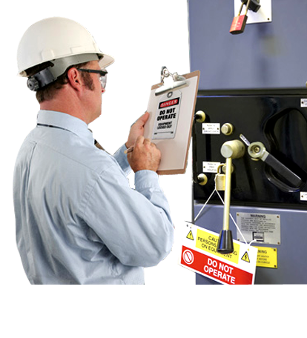
Authorized employee
Trained to perform locking or tagging procedures
No other employee can attach or remove lock or tag devices

Slide 12

Authorized employee
Responsibilities
Repair or service equipment as needed
Ensure that all energy sources are locked out
Test equipment to verify residual energy is dissipated
Place tags on equipment

Slide 13
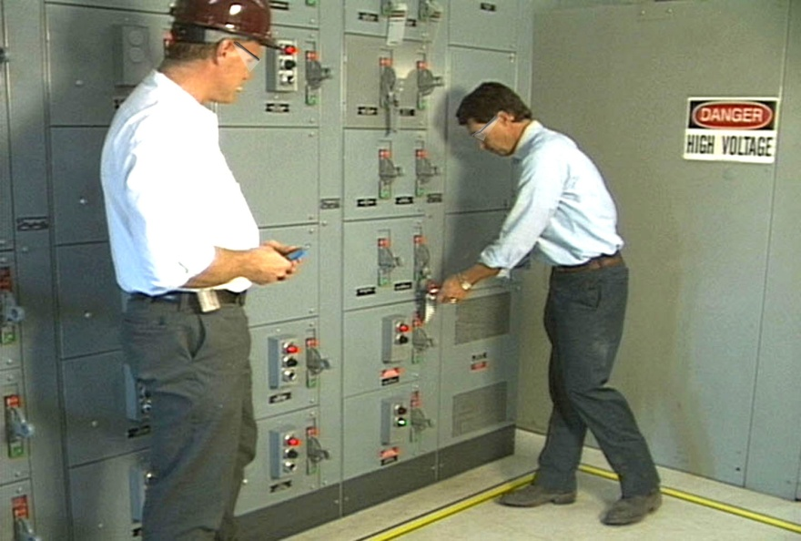
Authorized employee
Responsibilities (cont’d)
Obtain assistance when necessary
Remove locks and/or tags following lockout/tagout
Coordinate multishift repair

Slide 14

Affected employee
Operates machinery or equipment
Aware of energy control procedures
Performs emergency procedures
Affected employees MUST understand what Lockout/Tagout is

Slide 15

Affected employee
Responsibilities
Notify maintenance
Leave all lockout/ tagout devices in place
Verify equipment is safe to operate
Ensure safety guards are in place and functioning
Follow all safety rules

Slide 16
Workplace responsibilities
Ensure de-energization of equipment
Ensure employee awareness
Provide appropriate levels of training
Review program effectiveness
Maintain and revise program
Administer appropriate disciplinary actions

Slide 17
exercise
Authorized Employee
Affected Employee
Repair equipment
Place tags on equipment
Verify equipment is safe to operate
Remove locks or tags
Test equipment
Notify maintenance for servicing
Test equipment

Slide 18
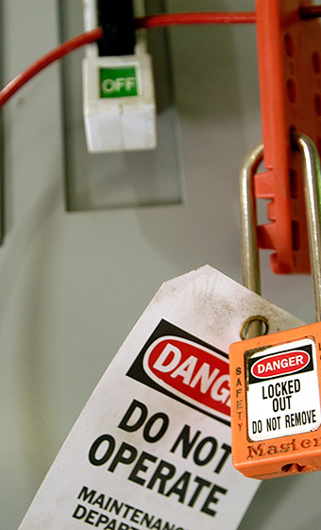

Recognize and control hazardous energy
Do you understand how to recognize and control hazardous energy?

Slide 19
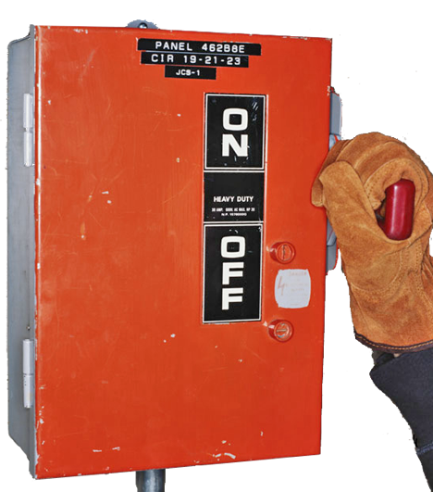
Energy isolation device
Isolate the equipment from the energy source
Isolation device
Circuit breaker
Pressure valve
Machine block

Slide 20


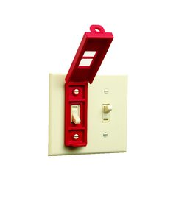
Lockout device
Lock
Block
Chain
Multilock hasp
Wheel valve cover
Ball valve cover

Slide 21
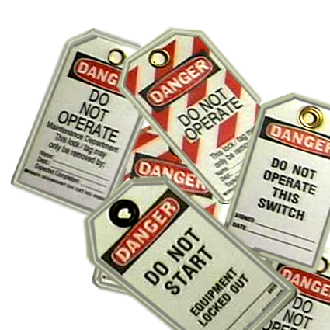
Tagout device
Warning devices only
Legible
Attached securely
Resistant to degradation
Removed only by an authorized employee

Slide 22
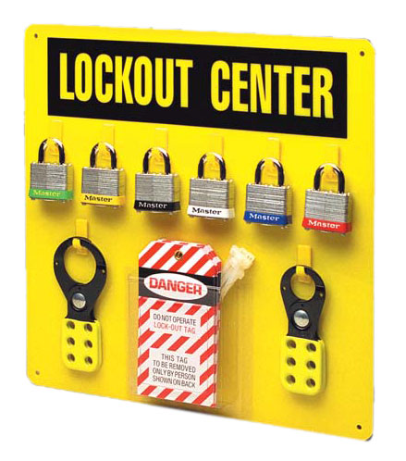
Requirements for lockout/tagout devices
Durable
Standardized
Traceable
Substantial
Identifiable

Slide 23

Typical equipment requiring lockout/tagout
Fan motors
Light fixtures
Water Valves
Table Saws
Hydraulic Hoses
Air Handlers
Automobiles/Trucks
WHAT ELSE?

Slide 24
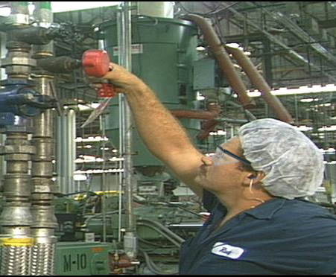
When to use lockout/tagout devices
Use lockout/tagout when:
Equipment needs servicing
Hazardous energy exists
Unexpected start-up could occur

Slide 25
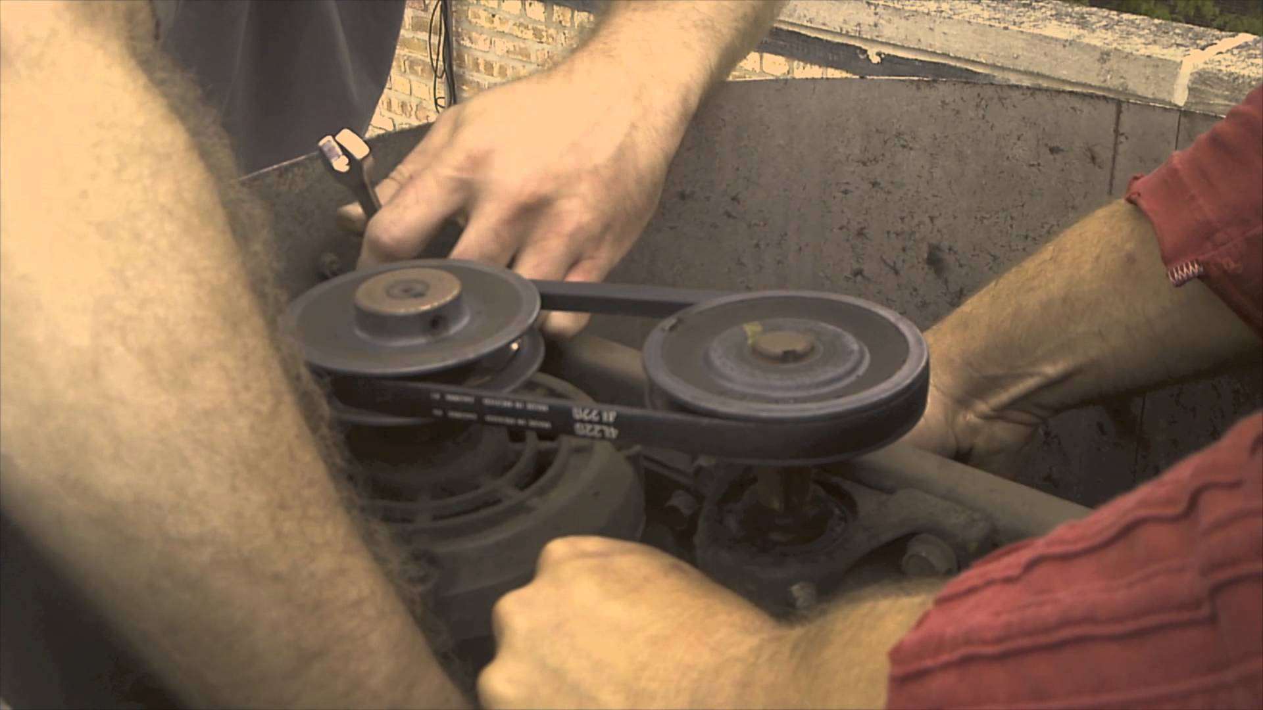
Actions that trigger LOTO
Removing or bypassing a safety device
Any part of the body is placed in harm’s way
Exposure to hazardous energy

Slide 26

Loto exceptions
When hazardous energy does not exist
During routine production processes
Cord-controlled devices
Hot tap operations

Slide 27
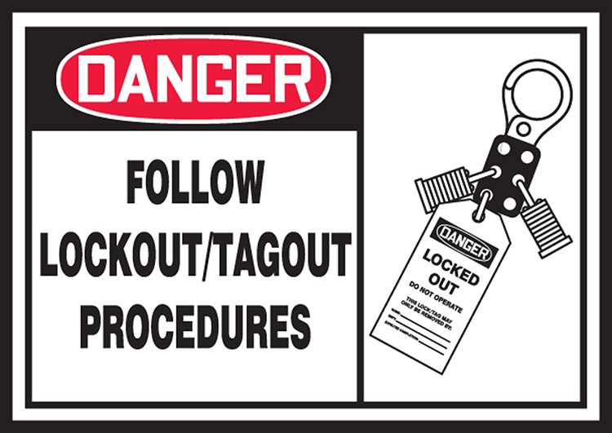
Lockout/tagout procedure
Preparation: review all hazards and controls and perform full employee briefing.
Notify affected personnel, verify it is safe to shut down the equipment.
Isolate energy sources - perform normal equipment shutdown.
Apply LOTO Device - Lock and Tag
Release Stored Energy if necessary (apply blocks, grounds, etc.)
Test and Restart to Verify Zero-Energy State - RETURN OPERATING CONTROL(S) TO "NEUTRAL" OR "OFF" POSITION AFTER THE TEST.

Slide 28
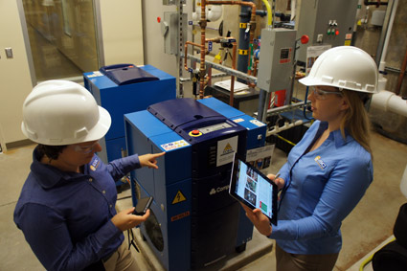
Restart procedure
Clean up and inspect equipment. Ensure no tools or materials are left in or around the equipment.
Clear affected personnel away from area to ensure that no one is exposed.
Verify that the controls are in neutral.
Remove Locks and Tags.
Reactivate isolation device(s) to restore energy to the equipment.
Notify the "affected" employees of their removal and startup.
You are now ready to restart machinery or equipment.

Slide 29
Exercise – what steps should you take to perform a proper loto?
Put the steps in their proper order:
Notify affected personnel
1.
Release Stored Energy if necessary (apply blocks, grounds, etc.)
2.
Test and Restart to Verify Zero-Energy State
3.
Apply LOTO Device - Lock and Tag
Preparation: review all hazards and controls
4.
Isolate energy sources - perform normal equipment shutdown.
5.
6.

Slide 30
Loto device and procedures
Do you understand:
How to recognize hazardous energy?
When you must use LOTO?
All lockout/tagout procedures for controlling hazardous energy?

Slide 31

Key points to remember
Energy can be dangerous and deadly
When in doubt, lock it out!
Adhere to lockout/tagout and restart procedures
Keep everyone informed

