Slide 1
ONLINE COURSE OF STUDY FORM:
A step by step guide
Off-Campus Study & Exchanges

Slide 2
Congratulations on deciding to study abroad! Before completing your course approval form, you should have declared your major and then started your online application with OCSE.
The following slides will show you how to complete the online course approval form. Please read each step carefully and refer to it as you go through the process.
If you have questions, please contact ocse@Skidmore.edu

Slide 3
Getting Started –
Before you login
Select your courses using your program’s website NOT the departmental Matrix or online course form! Courses on the Matrix or course form indicate what has been offered in the past and might NOT be offered the semester you plan to study off campus.
Refer to the Course Equivalency Matrix (https://app.skidmore.edu/ocse/) to determine which courses have been pre-approved for your academic area of interest.
For the courses that are not pre-approved, you will need the following information to get them approved:
  Course title (at the host institution not at Skidmore)
  Course number (at the host institution not at Skidmore)
  Credit amount
  Link to course description or syllabus

Slide 4
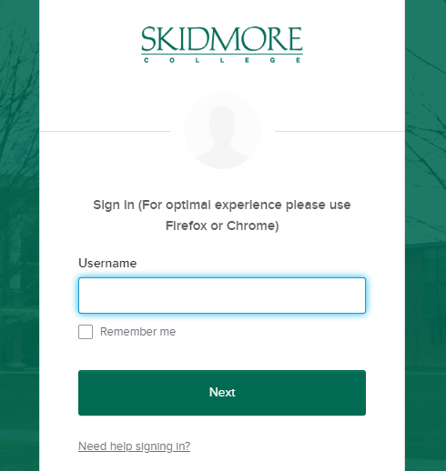
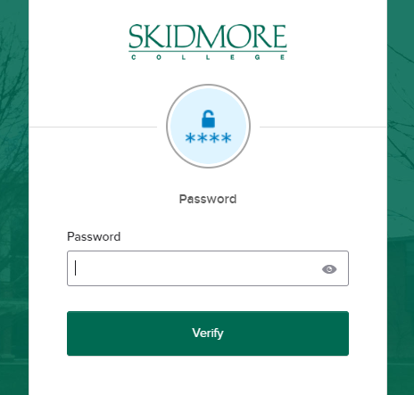
1. LOG INTO SYSTEM
You will find the link to the course approval form in your MyOCSE student account. Log in using your Skidmore User Name (*without* @skidmore.edu) and Password

Slide 5
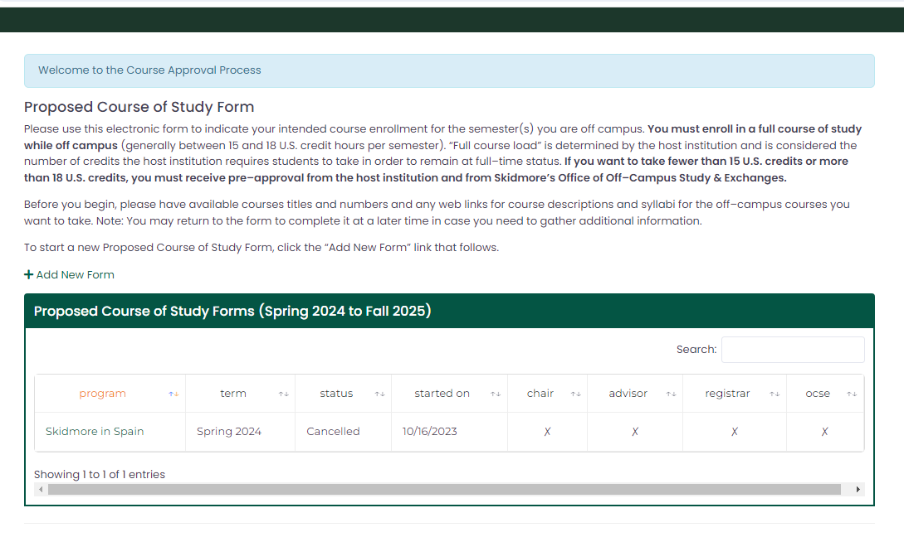
2. ADD A NEW FORM
Click “add a new form” if you are logging in for the first time or are starting a new form. If you have already started your form, click the name of the program to access the form.

Slide 6
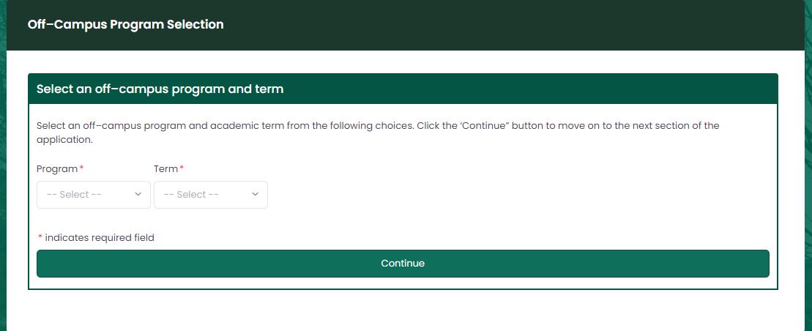
3. SELECT YOUR PROGRAM
Select the program you are applying to, as well as the term/year. This form is NOT for summer programs.
You can only have one active form for a given term/year combination. If you have one and wish to start another, you must come speak to OCSE.
Please Note – if you are petitioning for a Non-Approved program, you should select “Non-Approved Program” from the drop-down list.
Non-Skidmore students will not be able to use this online system. They and their faculty will not have access to the Skidmore system.

Slide 7
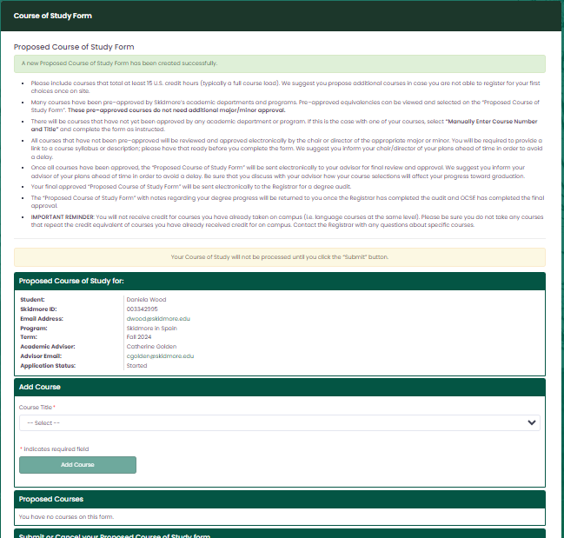
4. ADDING COURSES
List ALL the courses you would like to take abroad, including backup options. If your course was found on the matrix, you should see it listed in the “Course Title” dropdown menu. It may be listed more than once if it has been pre-approved by more than one department.
If you see your course, hit “add course” and it will appear under the “Proposed Courses” section.
If your course was not pre-approved or it has not yet been pre-approved by the department you are seeking credit
towards, you must “manually enter
course”. This option is listed at the bottom of the dropdown menu.
(See next page for instructions on manually entering a course)

Slide 8
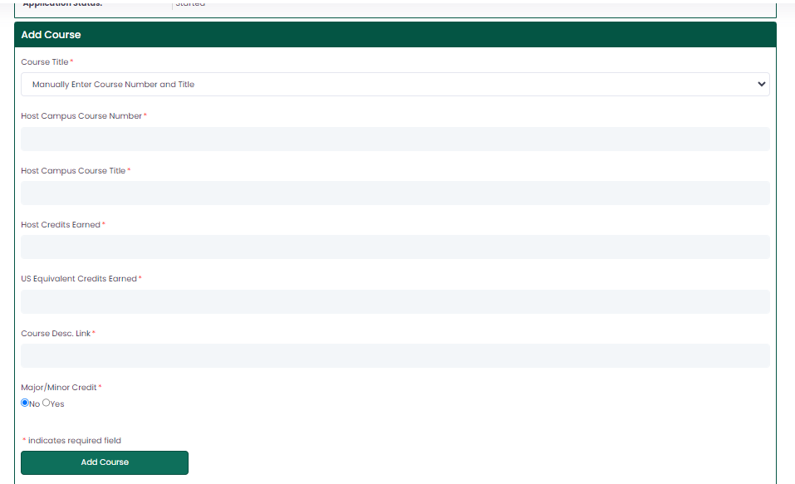
5. ADDING NEW COURSE - MANUALLY
Select “Manually Enter Course Number
and Title” from the dropdown menu
The screen at left will appear.
Complete the form using the number, title, host credits earned and US equivalent credits earned for the OFF-CAMPUS COURSE. You should be able to find this information from the program web site. You will also need an active link to the course description/syllabus. DO NOT INCLUDE A LINK TO THE DEPARTMENT
PAGE as it cannot be used to approve
your course.
If the want only general-elective credit, you should mark “NO” for the question
“Major/Minor Credit” then “Add Course” to complete the step.
If you want major/minor credit, mark
“YES” for the question “Major/Minor
Credit” and choose the department from which you hope to get credit.
Click “Add Course” to complete this step.
*The system will save your courses as you add them so that you can
complete this form in more than one sitting.

Slide 9
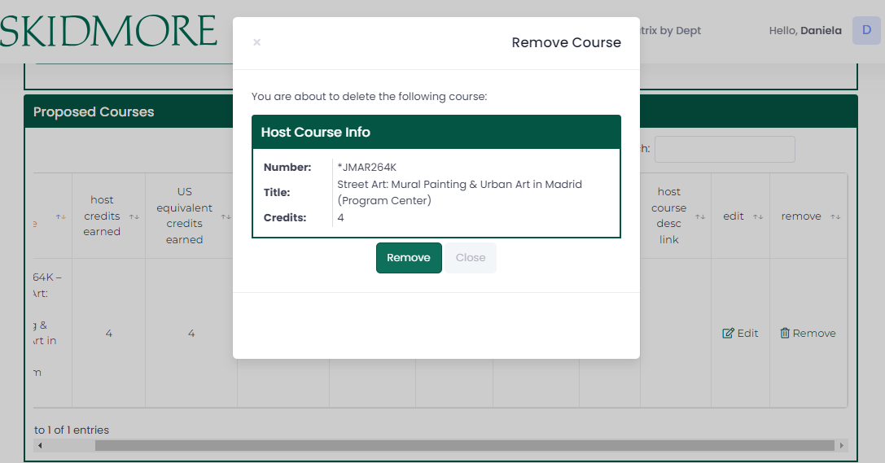
6. REMOVING A COURSE
Do not hit “Submit” until you are sure you have listed ALL courses you would like approved.
BEFORE you submit your form, you
may add and remove courses freely.
To remove a course you should click on the specific course and choose
“Remove”. This will delete the course from the course form.
Once the form is submitted, no
changes can be made.
If you decide you want to cancel the entire form and not just one course, you can click “Cancel” on the previous screen and the form will be deactivated. These forms cannot be re-activated. You would need to start a new form.
Please Note: If you are withdrawing your application to study abroad, you MUST also withdraw your online application with OCSE. Canceling the course form DOES NOT withdraw you for off-campus study.

Slide 10
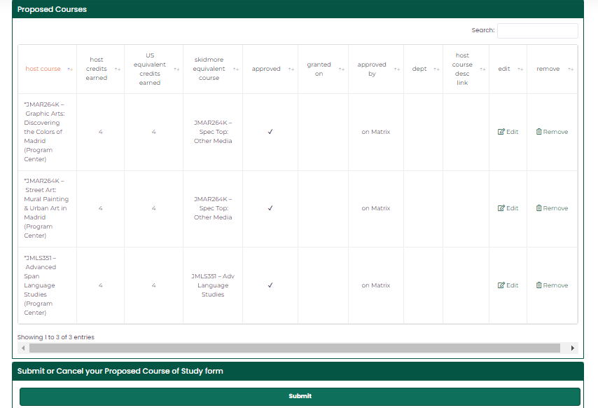
7. SUBMIT – FINAL STEP
Once you have listed ALL courses you would like sent for approval, you may hit “Submit” at the bottom of the page. The course list will then be sent to your advisor for approval, to any necessary Department Chairs for approval, to the Registrar’s office, and finally to OCSE for approval. When this process is complete, you will be notified via email.
If the rest of your OCSE online application is complete, your application will be reviewed and you should hear an approval decision within 2 weeks of submitting your complete application. This approval decision will also be sent via email.

Slide 11
Important Points to Remember
It is your responsibility to understand how many HOST institution credits you need to take in order to be registered full time. It may or may not be 15 credits. This includes knowing how host credits will convert to US credits.
ONLY courses worth 3 or more credits can be considered for breadth and major/minor requirements.
Having your courses approved does not mean you are approved to study off- campus or that you have been approved by your program. Also, it does not mean that these courses are guaranteed.
If you have questions, please email ocse@skidmore.edu or call 518-580-5355

