Slide 1
How to Request a skidmore vehicle for multiple days using EMS
Skidmore’s online Event Management System
https://calendar.skidmore.edu//EMSWebApp/

Slide 2

Before you request use of a Skidmore Vehicle, you MUST be an approved driver with the college.
Here is how to get started with that process:
Faculty and Staff https://www.skidmore.edu/risk-management/motor_vehicle_policy/staffprocedures.php
Students https://www.skidmore.edu/risk-management/motor_vehicle_policy/studentprocedures.php

Slide 3
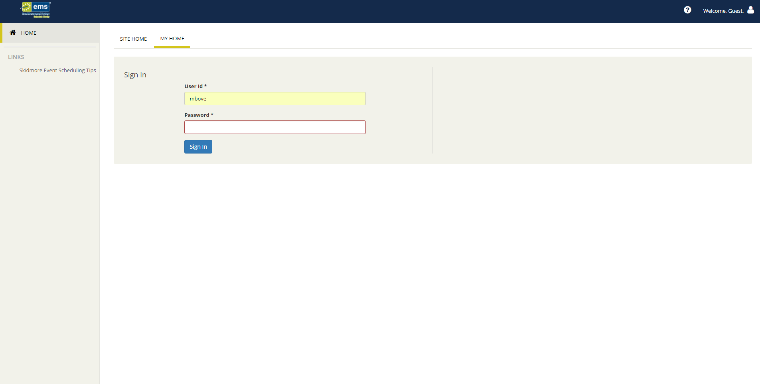
Log into EMS
Log in using your Skidmore user name and password
Do NOT put “@Skidmore.edu” in your username field”

Slide 4
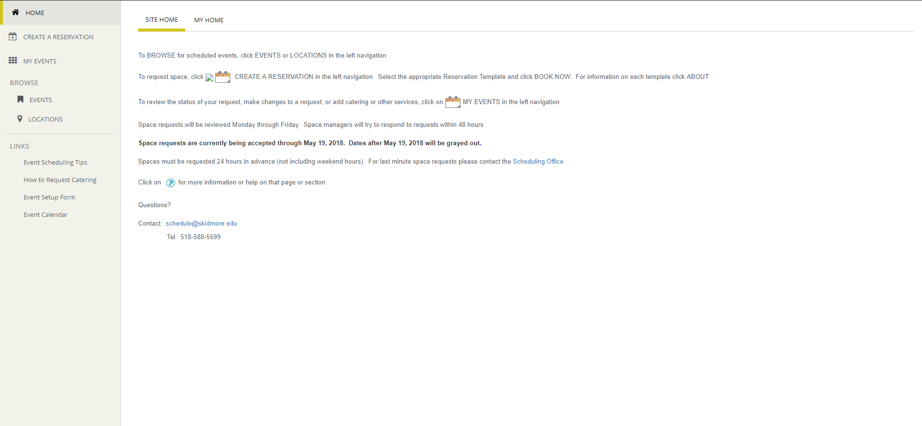
Click on “Create A Reservation” at your home screen

Slide 5
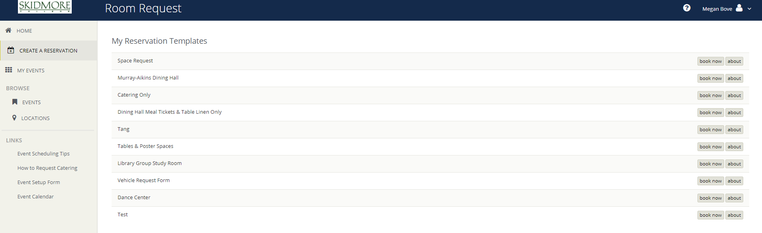
Click “Book Now” for the Vehicle Request Form template

Slide 6
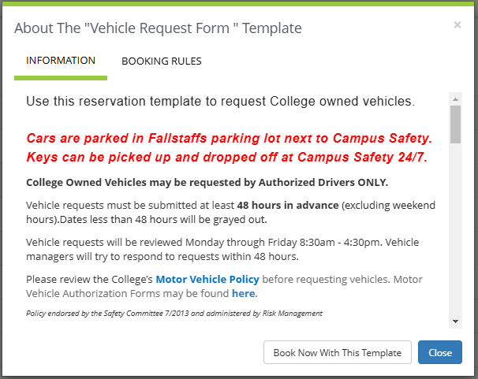
Be sure to read the “About” section of the template for additional information and booking rules

Slide 7
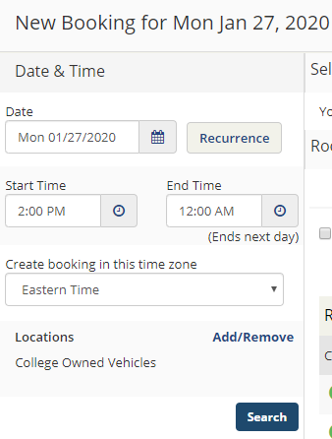
Instructions for multiple day reservations
If you are requesting a vehicle for multiple days enter the pick up date only
Start time = time you plan to pick up car
End time = midnight at end of day
Press search

Slide 8
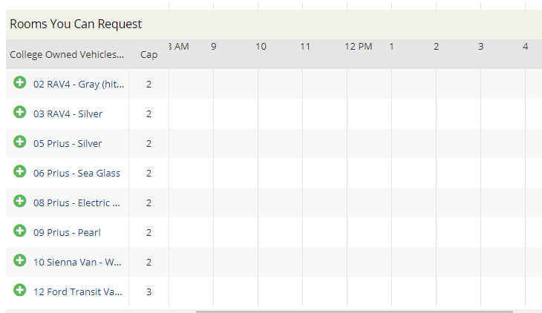

Please note the Prius and RAV4 seat 4-5 passengers. The Van’s are for faculty and staff use only.
Click on the “+” to select your vehicle, then click

Slide 9
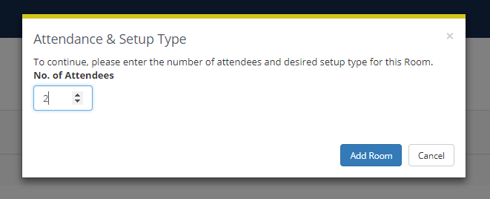
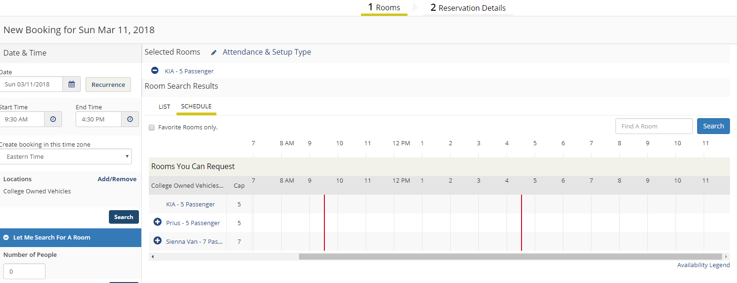
Enter “No. of Attendees” and click “Add Room”
Your selected vehicle will now show under “Selected Rooms”
Click “Next Step”

Slide 10
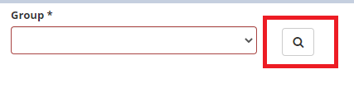
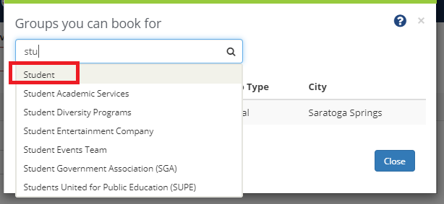
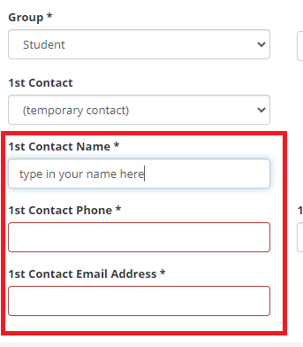
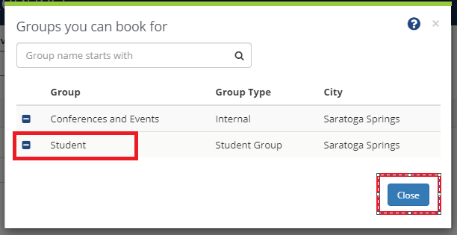
Enter your Reservation Details and choose your group.
If you are a student and not associated with a sponsored department search for “student” group and enter your contact information.

Slide 11
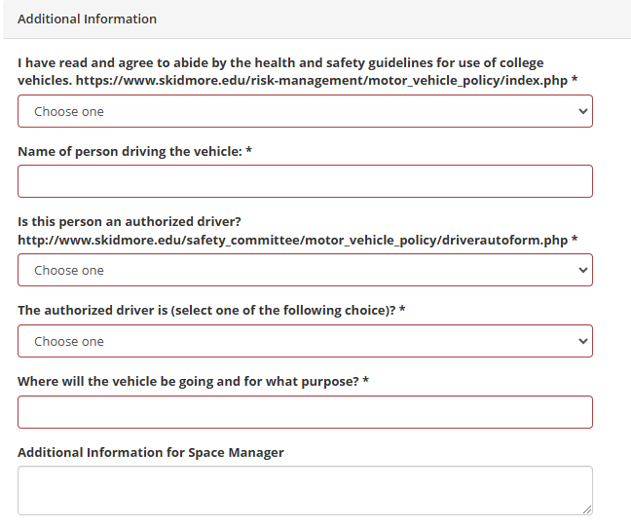

Answer the additional information questions.
Accept the terms and conditions, then press create reservation.
Your reservation will be followed up within 48 hours by facilities.
When finished click
For additional information about campus vehicles click Here

Slide 12
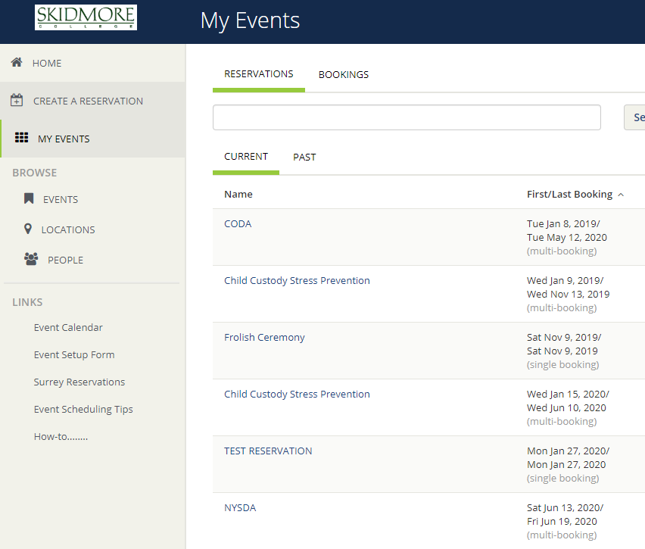
Now we are going to add the additional days for the same vehicle
After you have submitted day 1 of your reservation you now need to go in and add the other dates.
Click on “My Events”
Click on your event Name

Slide 13
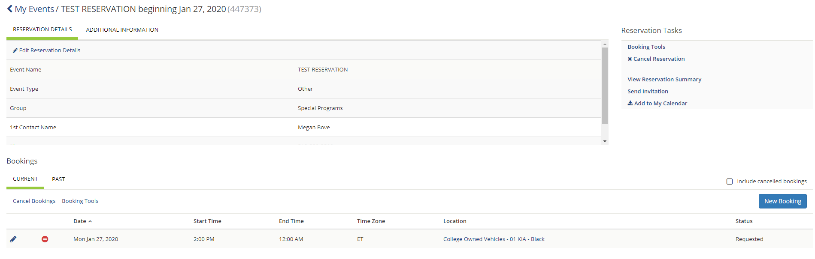
Here you will see day 1 of your reservation.
Click “New Booking” to add the next day.
Day 1 of your reservation

Slide 14
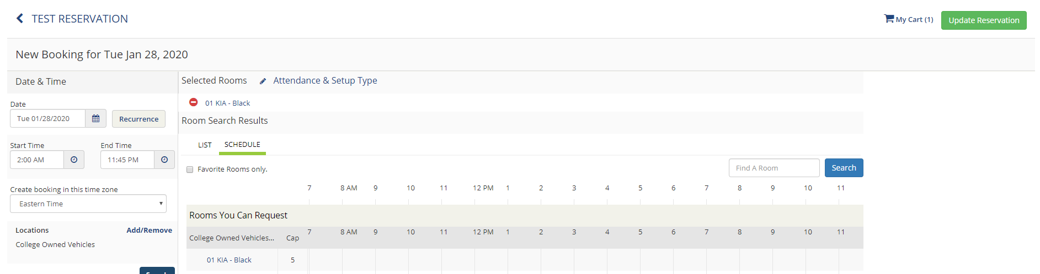
Select the next day of your trip
Enter an early start time in the morning
End time should be late into the evening
Select the same vehicle you chose on the 1st day
Enter number of people
Update reservation

Slide 15
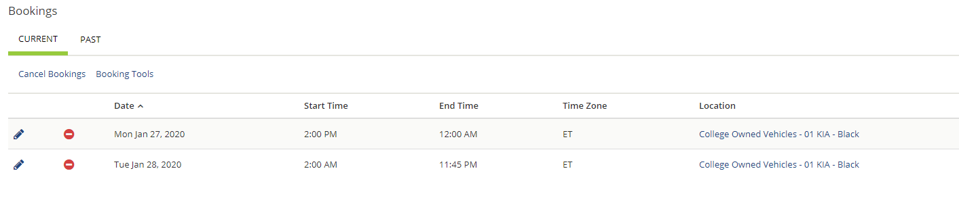

You will now see 2 days listed for your reservation.
Repeat those same steps to add your 3rd day by clicking
For your end time select the time you will be returning the vehicle.

Slide 16
?
?
QUESTIONS?
PLEASE CONTACT
SCHEDULE@SKIDMORE.EDU
For additional information about campus vehicles click Here

